Slide 1
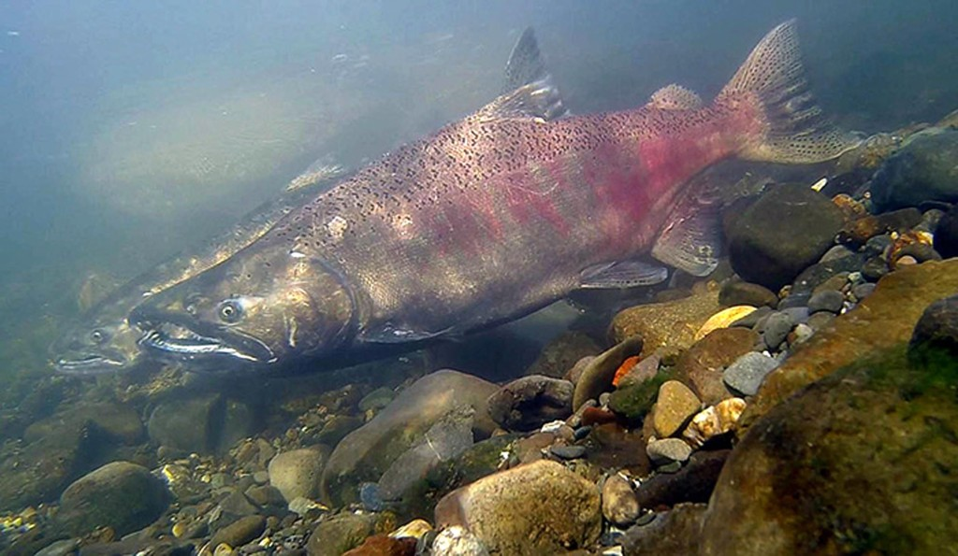

Climate change impacts to fishes in the Columbia River Basin
Ken W. Davis
Tracy Bowerman, Christopher Caudill, Matthew Keefer

Slide 2
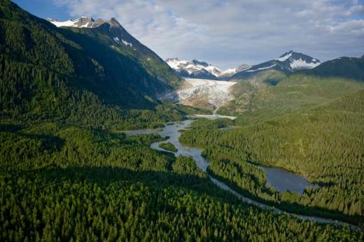
Salmon and trout: cold water species
Climate predictions:
  Increased summer temperatures
  Less water available in summer (decreased snowmelt)
Negative effects of warm water:
  Thermal barriers to migration
  Disease susceptibility
  Physiological stress
  Competitive disadvantages
Notes:
Focus on salmon and trout bc cultulrally and economically important

Slide 3
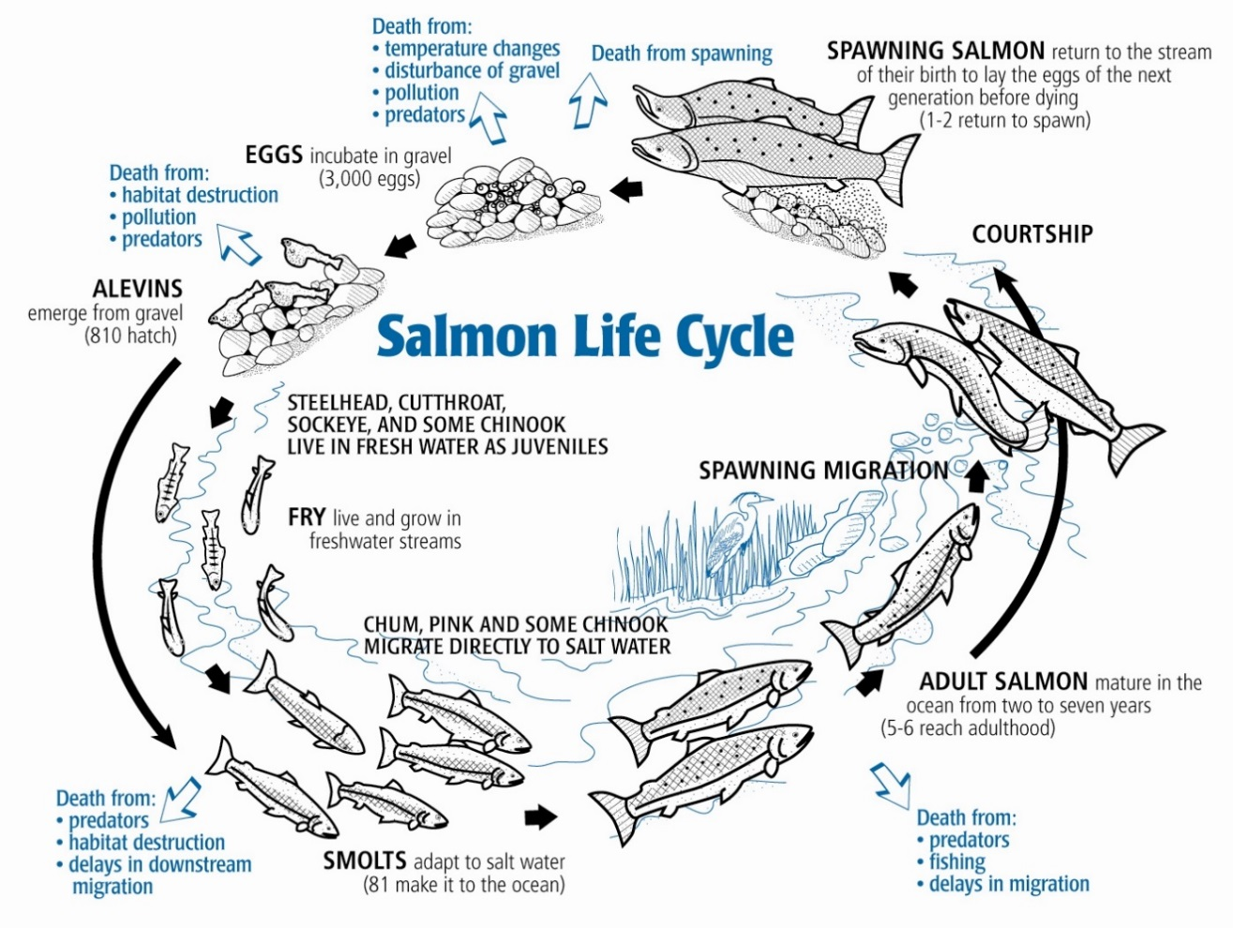
Salmon life cycle
Prespawn mortality
Migration rate
Migration success
Salmon: 1-7 years in ocean
Native trout: migrate within river system

Slide 4
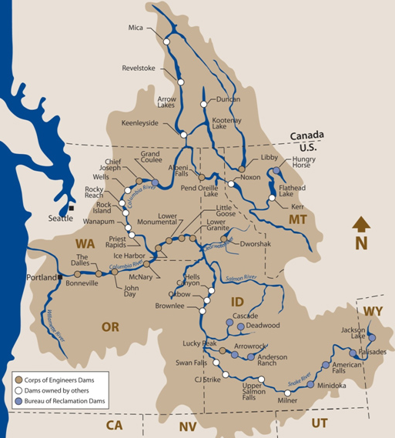
Native trout
Upper Columbia
Salmon migrate
500 – 1000 km

Slide 5

Projected summer temperature change
1970-1999
2070-2099
Upper limit
thermal tolerance
Average summer temperatures predicted to increase throughout Columbia Basin
Beechie et al. 2013 Riv. Res. App. 29: 939-960

Slide 6
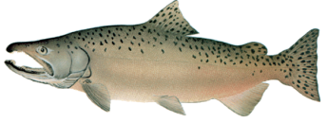
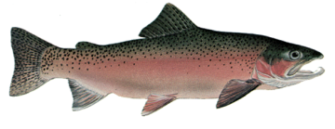
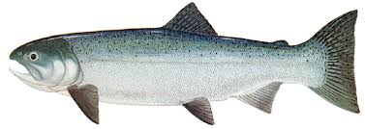
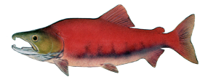
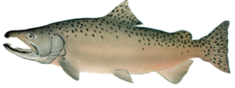
Typical adult salmon migration timing
Fall Chinook
Steelhead
Coho
Sockeye salmon
Summer Chinook
Notes:
Note: coho is freehand estimate

Slide 7
Migration rates slow with temperature
Fall Chinook migration rates Bonneville Reservoir
Fall Chinook salmon migration rates dropped by ~50% at warmest temperatures
Goniea et al. 2006. Trans. Amer. Fish. Soc. 135: 408-419

Slide 8
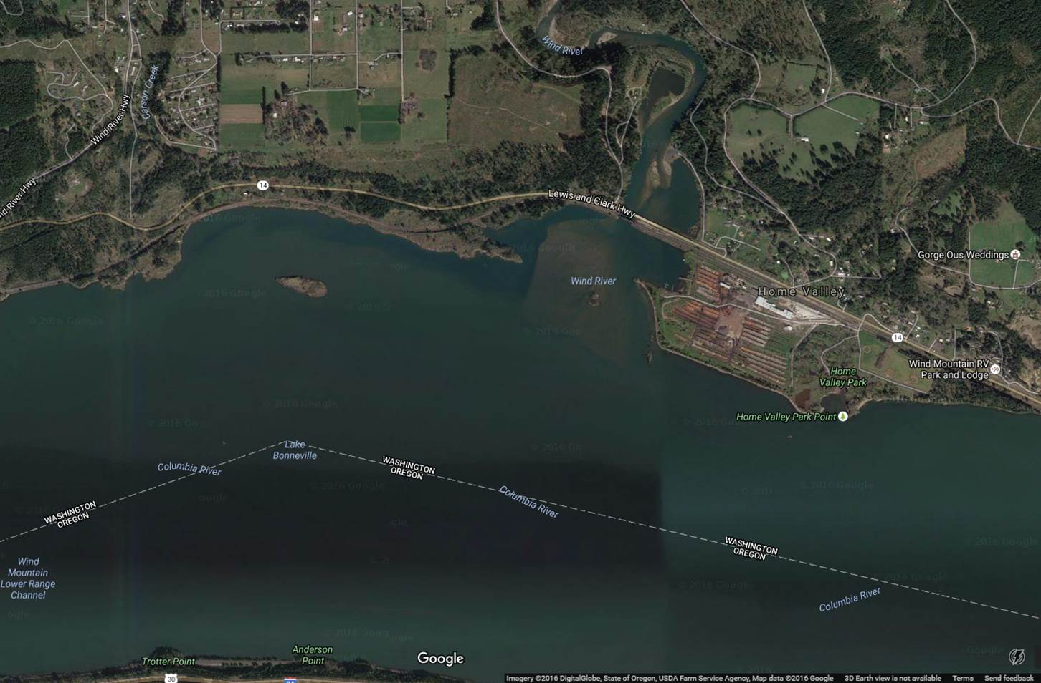
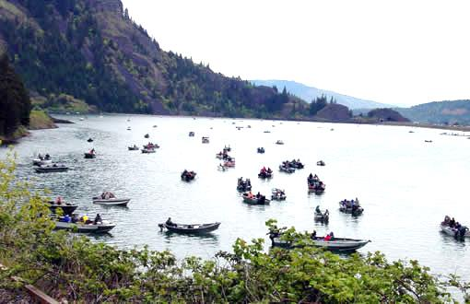
Cold water refuges along migration route
Cold source
Cool Lake
Mixed Temp Plume
Risks associated with refuges
Adult migrants shoreline-oriented
High probability of refuge detection

Slide 9

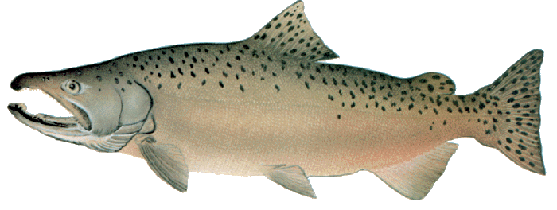
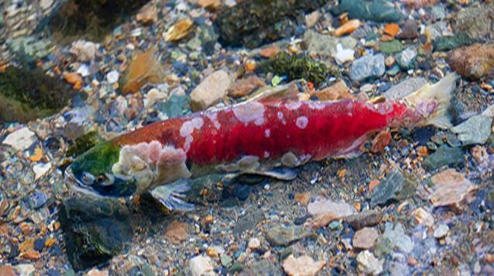
Migration survival decreases with temperature
Sockeye salmon survival to tributaries
Sp-Su Chinook salmon survival past 4 dams
Substantially reduced survival for some stocks exposed to warm water temperatures
Naughton et al. 2005 CJFAS 62:30-47

Slide 10
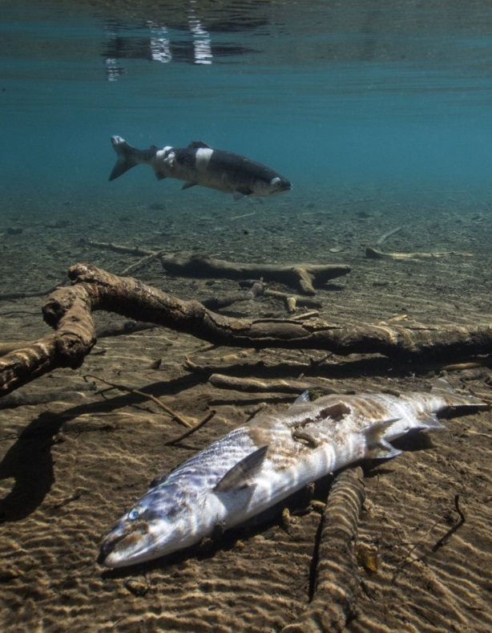
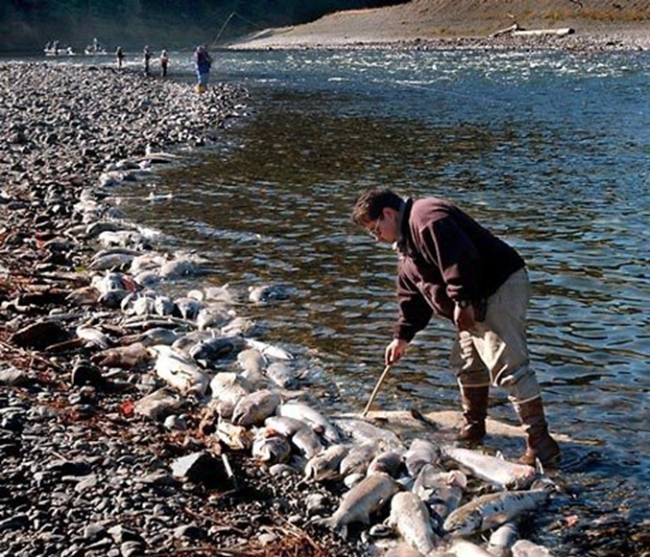
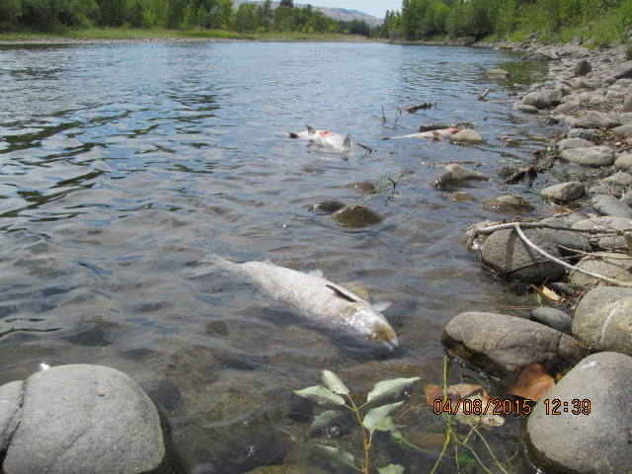
Catastrophic effects of high temperatures during migration
2002 Klamath River fish kill
2004 Fraser River 1.3 million sockeye disappeared
2015 Upper Columbia River sockeye die-off
  Only 2% of adult fish that began
  migration returned to Lake Osoyoos
Seattle Times
Chris Fisher, Colville Tribes
Steve Ringman/The Seattle Times
Notes:
In 2015, salmon die-offs made headlines in Oregon and Washington. The die offs were largely attributed to disease, exacerbated by high water temperatures. This summer highlighted the need to better understand the various conditions that can affect salmon after they return to freshwater to spawn.

Slide 11
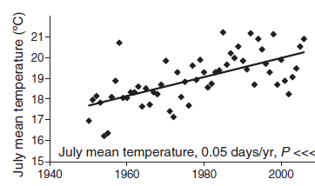
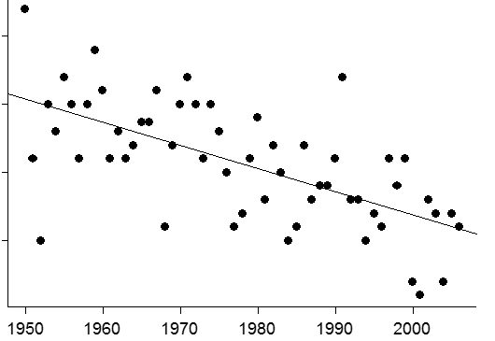
Migration timing has shifted earlier
Mean July temperature at Bonneville dam
Median date of sockeye migration
July 9
July 4
Median migration date
June 29
June 24
Average July temperature at Bonneville is >3°C warmer than 1950s
Sockeye salmon migrate ~ 10 days earlier than in 1950s
Crozier et al 2008. Evol. Apps. 1: 252-270

Slide 12
Annual prespawn mortality increases with temperature
Spring-summer Chinook salmon
Annual PSM (%)
Likelihood of dying before spawning increases dramatically at ~ 18-20°C
Modeled mean August temperature (°C)
Bowerman et al. in prep
Notes:
We fit a logistic model to these data, which is shown here for those of you interested. The model fit shows a steep increase in predicted PSM rate at about 18 deg C. The gray shaded area depicts 95% confidence intervals, and you can see that a lot of data points fall outside this range, indicating that there are other variables affecting PSM rates in specific streams, which likely include management practices such as handling and transporting fish, and both demographic and environmental variables such as density, prevalence of pathogens, and migration conditions prior to arrival at spawning grounds. These are the subject of ongoing research to understand additional factors affecting this residual variation.

Slide 13

Predicted future Chinook salmon PSM
Current average
Predicted 2040
NorWeST stream temperature model
Current:
10% habitat >50% PSM
Predicted 2040:
30% habitat >50% PSM
Methow
Okanogan
Wenatchee
Yakima
Notes:
I used the global model fit to predict PSM rates across the Upper Columbia Subbasin using spatially continuous modeled stream temperatures from the NorWeST model that Dan Isaak is going to talk about tomorrow. Based on these models, under current conditions, we expect approximately 10% of available spring and summer Chinook habitat to have PSM rates of 50% or higher. Based on future stream temperature predictions from the NorWeST model, in 2040 that number would increase to 30%.
See these increases primarily in middle Yakima, SU CHK habitat in Wenatchee, and in Okanogan

Slide 14
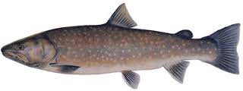
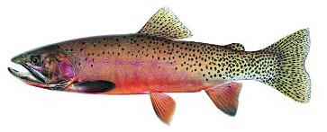
Native trout and climate change
Bull trout
Cutthroat trout
Primary concerns:
Loss of thermally suitable habitat
Hybridization with non-natives
Competition with non-natives
Diseases and parasites
Changes in flow regime may increase high winter flows, resulting in egg mortality

Slide 15

Observed temperature changes in past 30 years
North Fork Flathead River, Montana, mean summer stream temperature
Average summer temperatures increased by 1°C; 20% increase in stream habitat available to rainbow trout
1978
2007
Isaak et al. 2012, Fisheries 37:542-556

Slide 16
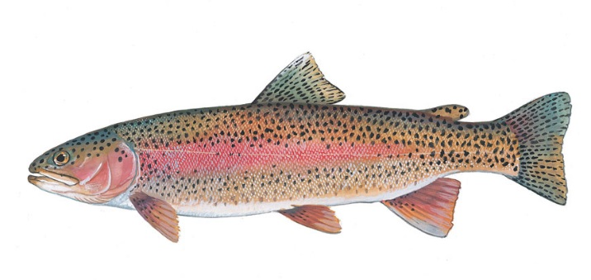
Increased potential for hybridization with non-native species
North Fork Flathead River
Hybridization with non-native rainbow trout where temperatures increased
1978
2007
Isaak et al. 2012, Fisheries 37:542-556

Slide 17
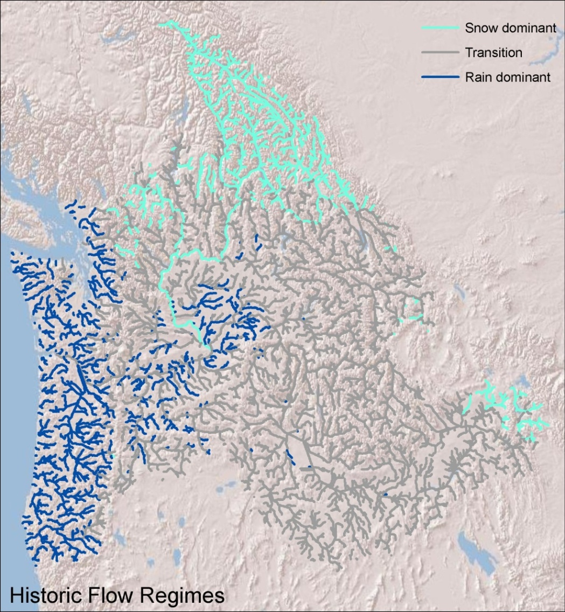
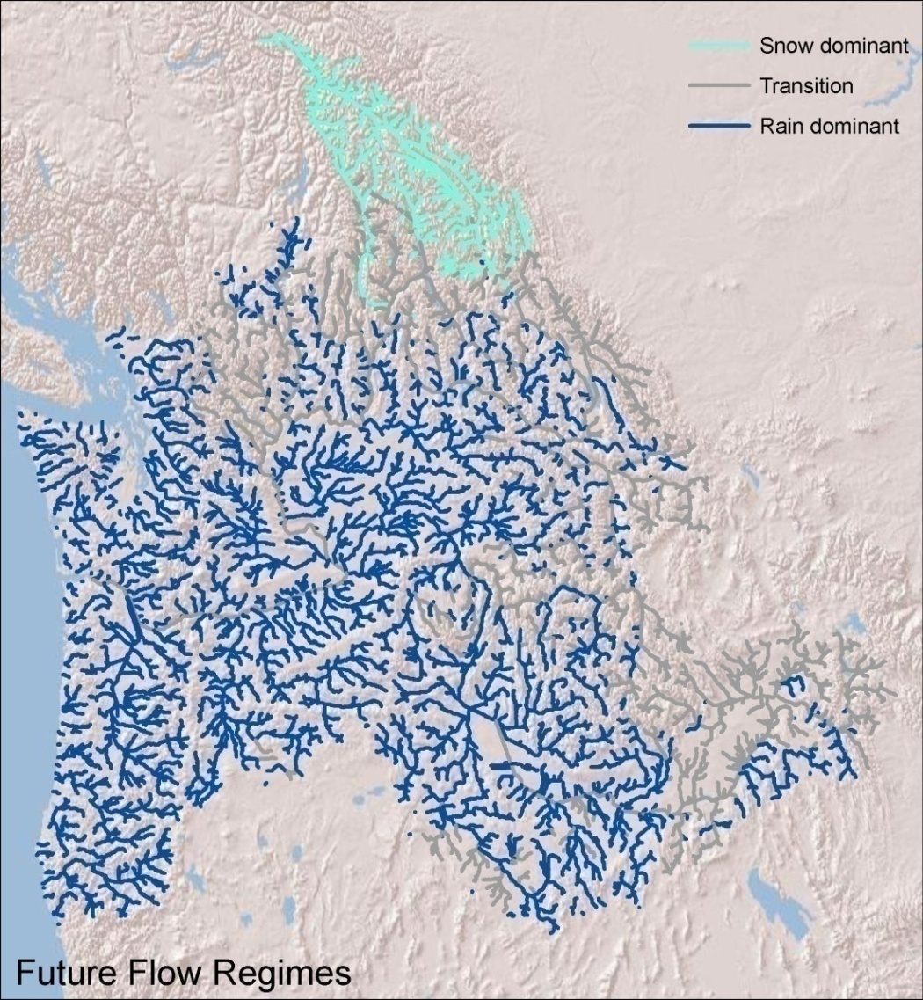
Other climatic changes
Dominant flow regime 1970-1999
Dominant flow regime 2070-2099
Banff
Banff
Snowmelt
Snowmelt
Seattle
Transitional
Seattle
Portland
Transitional
Portland
Boise
Boise
Rainfall
Rainfall
Changes to flow regimes could have severe effects on egg and fry survival and water availability in summer.
Data source: http://www.hydro.washington.edu/2860/report/
Slide courtesy of Tim Beechie, NOAA fisheries

Slide 18
Summary
Observed relationships between high temperature and:
  Slowed migration rates
  Migration mortality
  Prespawn mortality on spawning grounds
  Increased hybridization in trout
Response to temperature depends on species and timing of life-history events
Thermal refuges critical (migration, spawning grounds)
Mortality during migration and prespawn period predicted to increase

Slide 19
Thinking ahead: climate resiliency
Maintain thermally suitable habitat
  Considerations for all life stages
  Dam operations: maintain adequate flow during hottest times
  Targeted restoration in tributaries
  Protect large habitats, maintain connectivity
Improve adaptive fisheries management
  Limit fisheries in thermal refuges
  Anticipate hot stream temperatures before they occur
Consider alternative actions
  Transporting adults
  Managing for non-natives

