Slide 1
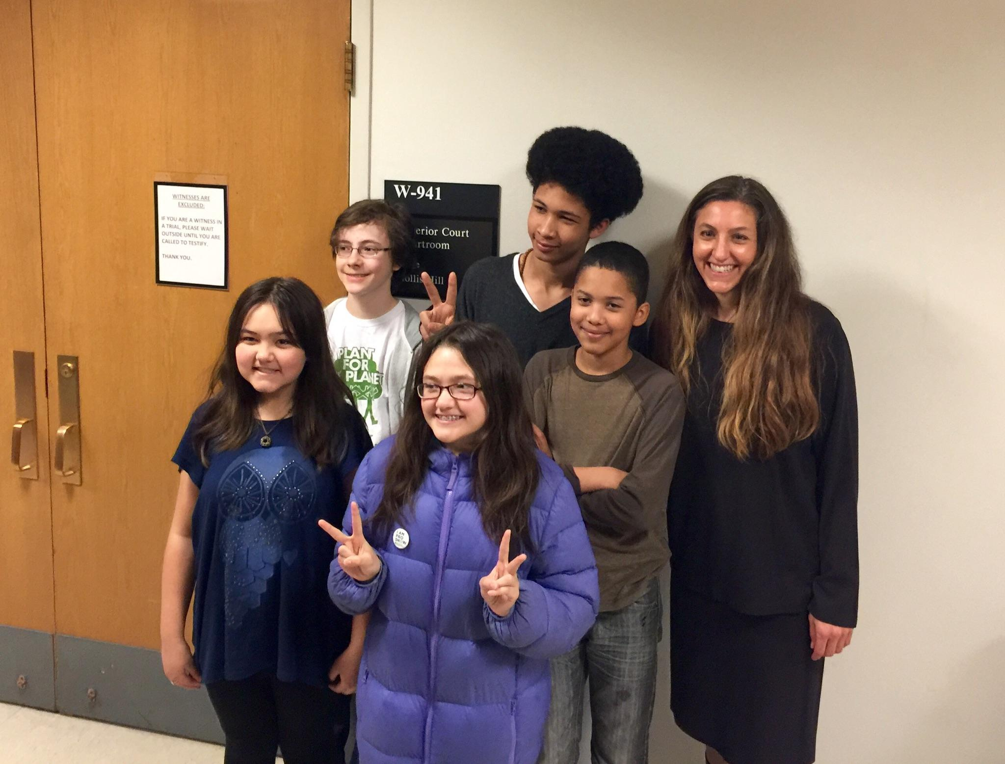

Atmospheric Trust Litigation Andrea K. Rodgers Attorney

Slide 2
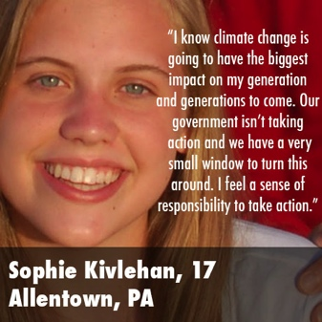
A Youth-Driven Campaign
16-year old Victoria Barrett:
“The future of our generation is at stake. People label our generation as dreamers, but hope is not the only tool we have.”

Slide 3
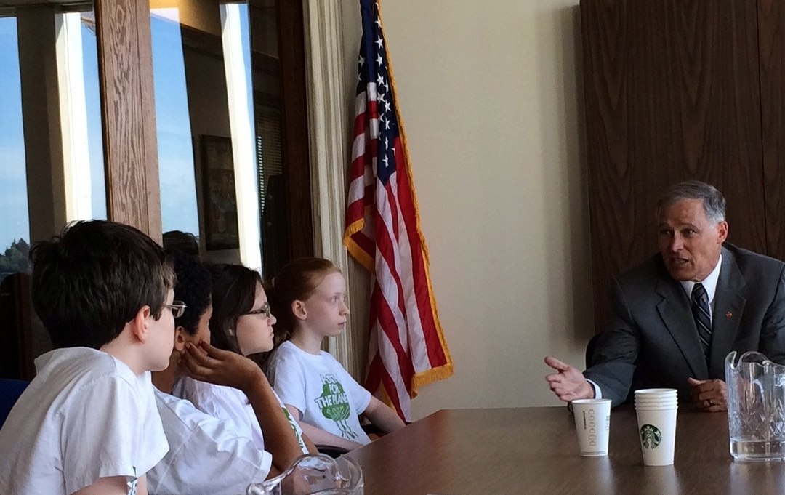
My Clients: A Force for Change

Slide 4
The Failure to Act in WA
1990: “the potential impacts of global warming dwarf those of other environmental threats.”
2008: “the science is clear that we must move forward quickly to reduce greenhouse gas (GHG) emissions in order to mitigate its effects.”
2009-2014: “Without action, climate change will negatively affect nearly every part of Washington’s economy through changes in temperature, sea level, and water availability.”
2014: “We are imposing risks on future generations (causing intergenerational inequities) and liability for the harm that will be caused by climate change that we are unable or unwilling to avoid.”

Slide 5
The Legal Theory: Atmospheric Trust Litigation
Developed by University of Oregon Law Professor Mary Wood.
Without judicial mandates, legislative and executive branches have not and cannot enact adequate climate protections in time.
We have the laws in place, but they are not being implemented to address the climate crisis.
The urgency is unprecedented: “There is such a thing as being too late.” MLK, Jr.

Slide 6
The Public Trust Framework
Sovereign governments hold vital natural resources in perpetual trust for present and future generations, the beneficiaries.
Expressed in Roman Law: “By the law of nature these things are common to all mankind – the air, running water, the sea, and consequently the shores of the sea.”
An attribute of sovereignty: “The state can no more abdicate its trust over property in which the whole people are interested . . . Than it can abdicate its police powers in the administration of government . . . .” Illinois Central R.R. v. Illinois, 146 U.S. 387 (1892).

Slide 7
The Public Trust Doctrine Is “Universal” Law
“The survival of our wildlife is a matter of grave concern to all of us in Africa. In accepting the trusteeship of our wildlife we solemnly declare that we will do everything in our power to make sure that our children’s grandchildren will be able to enjoy this rich and rewarding inheritance.”
Julius Nyerere, 1964, First President of Tanganyika (now Tanzania).

Slide 8
Atmospheric Trust Litigation
A coordinated legal campaign to invoke the Public Trust Doctrine to protect the atmosphere from GHG pollution to restore climate stability.
Goals:
(1) Invoke the judiciary’s role in upholding the rights of youth plaintiffs.
(2) Declare the rights of young people to guide government policymakers and provide a framework for action.
(3) Order and manage a remedy that offers a practical means to enforce and protect the rights of plaintiffs.

Slide 9
The “Scientific Prescription”
“Unless action is undertaken without further delay to return the atmospheric concentration of CO₂ to 350 ppm by 2100, Earth’s climate system will be pressed toward and past points of no return, with ever-worsening climate-related impacts in the meantime.
Hansen, et al., Assessing “Dangerous Climate Change”: Required Reduction of Climate Emissions to Protect Young People, Future Generations and Nature (2013).

Slide 10
King Count Superior Court
Round 1: Youth prevail and judge remands petition back to Ecology for reconsideration in light of most current climate science.
Round 2: Youth meet with Governor Inslee and ask that he direct Ecology to promulgate a rule regulating carbon dioxide emissions, which he does, but does not base rule on science.
Round 3: Judge Hill’s decision (November 19, 2015)
Agrees with youth’s legal arguments, but affirms Ecology’s decision denying petition in light of Ecology starting the rulemaking process as directed by Governor Inslee.

Slide 11
The Kids Have Legal Rights!
“Although, a statutory duty cannot be created from the words of the enabling statue [right to a healthful and pleasant environment], this language does evidence the legislature’s view as to rights retained under Article I, Section 30.”
“If ever there were a time to recognize through action this right to preservation of a healthful and pleasant atmosphere, the time is now.”
“[the youths’] very survival depends upon the will of their elders to act now, decisively and unequivocally, to stem the tide of global warming . . . before doing so becomes first too costly and then too late.”

Slide 12
The State Has Broad Authority To Act To Protect The Rights of Youth
“[T]he State has a constitutional obligation to protect the public’s interest in natural resources held in trust for the common benefit of the people of the State.”
“The navigable waters and the atmosphere are intertwined and to argue a separation of the two, or to argue that GHG emissions do not affect navigable waters is nonsensical.”
“[T]he Public Trust Doctrine mandates that the State act through its designated agency to protect what it holds in trust.”

Slide 13
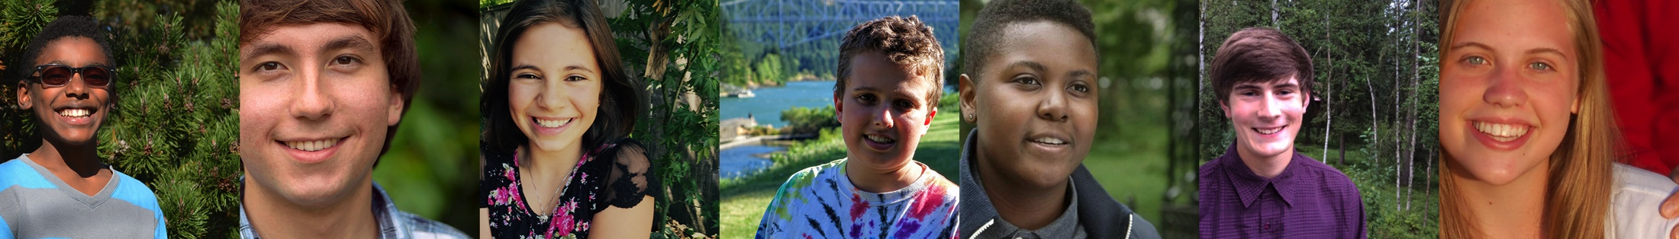
The State Has Broad Authority to Act to Protect Future Generations
A mandatory duty to establish air quality standards for GHG emissions, including carbon dioxide, in a manner that “preserves, protects and enhances the air quality for the current and future generations.” WA Clean Air Act.

Slide 14
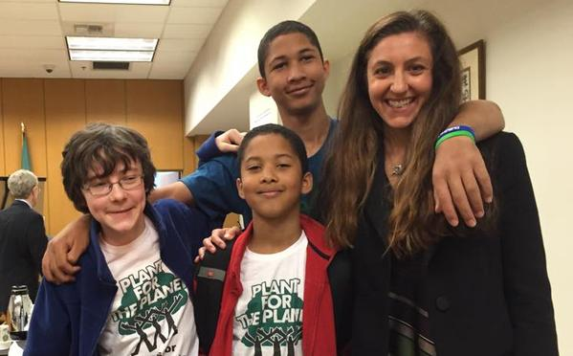
Politics Intervenes
February 2016: Ecology withdraws the proposed Clean Air Rule.
The youths’ rights are being violated with no legal remedy in sight: we head back to court.

Slide 15
Round 3: Rule 60(b) Motion
A motion for order for relief from judgment based upon Ecology’s (1) misrepresentations; or (2) extraordinary circumstances.
Judge grants Rule 60(b) motion based upon a finding of extraordinary circumstances.
“The climate crisis presents an urgent situation that youth petitioners cannot wait on.”
“Polar bears can’t wait, the people of Bangladesh can’t wait. I don’t have jurisdiction over their needs in this matter, but I do have jurisdiction in this court, and for that reason I’m taking this action.”
Orders Ecology to promulgate a rule regulating carbon dioxide emissions by the end of 2016.
Orders Ecology to make a recommendation to the 2017 legislature to update GHG emissions limits set forth in RCW 70.235.020.

Slide 16
Round 4: Ecology Releases Revised Clean Air Rule
June 1, 2016: Ecology releases a revised version of Clean Air Rule.
Comments due: July 22, 2016.
Gabe Mandell: “By putting out a weak rule based on outdated science, the Governor and Ecology have defied the court and violated the constitutional rights of every kid in Washington. The rule is green window dressing, not a window to a livable future.”
Aji Piper: “I can’t turn in my homework ignoring modern science. Yet Ecology and the Governor can ignore a decade of modern science?”

Slide 17
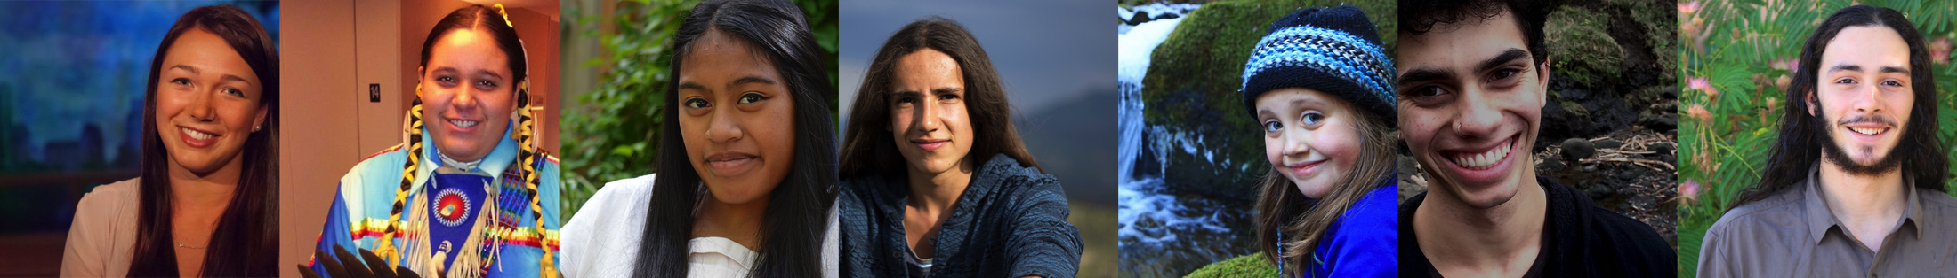
Politics REALLY Intervenes
Governor Inslee: “Eight courageous kids went to court to compel us adults to take action on climate change. I’m happy to say that they won. Those eight kids know that our state can do more to fight climate change – and I do, too. Their case has been a call for action to no longer ignore our climate and our kids.”
Governor appeals court’s decision ordering promulgation of the Clean Air Rule.

Slide 18
Contempt?
Youth file Motion for Order to Show Cause why Ecology should not be held in contempt of court for violating the court’s prior orders.
Do the court’s prior order contain substantive legal requirements?
Requested Relief: (1) why Ecology should not be held in contempt of this Court’s November 19, 2015 and May 16, 2016 court orders; and (2) why this court should not enter an order directing Ecology to regulate greenhouse gas (“GHG”) emissions in a manner that fulfills its statutory and constitutional responsibilities as set forth in this court’s November 19, 2015 and May 16, 2016 orders.
We also ask that the court retain continuing jurisdiction over the matter to ensure that Ecology makes progress towards reducing GHG emissions in a manner that fulfills its statutory and constitutional responsibilities.
Hearing set: November 22, 2016 at 4:00 pm.

Slide 19
Proposed Legislation
(i) By 2020, reduce overall emissions of greenhouse gases in the state to at least ten percent below 1990 levels, and ensure that emissions of carbon dioxide in the state decrease by at least ten percent below 1990 levels.
(ii) By 2035, reduce overall emissions of greenhouse gases in the state to twenty-five percent below at least sixty-eight percent below 1990 levels, and ensure that emissions of carbon dioxide in the state decrease by at least sixty-eight percent below 1990 levels.
(iii) By 2050, the state will do its part to reach global climate stabilization levels by reducing overall emissions of greenhouse gases in the state fifty percent to at least ninety-one percent below 1990 levels, and ensure that emissions of carbon dioxide in the state decrease by at least ninety-one percent below 1990 levels or seventy percent below the state’s expected emissions that year.

Slide 20
Climate Movement Instability
I-732: Carbon Tax
Is there truly support for science-based GHG emission limits?
Climate change is an “all hands on deck” issue, requiring several different policy solutions.
What are we lacking? LEADERSHIP to guide us where we need to go.
What is the safe level of atmospheric carbon dioxide?
Science needs to inform where we need to go, but not necessarily dictate how we need to get there.

Slide 21
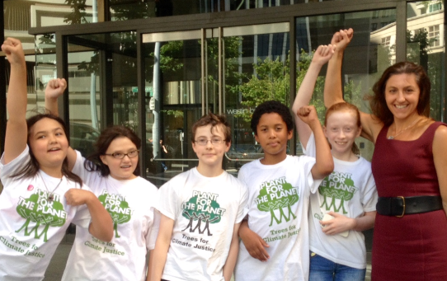
Lead, Empower, Educate and Inspire!

