Slide 2
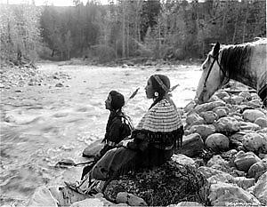
Tribal cultures connect people with the environment
Our lands and resources are the basis of our spiritual life. That’s been our way since time began. By preparing for further environmental changes, we can mitigate threats to our way of life.
Our traditions rely on abundant population of native fish and wildlife, healthy plant communities, clear air, water, undisturbed spiritual sites, prehistoric and historic campsites, dwellings, burial grounds, and other cultural sites because these areas reaffirm the presence of our ancestors. These resources also provide future generations with a connection to their ancestors and native traditions.
Salish couple by the Jocko River. Source: CSKT
Notes:
Our lands and resources are the basis of our spiritual life. That’s been our way since time began. By preparing for further environmental changes, we can mitigate threats to our way of life. Our traditions rely on abundant population of native fish and wildlife, health plant communities, clear air, water, undisturbed spiritual sites, prehistoric and historic campsites, dwellings, burial grounds, and other cultural sites because these areas reaffirm the presence of our ancestors. These resources also provide our future leaders with a connection to their ancestors and native traditions.

Slide 3
Strategic Plan Purpose
Serve as an early step towards addressing the impacts of climate change on the Flathead Reservation in Montana.
Improve the Tribal community and its lands resiliency by effectively informing the Tribes.
Initiate the development of collectively beneficial impact mitigation and adaptation solutions.

Slide 4
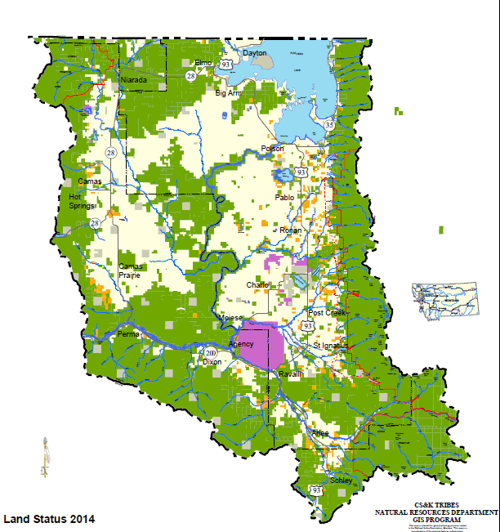
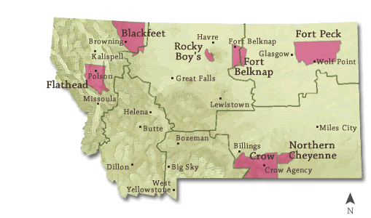
Flathead Reservation
Montana Reservation Map by Montana Office of Tourism
Notes:
1.3 Million Acres
790,000 acres owned by Tribes and Tribal members
FIR lies in Western Montana with a major interstate running east/west to the south of us and glacier nP and Canada to the north. We have the largest natural freshwater lake to the west of the Mississippi river, Flathead Lake

Slide 5
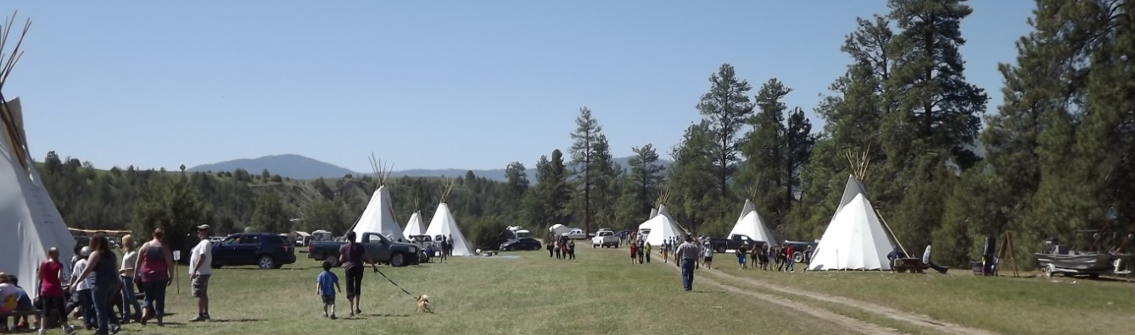
Cultural Considerations
Indigenous people of the world have a special moral stature on this issue [of climate change] and may have a special role in coming together to advocate for action. –SPCC
River Honoring, photo by Conrad Durglo
Notes:
The CSKT Tribal Council recognizes and acknowledges the potential impacts of climate change and declares the intent and commitment of the Tribes to address effects of climate change and that Traditional Ecological Knowledge shall be integrated into the CSKT Climate Change Strategic Plan.
Tribal Elder Observations
The elders would sit down and they would tell stories. They would talk about certain things that were coming…One day this earth is going to become warm….The snow and ice is going to melt in the north and the oceans are going to fill up…I am witnessing this today.”
- Patrick Pierre

Slide 6
Impacts on the Tribes
Cultural resources of the Tribes are being lost, substantially altered, or destroyed with increasing frequency in the face of energy, economic, residential, transportation, sanitation, and public health developments.
Impacts are region wide. Collaborations need to be sought to care for the land on a larger scale than just the boundaries of the Reservation

Slide 7
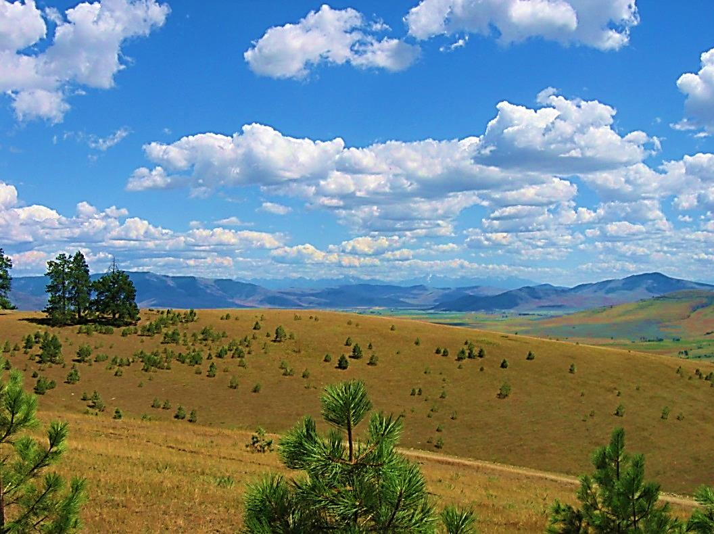
Planning Sectors
Forestry
Land
Fish
Wildlife
Water
Air Quality
Infrastructure
People
Culture
Flathead Reservation, photo by Roian Matt

Slide 8
Next Steps
Develop implementation plans
  Establish specific tasks and timeframes
  Monitor and measure progress of goals
  Research more Traditional Ecological Knowledge
Regularly revisit and modify the plan
  Review basic assumptions
  Add new information as it becomes available

Slide 9
Next Steps
Engage in resource development
  Request grant funding
  Leverage available resources
  Promote active collaboration
Make region wide connections
  Great Northern Landscape Conservation Cooperative
  Crown of the Continent Conservation Initiative
  The Wilderness Society

Slide 10
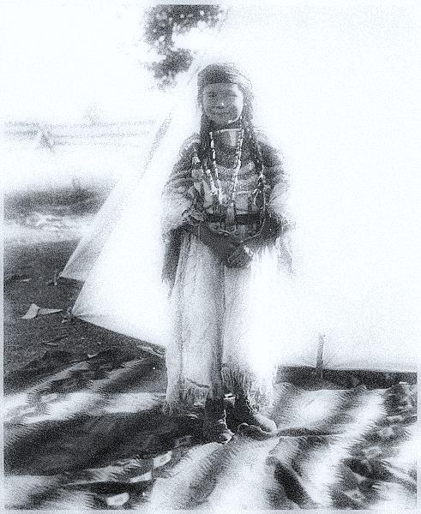
The lesson is not a debate about whether the climate is changing, but that---we should pay attention, be mindful, plan and prepare. We are the caretakers of our environment to prepare a place better than what we found. For those yet unborn.

