Slide 1
Ni?l escut’
Take Heart, Don’t Give, Keep Going
A Call To Action

Slide 2
Talking Points
Where We Are and Who Are We?
What are the First Foods Telling Us? Water?
Indigenous Voices, Collaborations and Leadership
US Consultation and International Action
Our Shared Responsibility; Monumental Effort
Our Legacy, Our Duty
The World is Watching
Conclusions
Notes:
Formed in 1983 to provide a common voice for our region through the collaborative efforts of the Upper Columbia River Tribes.
Formed to ensure a healthy future for the traditional lands of our ancestors and for the benefit of all people.
Proactive, collaborative and science-based approach to promoting culture, fish, water, wildlife, and diverse habitat.

Slide 3
UCUT Mission Statement
To unite Upper Columbia River Tribes for the protection, preservation, and enhancement of Treaty/Executive Order Rights, Sovereignty, Culture, Fish, Water, Wildlife, Habitat and other interests and issues of common concern in our respective territories through a structured process of cooperation and coordination for the benefit of all people.
Notes:
Formed in 1983 to provide a common voice for our region through the collaborative efforts of the Upper Columbia River Tribes.
Formed to ensure a healthy future for the traditional lands of our ancestors and for the benefit of all people.
Proactive, collaborative and science-based approach to promoting culture, fish, water, wildlife, and diverse habitat.

Slide 4
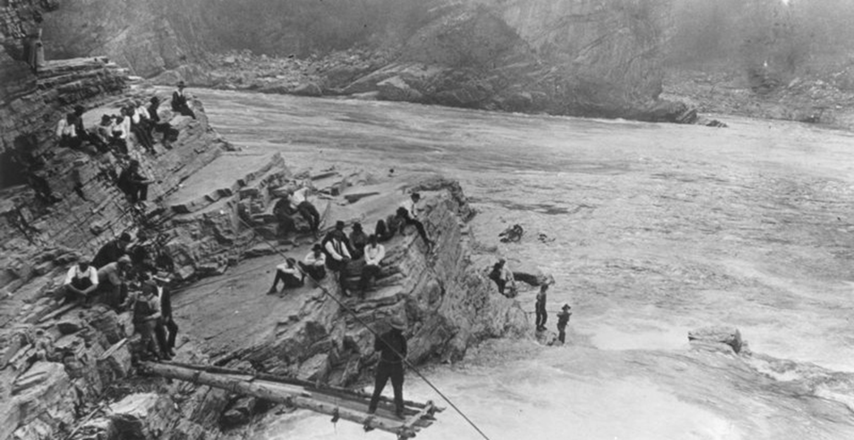
Kettle Falls Fishermen

Slide 5
Four Chiefs, First Foods
All begins with water; medicine, travel, food
Four Chiefs;
  salmon, bear, bitterroots, service berry
Traditional knowledge of what the land provided
We have a sacred obligation to pass on this knowledge to coming generations and to leave our home better than when we found it.
Gathering and Fishing seasons have been affected!
Water regimes are telling us what is wrong!
Notes:
We used canoes to navigate these rivers and each river was named for each Tribe
60-70% of our diet; salmon
We used biology, climate, etc. to gauge our actions

Slide 6
Balance and Commitment
The cultural and traditional principles work to maintain balance with the environment
These gifts of the First Foods also carry a responsibility of active stewardship
We stand committed to uphold our teachings
We honor that responsibility by taking action on improving salmon runs, water quality and preparing for Climate Change impacts
Notes:
They have sustained our people the Upper Columbia River Tribes for tens of thousands of years.
This is our foundation
We have to work to ensure a healthy future for the traditional lands of our ancestors and for the benefit of all people.
Again based in science; Proactive, collaborative and science-based approach to promoting culture, fish, water, wildlife, and diverse habitat.

Slide 7
Including Indigenous Voices into the Process; Leadership and Policy
The First Nations and Tribal Governments voices in the Regional Recommendation submitted in 2013. http://www.crt2014-2024review.gov/RegionalDraft.aspx
We fought for inclusion of Eco based System Function (EbF) as 3rd leg of treaty pillars of hydropower production and flood control
Endorsed by 15 Tribes Coalition, US Entity, local governments, NPCC and countless others.
15 Tribes Coalition! The Great Sioux Nation coming together for NODAPL.
Including the Youth Movement and Voices
Personal Responsibility and joining movements like No Coal/Oil Transport
Partnerships and Collaborations are a necessity.
Notes:
Stirred many in the region, fascination and support
UCUT is working hard to make this a reality

Slide 8
Saving Fish, We Save Ourselves
  Current and Future Impacts to First Foods
Getting access to cooler waters will be crucial
Addressing legacy pollution
Water Temperature, Water Quality & Quantity
Drought and Dry Year Strategies
First Food Impacts
We must be the voices for the plants and animals!

Slide 9
Traditional Knowledge as Direction
Climate Change is happening, perhaps the land, water and animals can give us some clues on what is next
These Climate Issues affects all of us
We work for a better world for generations to come
Our Projects are all affected by Climate Change AND could be a point of collaboration of all to work toward a better world

Slide 10
US Federal Government Consult?
The Obama Administration and the U.S State Department DID NOT conduct any meaningful consultations with any of the 567 Tribes with regard to the US Position on Climate Change at the COP 21 negotiations nor included Tribal Governments at any table
Now, it is up to tribes to demand the Obama Administration and subsequent Administrations to conduct formal consultations on the outcomes of the COP21 and address the Tribal Climate Change Principles
The United States needs to follow Canada and New Zealand by put First Nations leaders on their negotiation team like they did at COP21 in Paris! Norway also consulted the Saami regularly at COP21.

Slide 11
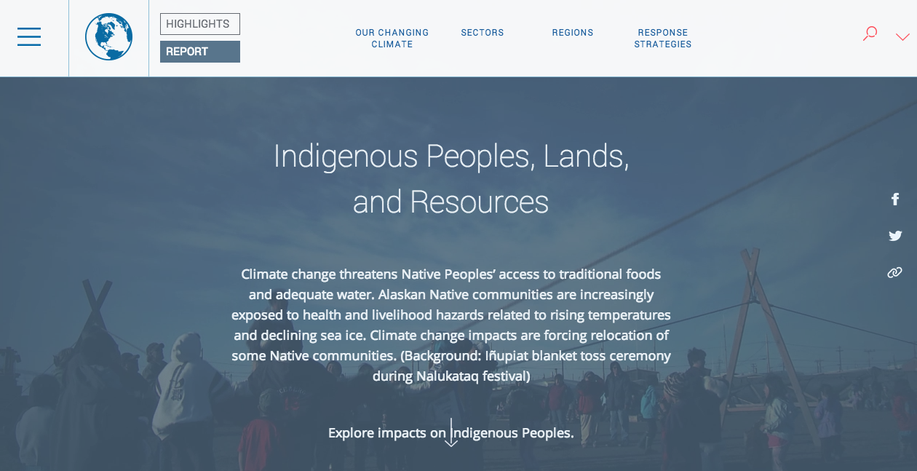
Climate Change and Tribes
3rd U.S. National Climate Assessment clearly states
“climate change impacts on many of the 567 federally recognized tribes and other tribal and indigenous groups in the U.S. are projected to be especially severe, since these impacts are compounded by a number of persistent social and economic problems.”
Notes:
The question of who pays and who benefits has been clear since colonization. Tribes pay and will face the greatest impacts due to CC
Manmade climate change with hydropower facilities impact all aspects of tribal life.
With change in hydropower operations, tribes will pay again
Salmon remains blocked,
challenges to basic transportation to hospital, schools
Irrigation goes south to support $800 million in ag
CCT members pay 3 times the rate for power than they pay across the river
How will river operations change with CC more impact Tribes?

Slide 12
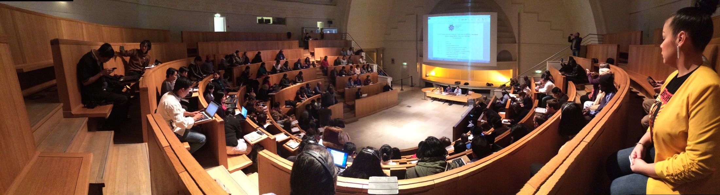
Indigenous People answered the urgent call in Paris at COP21 and took action.
Notes:
Meeting at the Natural History Museum

Slide 13
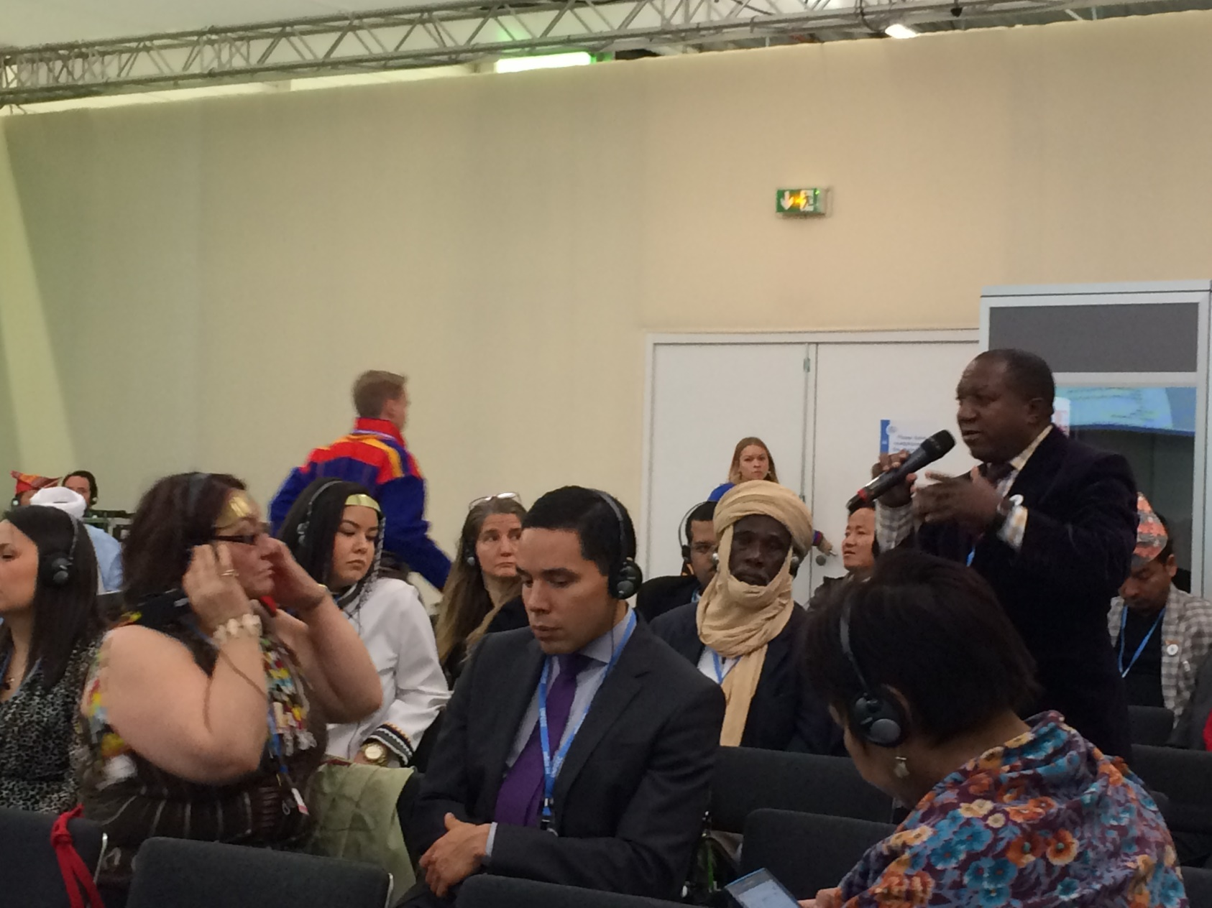
Notes:
Indigenous people from Africa, South America, Artic, Russia, China, North America and Pacific

Slide 14
Indigenous Peoples Fight for 1.5 or Less
U.N. Structured Expert Dialog report concluded that at 2 degrees C of warming,
  “…indigenous people[s] would be at risk of loss of land and cultural and natural heritage, and cultural practices embedded in livelihoods would be disrupted”;
Therefore, Indigenous Representatives advocated States to adopt a goal of a temperature rise of no more than 1.5 degrees C of warming, with a larger goal lowered to no more than 1 degree C of warming

Slide 15
The Rights of Indigenous Peoples
Indigenous Peoples called upon States to adopt an agreement with;
a strong human rights based approach reflected in the operative provisions of the agreement, and
covers all aspects of the agreement such as mitigation, adaptation, finance, capacity building, and specifically recognizes the rights of Indigenous Peoples

Slide 16
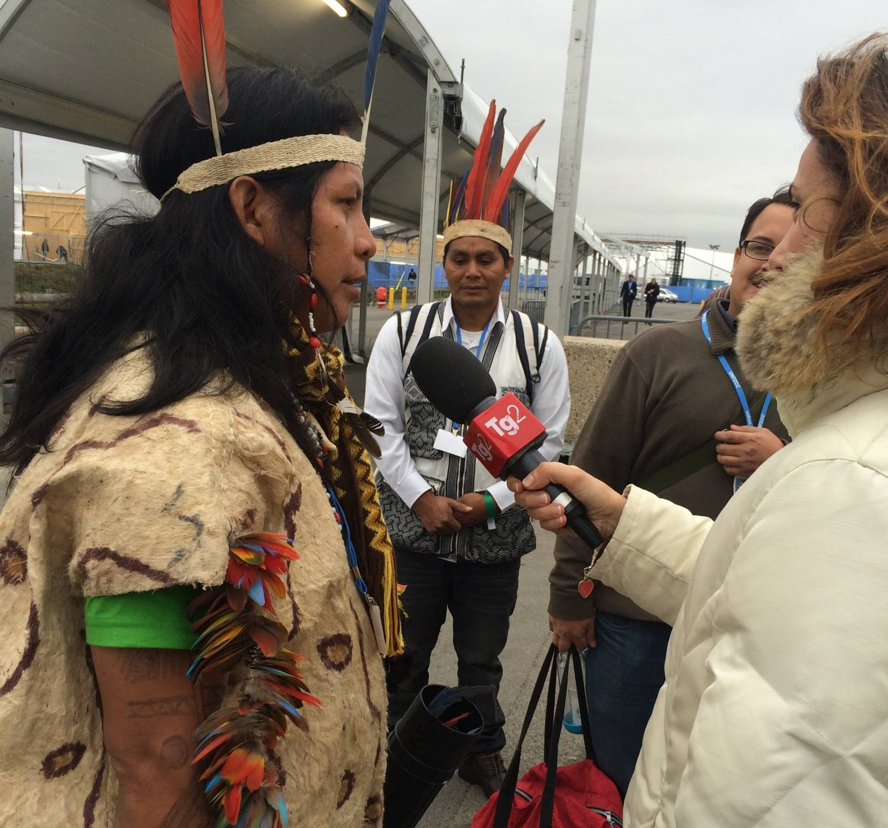

Slide 17
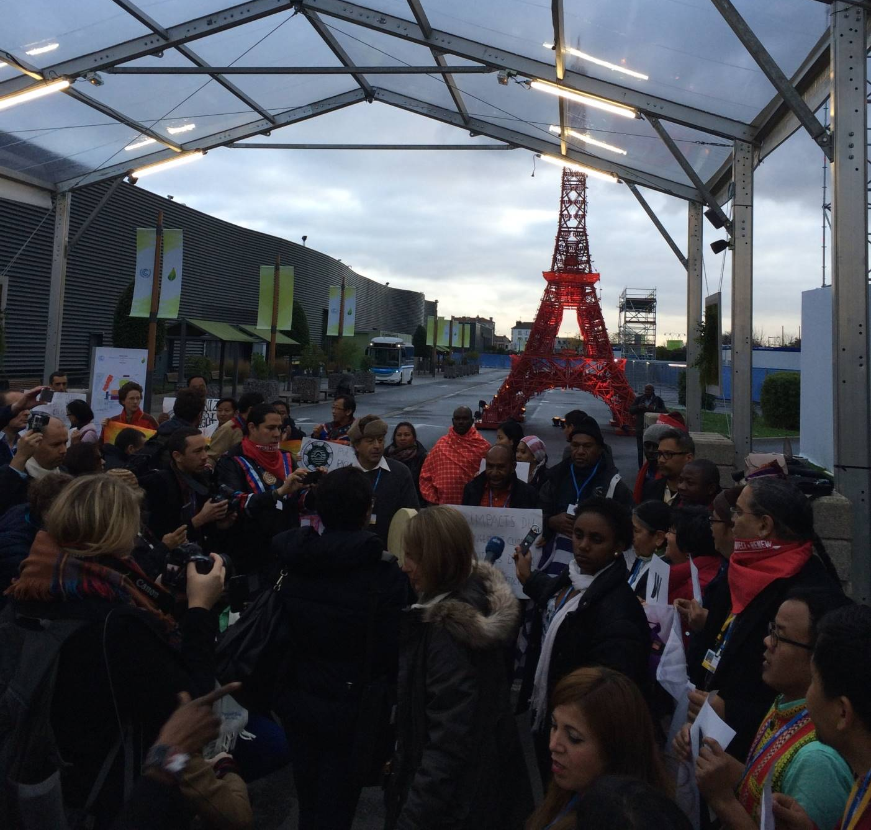

Slide 18
COP21 Outcomes, Local Impacts
Outcomes can be debated, however it was a turning point on putting limits on emissions in a global sense.
A legally binding Agreement was signed by 187 States!
Emphasis on healthy forest and landscapes but through a market based approach like REDD+ (reducing emissions from deforestation and forest degradation)
Funding for protecting and promoting forest health.
A recognition of the rights of Indigenous Peoples and knowledge of the first stewards of the land.
Notes:
3.1 Billion set aside by China and a US endorsement as well.
Indigenous People made an impact, visually and through telling their stories

Slide 19
“Monuments Men” Effort
We must change the narrative of the story!
Everyday people do not have to be the villains in our climate change story; always polluting, not caring
We must mount a full scale effort together to change what is happening to salmon and the environment.
The heroes in this story come together to defeat climate change and provide for our families, for generations to come!
The heroes are right here in this room and in every community!
Notes:
In a race against time, a special force of American and British museum directors, curators, art historians, and others, called the Monuments Men, risked their lives scouring Europe to prevent the destruction of thousands of years of culture by Nazis
Read more: http://www.smithsonianmag.com/history/true-story-monuments-men-180949569/#wEbXkjfVFctM52gl.99
Give the gift of Smithsonian magazine for only $12! http://bit.ly/1cGUiGv
Follow us: @SmithsonianMag on Twitter

Slide 20
The Legacy of Our Generation
A Man on the Moon; Is there water on Mars?
We have the knowledge and ability to meet this threat decimating our society and our future!
We have the ability to come together to address climate change impacts, use applied science, provide habitat for these species and for a better ecosystem
We can be the Monuments Men of our generation to pass along a better future for our grandchildren’s grandchildren.
Notes:
Most had expertise as museum directors, curators, art scholars and educators, artists, architects, and archivists. Their job description was simple: to save as much of the culture of Europe as they could during combat.
These men not only had the vision to understand the grave threat to the greatest cultural and artistic achievements of civilization, but then joined the front lines to do something about it.

Slide 21
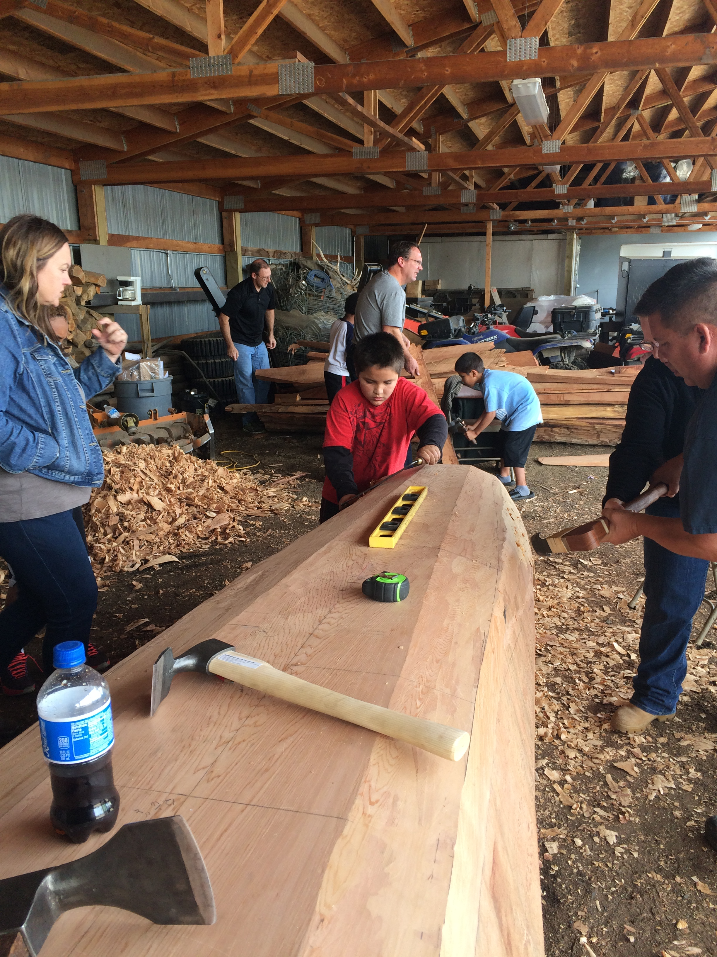
Show, Teach and Carve

Slide 22
Take Away Actions
In Summary
We Are the Rivers, We are the Salmon
We have the Knowledge and We Collaborate
Enhance the First Foods, We address Climate Change
We must answer the call to action and our partners must be there
Change the Story; Collaborative Efforts and Resources; We can be that “Monuments Men” story all!
Collaborate with all in the region to realize the potential benefits; cultural, spiritual, physical and economical
Our Legacy, Our Duty
The World is Watching
Notes:
1. Fulfilling First Foods will help everyone in the region and has economic benefits
2. Most impacted, least mitigated
3. It is time to take action

Slide 23
Questions?
Thank You for Your Time
Lim Limpt’

