Slide 1

Climate Change Impacts to Human Health and Infrastructure
CCT Environmental Trust Department
Amelia Marchand, Water Regulatory Specialist

Slide 2
where we are…Health
1%...4%
Twenty-six percent
5
147,000
26%
23%...18%

Slide 3
Where we are…infrastructure
10%
12%...0.6%
1/5
Ten percent
50%
10x

Slide 4
Where we are…Socially
14%
28.4%...15.3%
177,000
Seventy-six percent

Slide 5

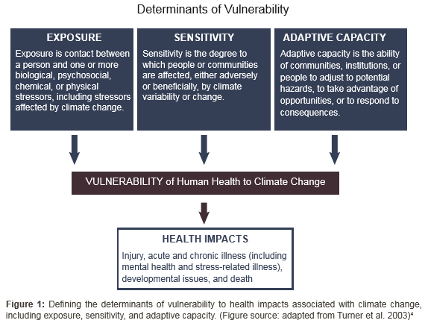

What do these figures mean?

Slide 6
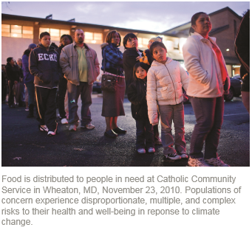
What do these figures mean?
Vulnerable groups have a greater incidence of chronic medical conditions
  AI/AN death rates from diabetes mellitus are 177% higher than general population
  Heart disease death rates for AI/AN is 20% greater than general population
  Stroke death rates for AI/AN is 14% greater than general population
Risk-prone areas:
  Isolated rural areas
  Flood-prone areas
  Areas with older or poorly maintained infrastructure

Slide 7

Projected Impact:
More Extreme Heat Events
Worsening of existing problems with respiratory illness, cardiovascular disease, and kidney failure;
More heat exhaustion, heart attacks, strokes and drownings;
More heat-related deaths
Road material degradation
Railways expand and begin to buckle,
leading to derailment
Heat can also cause more outage accidents when
overhead electrical lines sag
Increased heat will necessitate more upkeep in
airports

Slide 8

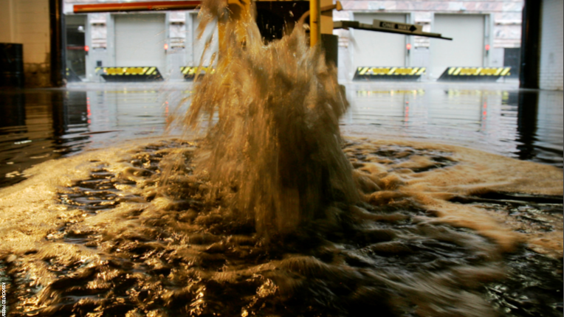
Projected impact:
Increased Flooding
Injuries and death
Exposure to hazardous and toxic substances released and spread by flooding
Respiratory illness from mold and microbial growth in flood-impacted structures
Contamination of, or disruption of, public water supplies or private wells by waterborne and vector-borne diseases
Substandard or deteriorating water infrastructure (sewerage, drainage, storm water and drinking water systems) also contribute to increased risk of exposure to waterborne pathogens
Mental health impacts associated with damage to homes, communities, places of employment
More sediment and flood debris could affect bridges and ferry facilities

Slide 9
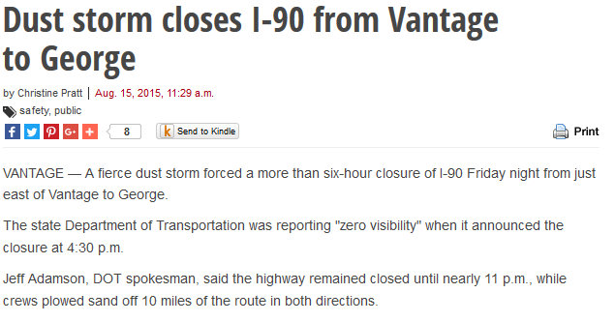
Projected Impact:
Increased Drought
Respiratory illness associated with increased forest fires
Reduced water supplies, including impacts to groundwater supplies used by private wells
Mental health effects
Lack of vegetation coupled with wind events reduces air quality and visibility
Reduction of food security and further alteration of traditional indigenous diets

Slide 10
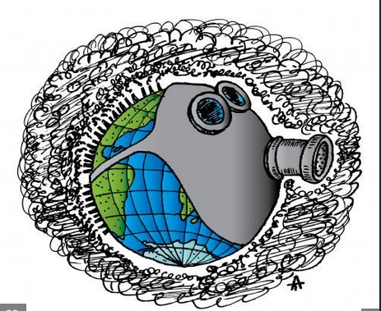
Projected Impact:
Increased Forest Fires
More severe and longer-lasting allergy symptoms, asthma, bronchitis, cardiovascular disease, pneumonia hospital admissions, respiratory disorders and mortality
Missed school and work days
Mental health effects due to potential or actual loss of property and disruptions to communities
Lack of visibility for transportation routes and helicopter/airplane operations increases accident potential

Slide 11
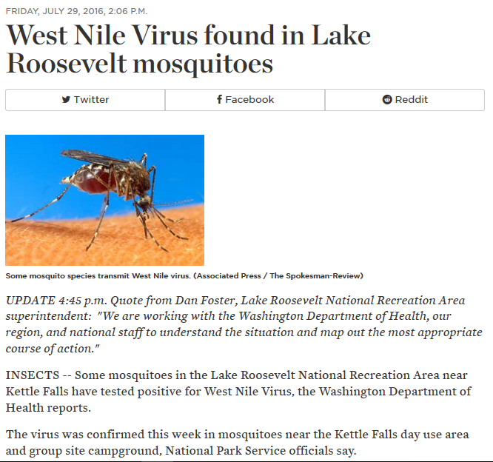
Projected Impact:
Infectious, vector-born, and fungal diseases
More illness and mortality associated with infectious diseases
Transportation routes may be closed to reduce spread of infectious diseases
The emergence of new diseases and/or expansion of existing diseases is expected to exacerbate these impacts

Slide 12
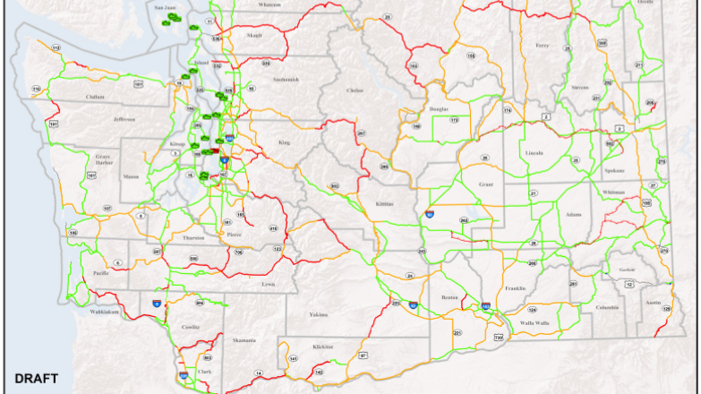
Projected Impacts:
WSDOT Infrastructure
All regions of the state include transportation infrastructure identified by WSDOT as being moderately or highly vulnerable to climate change
Transportation vulnerability to climate change is higher in certain locations:
  In the mountains
  Above or below steep slopes
  In low-lying areas subject to flooding
  Along rivers that are aggrading due to glacier melt

Slide 13
Sources
Weinhold, Bob. Climate Change and Health: A Native American Perspective. February 2010. Volume 118, Number 2. Environmental Health Perspectives, Health Disparities.
Levinson, Daniel R. Indian Health Service Hospitals: Longstanding Challenges Warrant Focused Attention to Support Quality Care. October 2016. OEI-06-14-00011. Office of the Inspector General. U.S. Department of Health and Human Services.
Melillo, Jerry M., Terese Richmond, and Gary W. Yohe, Eds. Climate Change Impacts in the United States: The Third National Climate Assessment. 2014. Doi:10.7930/J0Z31WJ2. U.S. Global Change Research Program.
Center for Disease Control. American Indian and Alaska Native Heart Disease and Stroke Fact Sheet. 2014. With the U.S. Department of Health and Human Services.
U.S. Environmental Protection Agency. Draft FY 2014-2018 EPA Strategic Plan. 19 November 2013. Public Review Draft.

Slide 14
Sources, continued
Snover, A.K., G.S. Mauger, L.C. Whitely Binder, M. Krosby, and I. Tohver. Climate Change Impacts and Adaptation in Washington State: Technical Summaries for Decision Makers. 2013. State of Knowledge Report prepared for the Washington State Department of Ecology. Climate Impacts Group, University of Washington.
Gerrard, Michael and Katrina Fischer Kuh (Eds). The Law of Adaptation to Climate Change: U.S. and Intentional Aspects. 2012. American Bar Association.
Bovarnick, Ben, Shia Polefka, and Arpita Bhattacharyya. Rising Waters, Rising Threat: How Climate Change Endangers America’s Neglected Wastewater Infrastructure. October 2014. Center for American Progress.
World Health Organization. Climate and Health Factsheet. 2014

Slide 15

Naqs spu’us kwa la ck’ram
Qweci’yewyew
lamlamt
limlmt
Amelia AM Marchand, MELP

