Slide 1
Climate Resilience for the Upper Columbia River
Climate Impacts on
River and Stream Hydrology
October 25, 2016
Stephen Smith
Notes:
Consultant these last 5-6 years for UCUT tribes, mainly focusing on the Columbia River Treaty. Not a climate change expert, Like most of you I integrate what I am learning about climate change into what I am doing to promote salmon recovery now and into the future.
Also, I want to learn from you about what climate change issues I should be aware of as I continue my work in the Columbia River Treaty and other forums.

Slide 2
Presentation Outline
Basin-wide Perspective
Layman’s Summary of the Science
Reconsideration of the Columbia River Treaty
Ecosystem & Climate Change Objectives in a Modernized Treaty
Ecosystem Options to Consider with Climate Change
Notes:
I will focus on issues related to climate change as it mostly affects the mainstem Columbia River and major tributaries.
I will provide a practitioner’s overview of what I have learned are the key expectations associated with climate change
How climate change is likely to affect river management, particularly as guided by the CR Treaty.
Provide a summary of some of the key water management issues we are working on as we look to modernize the Treaty
And looking at the Basin overall, some issues or actions that I think fisheries and water managers need to address in the face of climate change

Slide 3
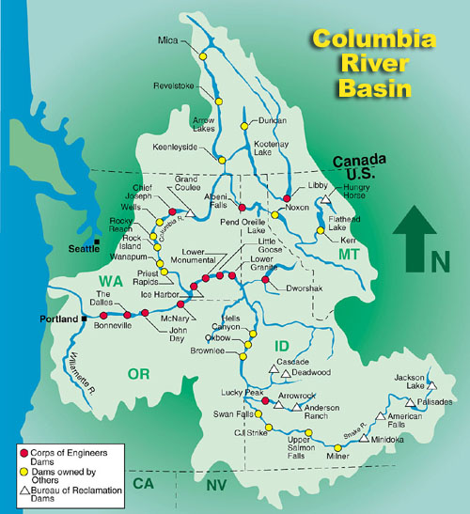
Notes:
General map of Columbia Basin dams including the CRT dams (Libby, Mica, Arrow, Duncan). Canadian dams hold about ¼ of April-August runoff on average or about 25 MAF
Grand Coulee is 5 Maf. Treaty dams doubled the overall storage capacity in the entire Basin

Slide 4
Factors Affecting Future Rivers & Resources
Wet v Dry
Snow v Rain
Warmer Air Temperatures Warmer Waters
Adapting Reservoir Operations
Notes:
For me, these are the key climate issues in simple terms. These are what will affect coordinated operations of the main river systems

Slide 5
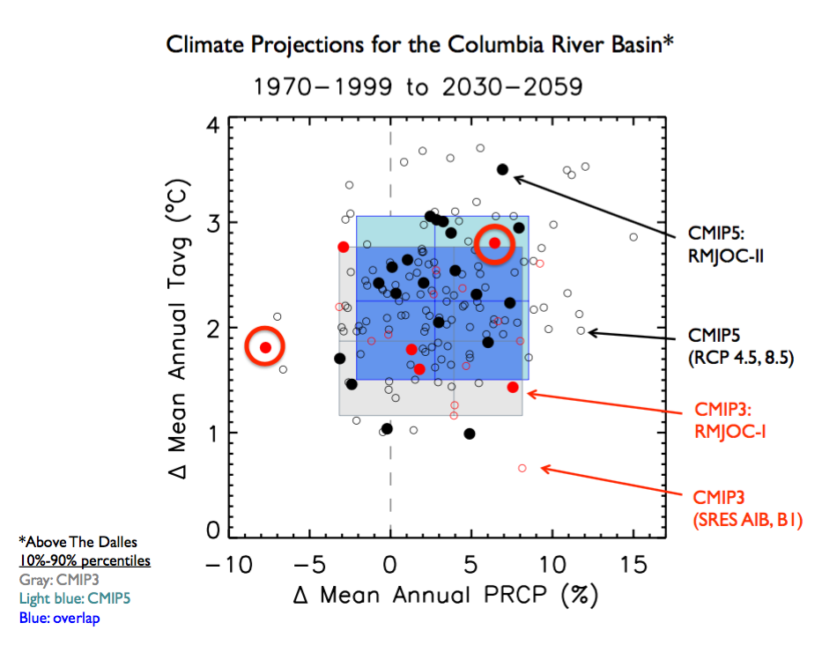
WET v. DRY
Notes:
Newest projections about climate change in the Columbia Basin, above The Dalles; indicate that temperatures will be warmer than older projections but precipitation will be about the same or slightly greater, BUT, more in winter (~+ 5% ) and less in summer (~ -5%).

Slide 6
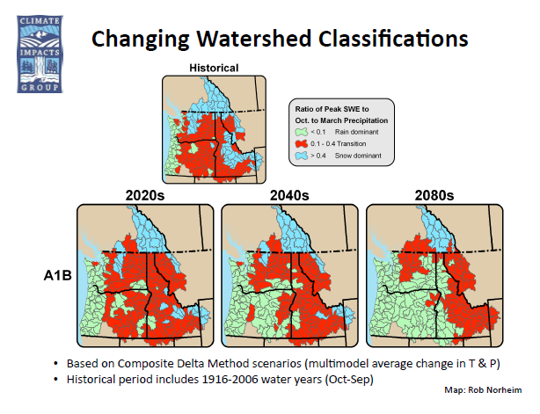
SNOW v. RAIN
Climate models concur that Canada will remain snow dominated while the U.S. portion of the basin will change from transient to rain dominant, no matter which precipitation projection is chosen
Notes:
6
6
Illustration of changes from snow areas to rain areas- by 2100 even glaciers in Canada may be gone. We can expect increased droughts – frequency, duration and intensity.
With a 5F increase in average temperature, the average snow level raises 1,800’. Oregon Cascades and most of Washington lose 100% of their April 1 snowpack water equivalency.

Slide 7
WARMER AIR TEMPERATURES Difference from 1950-1999 average (from Rupp 2014)
Notes:
Darker lines show the multi-model mean for each representative concentration pathway (RCP)- a combination of carbon, aerosols and other emissions.
. We are currently on the RCP 8.5 path- if we do not reduce emissions we will be at a no-return point in 15-20 years.
Different assumptions and model runs give different projections, but they show a 5F increase by 2050. After 2050, the model projects diverge; likely a +10 F average temperature by 2100
Dashed line is the average for the last half of the 20th century. Note that by 2030, annual temperature will always be above what we’ve grown accustomed to.

Slide 8
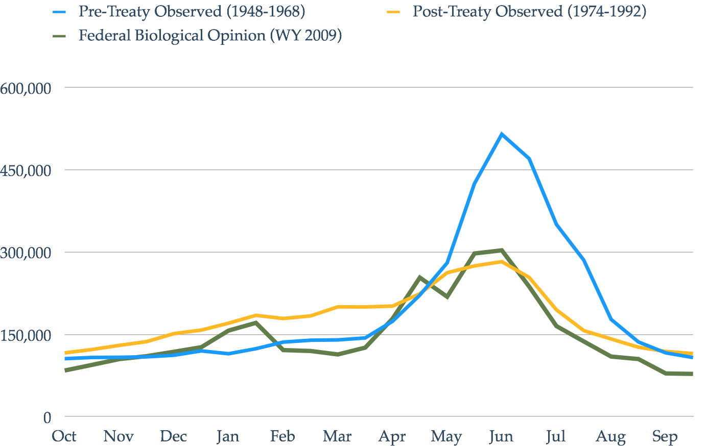
ADAPTING RESERVOIR OPERATIONS
Notes:
U.S. and Canadian reservoirs operated for flood control and power generation store the spring/summer freshet for release in the fall and winter months. The current rules for how reservoirs operate will not work in a future with climate change
Climate change models will show much higher winter flows from rain; a 1 month earlier spring freshet peak; the size of that peak is highly variable.
With warmer winters and higher flows, power interests won’t be looking to shift the natural hydrograph as much to winter time. Also big changes in the electricity sector, they will likely want to generate less firm energy and more capacity of daily peak energy so they will want to keep reservoirs fuller – this too leads to more spring freshet flows.
Flood control operations will be highly uncertain. We expect double peaks in flows – winter rain and spring snow melt
Flows should be available for refreshing wetlands and floodplains – any maybe more so as with more rain, less predictability and control by reservoirs.
Will show some options for future reservoir operations to better integrate fish and wildlife and adapt to climate change.

Slide 9
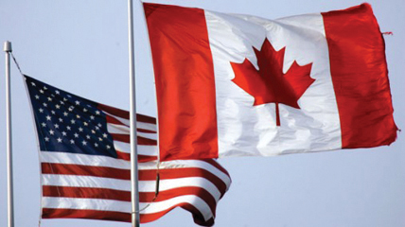
Columbia River Treaty
Ratified in 1964
4 Reservoirs Built – storing 25 MAF
2 Purposes: reduce flooding and maximize hydropower generation
No consideration of Ecosystem function
Key flood control provisions expire in 2024
U.S. now seeking to modernize the Treaty
Notes:
Coulee is 5 Maf

Slide 10
Columbia River Treaty
December 2013 Regional Recommendation
Integrate Ecosystem Function as third primary purpose
Create a dry water year strategy
More flexibility for climate change
Study fish passage back into Canada
U.S. Department of State
October 7, 2016: Approved Negotiating Position
Contents are guided by Regional Recommendation, but content is classified
Notes:
Locally, we have little affect on world climate change; wet v dry, snow v rain. But, we can affect how we operate reservoirs and manage our water. And we can affect how we manage our floodplains in anticipation of climate change.
Less predictable melting snowpack and now we will be subject to the “Atmospheric River”

Slide 11
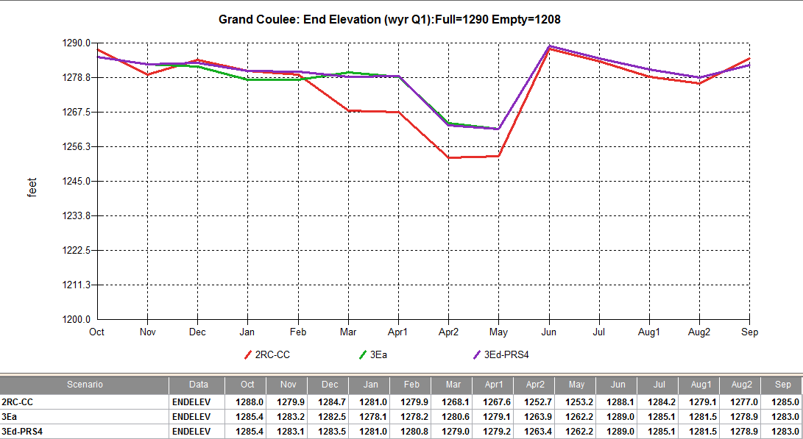
Ecosystem Operations in Dry Years
Notes:
Under Reconsideration of the Columbia River Treaty, what are ecosystem interests wanting to have considered? A few important examples.
Grand Coulee in drier water years – draft less. This will then require less refill in the spring thereby allowing more water for the freshet. Also better conditions for resident fish. Similarly less draft in the 20-40% driest water years. We are looking to do this at as many reservoirs as possible. This also ensures more refill going into dry summer and falls; so more water for later flow releases and water supply.
In the forecasted higher water years, we still allow Coulee to draft deep to avoid serious flood damages – We still get high flows and refill.

Slide 12
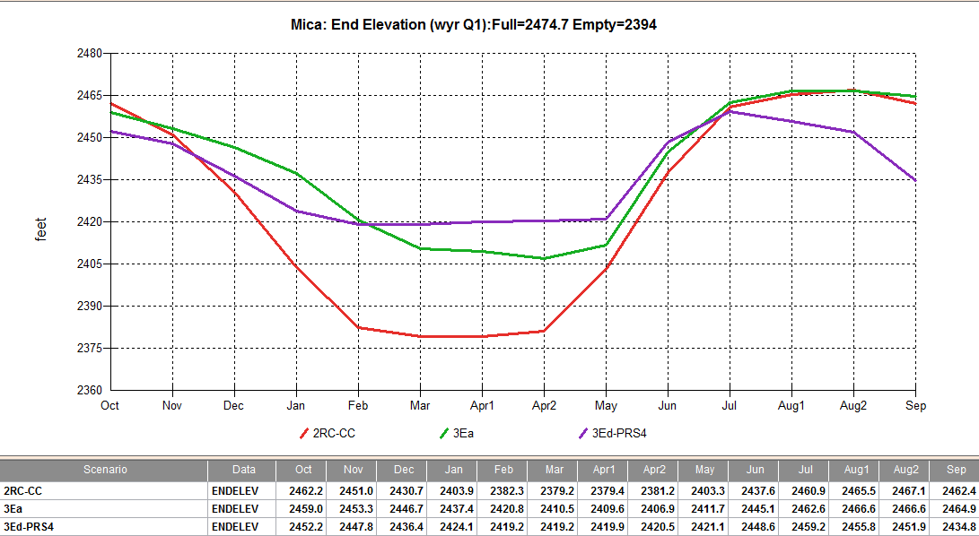
Ecosystem Operations in Dry Years
Notes:
At Mica – also looking for them to delay their deep drafts until they can be guided by runoff forecasts. This will ensure more water flowing down stream in the freshet period and more storage for summer/fall release

Slide 13
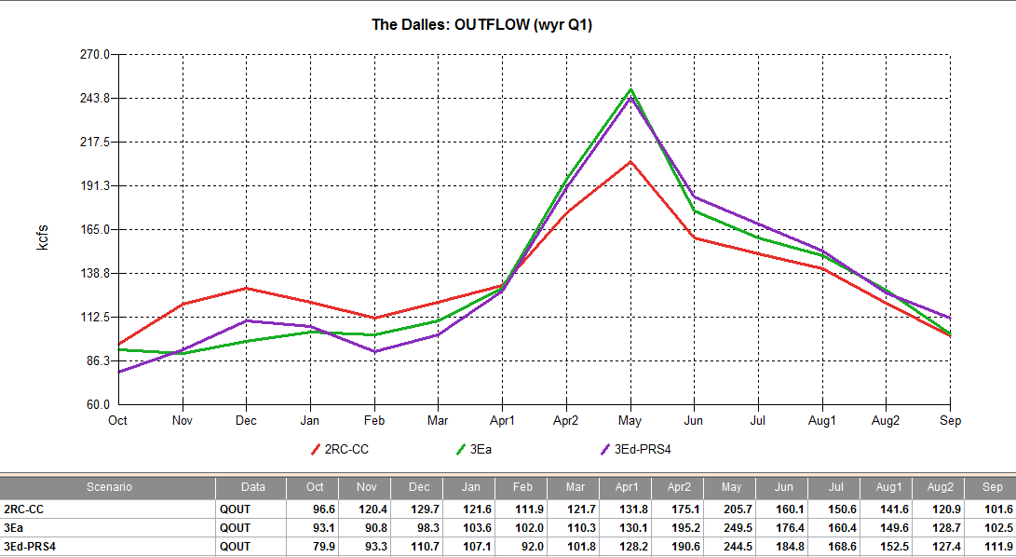
Ecosystem Operations in Dry Years
Notes:
Looking to partially restore the spring/summer freshet in the mainstem Columbia River and major, managed tributaries – particularly in the drier water years when flows most beneficial and least amount of conflict with Flood Control and power operations and marketing

Slide 14
Options We Must Consider
Alternative fishways
Deeper, cooler water into our fishways v. warmer, surface waters.
Accelerate research on the Whooshh “Salmon Cannon”
Protect our cooler waters
Reserve more reservoir water for dry years; delay fall and early winter drafting
Withdraw warmer, not cooler waters for irrigation
i.e. Lake Roosevelt to Banks Lake
Notes:
In 2015, fish ladders fed by surface waters were shown to hinder or block salmon migration; huge sockeye losses. Need to ready contingency actions as have been implemented in the Snake River to feed fishways with deeper, cooler waters rather than surface waters.
Need to accelerate investigations of the Whooshh system to determine if the salmon cannon is not only a good technology for passing fish at high head dams, but also at lower head dams to potentially avoid temperature blocks and perhaps pass fish with less metabolic energy which may be important in future warmer waters.
We need to alter our flood risk management operations to rely less on reservoir drafting in the drier water years to not only ensure more water for summer usage, but also store more cooler waters where we can.
Management needs to focus not only on water quantity, but water quality in all operations. Cool water will become an asset and will need to be treated accordingly. Need to protect and apply cool waters to their highest priority – likely not for irrigation. What might be gained by altering the pumping depth for the Banks Lake operation? 5,000 – 7,000 cfs? 3 Maf

Slide 15
Options We Must Consider
Revise our Flood Control Operations
Don’t draft so much in drier water years
Rely more on flood plain management, strategic levees
Structural changes to Dam
Temperature selection facilities
Permanently fix the spill gates at Grand Coulee
2.5 Maf above 1255’
Notes:
We have already learned that the COE does not need to draft reservoirs as much in the drier water years.. For the less than average waters years, the region needs to consider a flood risk management strategy that relies less on reservoirs, coupled with flood plain management, including inundations of wetlands, and bolstering of key levees where needed to protect valuable lands.
Need to study the pros and cons of temperature control facilities at key storage dams to determine ecosystem benefits and costs in the reservoirs and downstream.
A clear need is the redesign of spill gates at Grand Coulee that puts 2.5 Maf of storage capacity at risk – refill take away from the freshet that we are trying to restore.

Slide 16
Options We Must Consider
Reconnect salmon to historical, cooler habitats
U.S. and Canadian dams in upper Columbia River where cooler, snow-melt streams will survive
Counter potential loss of Basin’s southern habitats
Willamette Basin, Oregon: get salmon to higher elevation, cooler waters
Expand reservoir rearing of juvenile salmon
Investigate production potential of cooler reservoir waters before we lose stream production to low, warm summer & fall flows.
Notes:
As we saw in the SNOW v RAIN slide, traditional salmonid spawning and rearing waters may be available in very limited locations throughout the Columbia River Basin, except in the areas above Grand Coulee Dam. We need to reconnect – the sooner the better.
The Willamette Basin is not expected to have any late season snow. Salmon runs there may depend on the cooler waters at higher elevation coupled with reservoir rearing as summer stream flows decline.
We already have knowledge that lake or reservoir rearing of salmon can significantly increase the productivity of populations. In Willamette studies, they are reporting that 90% of returning adult spring Chinook originating from above a dam, reared in the reservoir and not the stream feeding the reservoir. Coastal populations of Oregon coho salmon have been most productive in those systems with natural lakes for rearing.

Slide 17
Options We Must Consider
Strategic reservoir operations in dry water years
i.e. 1’ draft of Albeni Falls increase Pend Oreille flows by 1,000 cfs.
i.e. Libby draft reduced 4’
UCR reservoir water for temperature refugia
Possible temperature refuge in mid-Columbia
Low temperatures won’t reach the lower Columbia
Likely too many mainstem dams slowing and warming upper basin waters.
Notes:
Need to investigate and consider new uses of reservoirs to aid stream flows in the drier or warmer years. In CR Treaty investigations, we have looked at supplementing Pend Oreille flows in the driest water years and increasing Kootenai River flows by drafting Libby, Lake Kooscanusa less. Are their other considerations that we should be modeling??
Releases of cooler reservoir waters to cool downstream rivers needs to be fully studied – but carefully. Must consider the ecosystem benefits of that cooler water in the reservoir for rearing resident fish and perhaps juvenile salmon versus what it might OR MIGHT NOT accomplish downriver. And of course, there is always the issue of whose resources are being helped or hurt.

Slide 18
Context We Must Consider
Sea level rise of 0.3 to 1.7 meters by 2100; tipping point at about a 1 meter rise
Reduces Columbia River plume out into the ocean – important for juvenile survival
May increase juvenile salmon habitat in lower river
At 1.7 meters, there will be salt water in Portland.
“Floodplain is not the land next to the river, it is the river, just at higher flows” Dr. Stan Gregory, OSU
Notes:
For anadromous fish management the ocean and estuary changes will be critical.
Stan Gregory’s quote: opens ones eyes to future floodplain management.

Slide 19
Summary
Modernize Columbia River System
for Climate Change Resilience
Modify river operations to reshape available storage: maintain/enhance spring peak- more significant in dry to average runoff years-keep reservoirs full/stable
Modify flood risk by reestablishing flood plains and improved monitoring/forecasting and modernize reservoir flood rule curves
Implement structural changes at dams to promote ecosystem function
Implement fish passage to cooler basin watersheds

Slide 20
THANK YOU
Notes:
I would be pleased to try an answer any questions and take ideas for consideration in the CR Treaty process – now or later.

