Slide 1
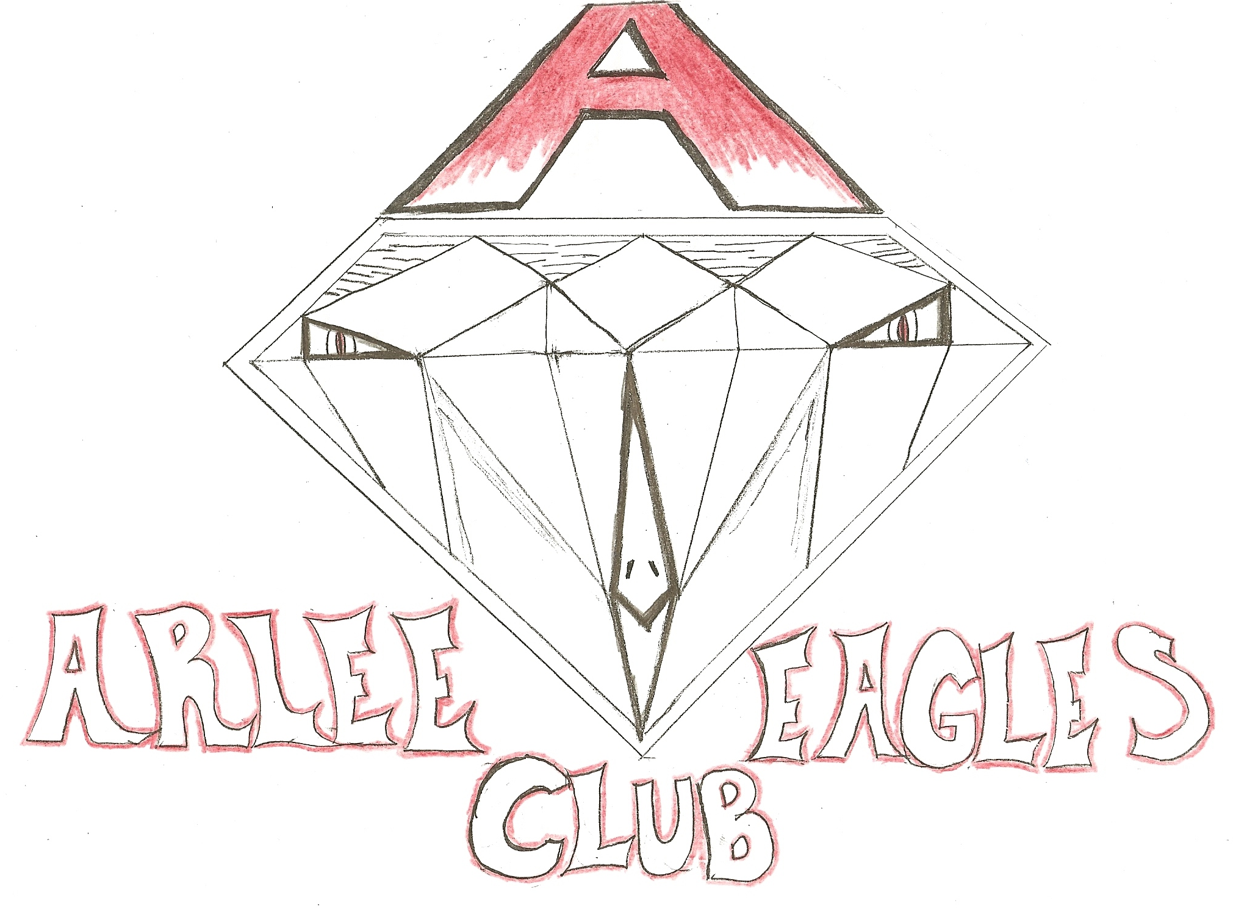
Presented to you by: Alyce Corcoran, Leondre Bolen, Colt Brazill, Bryeanna Brazill, Brian Baker, & Jasmine Dobson

Slide 2
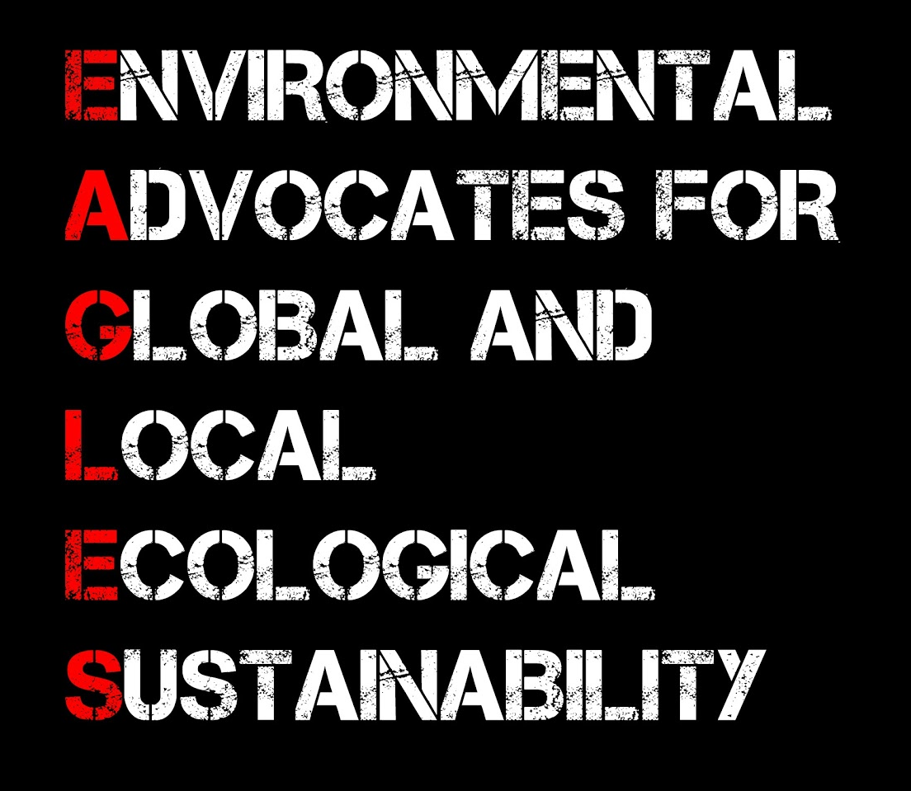
Who We Are
Arlee Eagles Club is a family of 35 students, 3 teachers, and many community members!
We care for our environment by:
1) Recycling paper, plastic, aluminum, and cardboard from our school and community.
2) Encourage the teaching staff to reduce energy use in the school.
3) Teach younger students about the importance of recycling & reducing our waste.

Slide 3
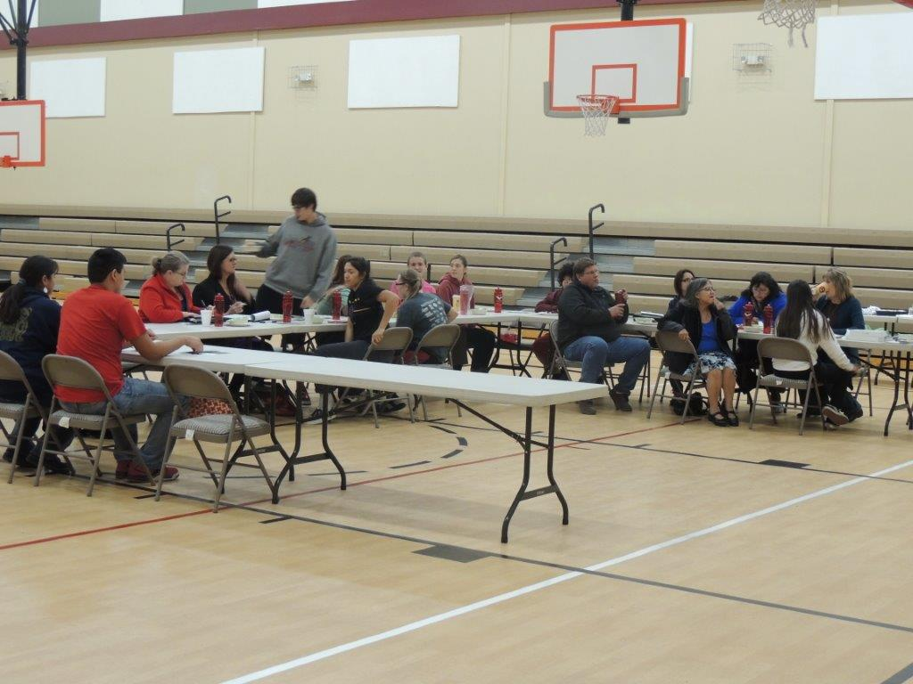
Accomplishments
Starting a Club for Environmentally Passionate Students -
Thank you to Mike Durglo, Rene Dubay, Mrs. White, Ms. Wright,
and all EAGLES club students for their efforts.

Slide 4
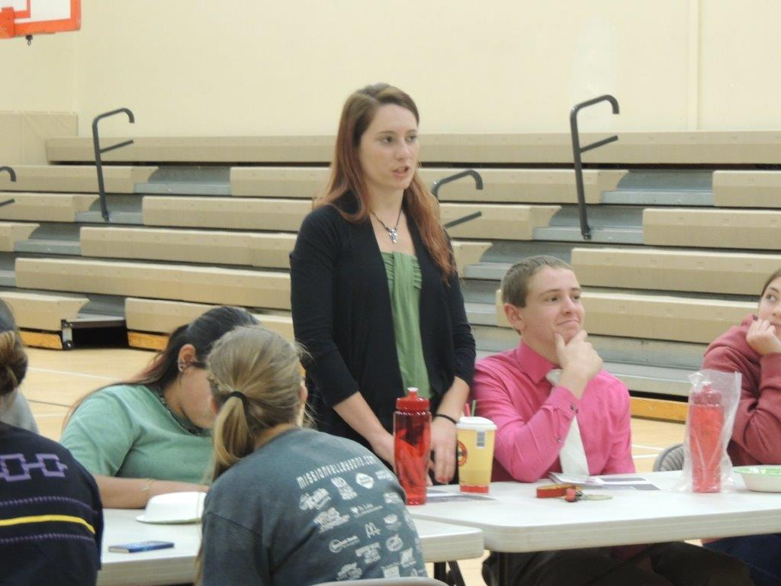
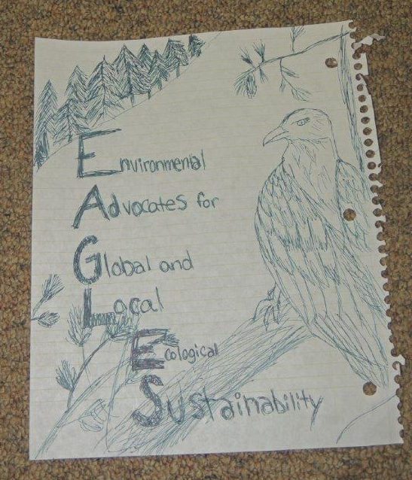
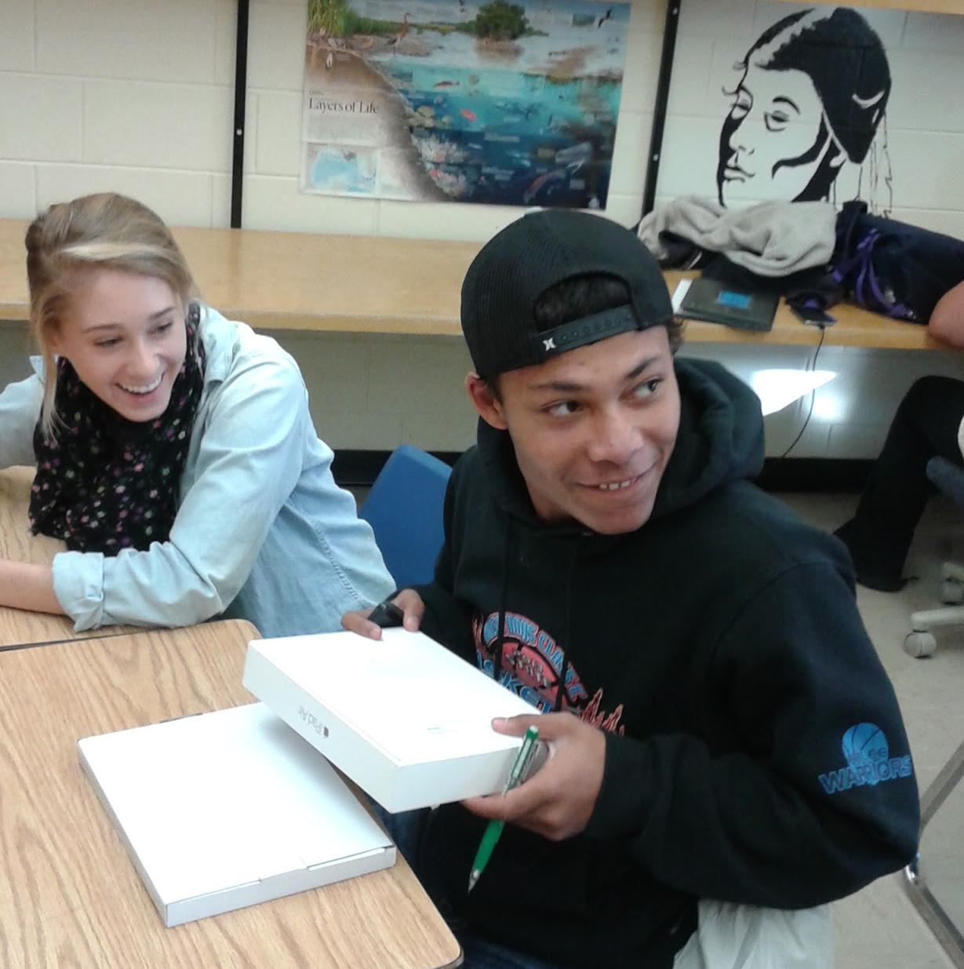
Accomplishments
2) Community Involvement - Introduction, Obtaining Local Business Owners Permission to Recycle, Logo Design voting and awards.

Slide 5




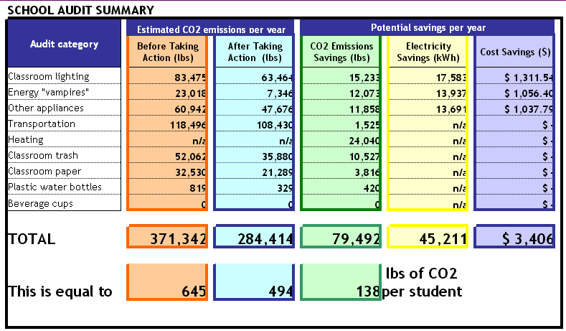
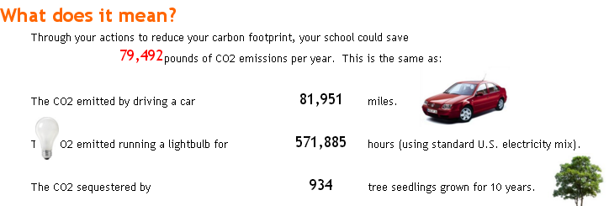
Accomplishments
3) SMART Schools Energy, Green, & Recycling Challenge

Slide 6

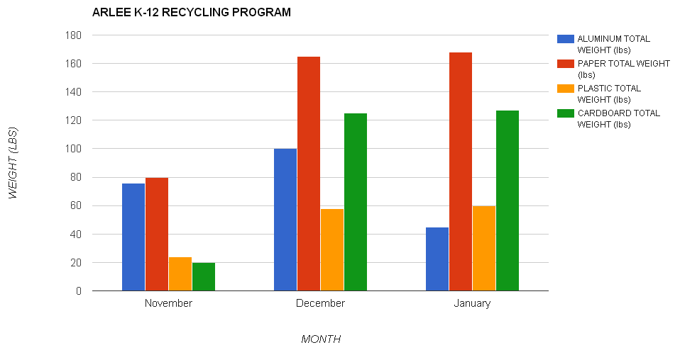
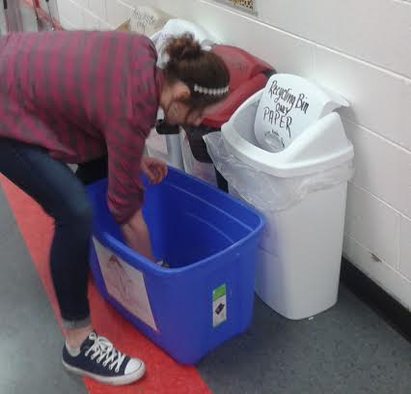
Accomplishments
4) Recycling and Education to Youth

Slide 7
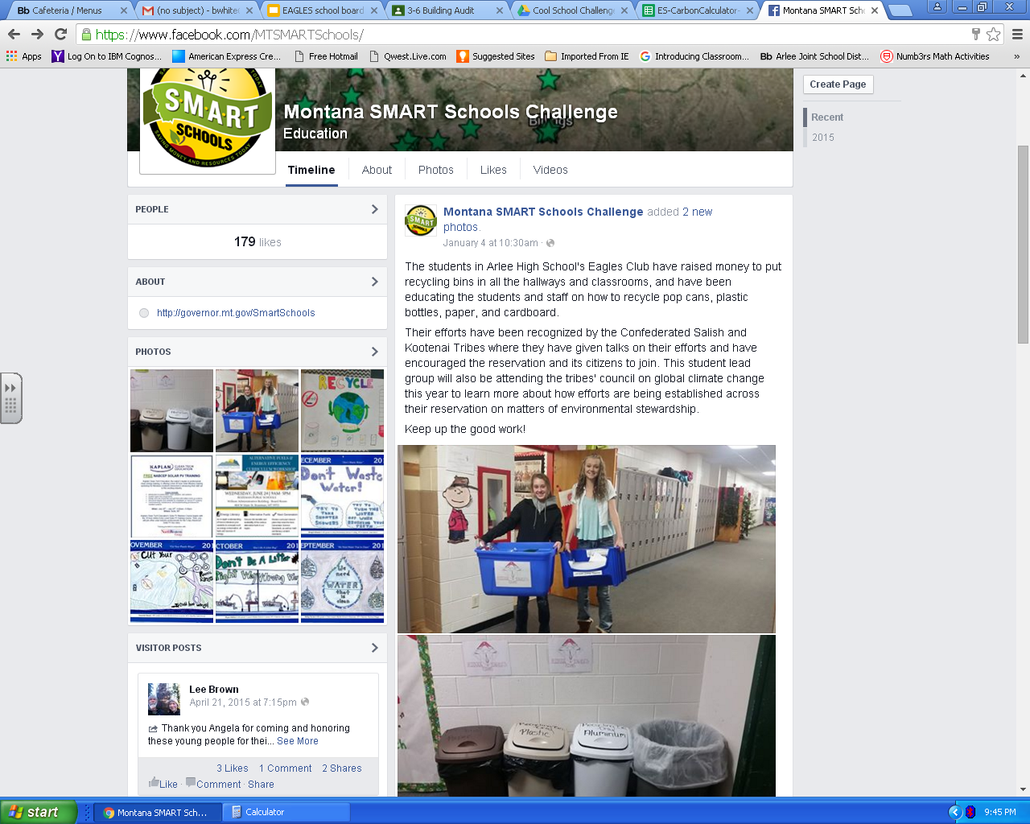
Accomplishments
5) Recognized by Montana’s SMART Schools Challenge

Slide 8
Plans for the Future
Increase recycling and energy saving efforts in the Arlee community and schools by creating challenges and incentives.
Create open forums with other EAGLES clubs in various schools to discuss current environmental topics and future solutions.
Present these findings to Arlee School Board in February to encourage more recycling and energy efficient methods and building upgrades.
Help build community gardens in Arlee with the help of Mike Durglo and Shelly Fyant.

