Slide 1
Planning for Connectivity: An approach for mitigating habitat loss, land use change, & climate change
Tabitha Graves
Research Ecologist, USGS

Slide 2
My academic ‘family’ Connections to connectivity
Chris Servheen (M.Sc. Advisor)
John Waller (also student of Chris)
Paul Beier (Ph.D. Advisor)
Brad McRae (also student of Paul)
Brett Dickson (committee member, Smith Fellow)
Dave Theobald (Smith Fellow- postdoc)

Slide 3
Why connectivity is important
‘Increases’ population size (if very small isolated populations mix enough)
Increases genetic diversity (continuous populations)
Allows re-establishment of animals (if metapopulation- subpopulations can blink out)
If disease/ invasives important (may be increased by climate change), may want to reduce connectivity
Thus, important to both understand and to ‘quantify’ factors influencing it, so can best manage land/ populations/ processes.

Slide 4
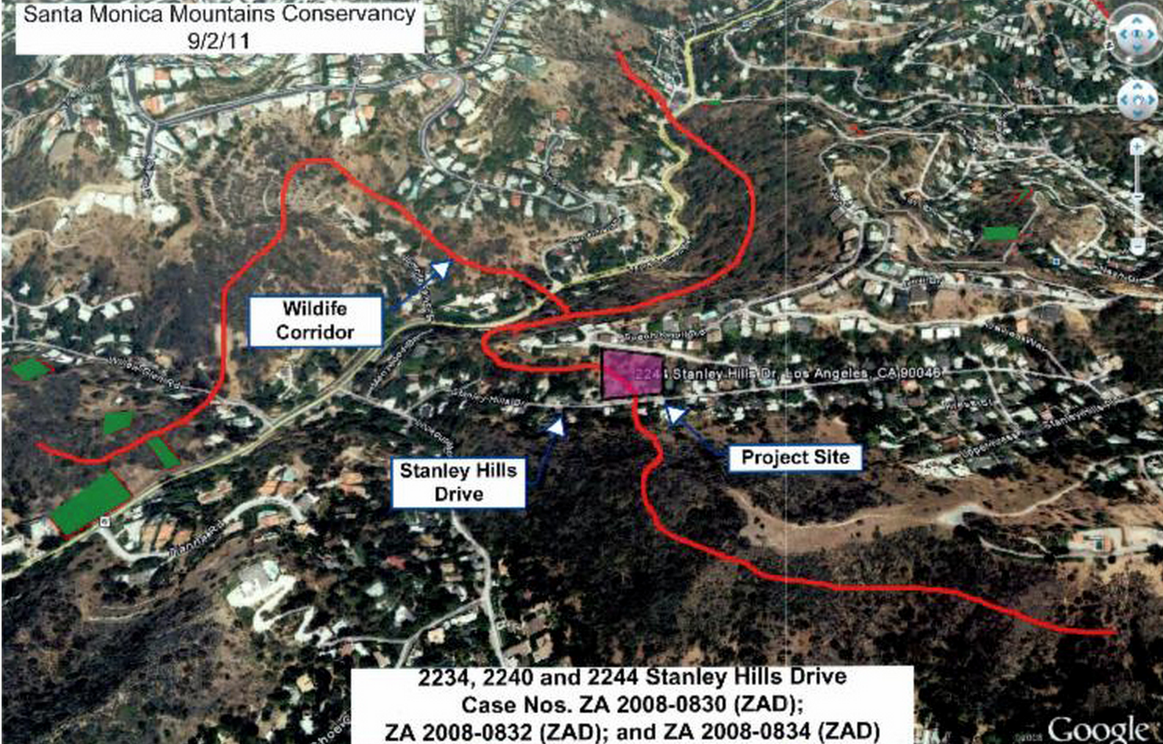
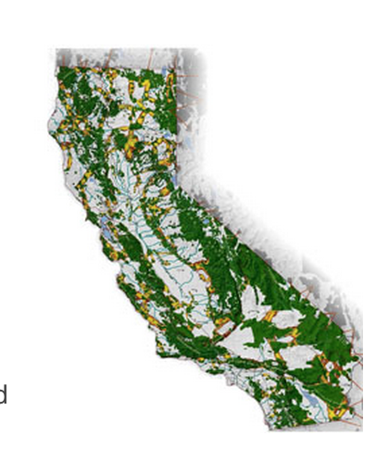
History
As learned about effect of habitat loss and fragmentation, realized this is an area where land use management could positively influence outcomes
As development has increased, becoming more important
With climate change, connectivity seen as a factor that may increase resiliency, allow species to move as their habitat moves
Notes:
Picture of California (huge influence) or other local example?
WANT TO DO something– and need to do something.
Perhaps use Forman as an exmple – Europe more heavily populated – roads…

Slide 5
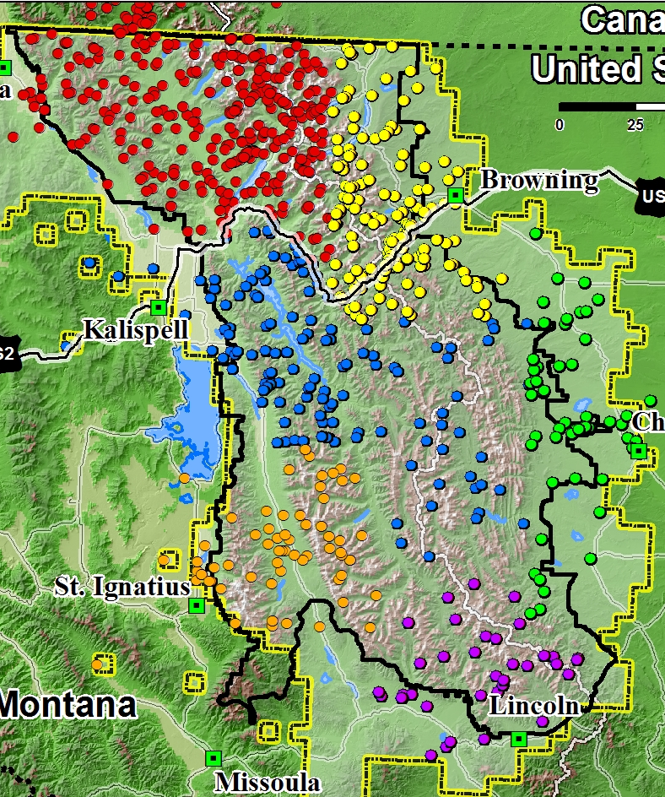
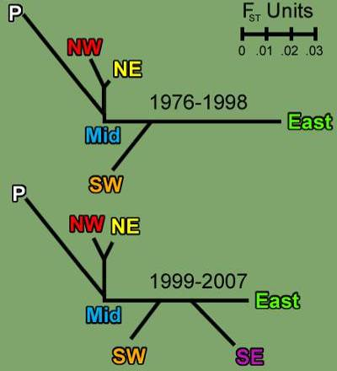
Grizzly Bear project
Is connectivity important? YES
Figures adapted from Kendall et al. 2009

Slide 6
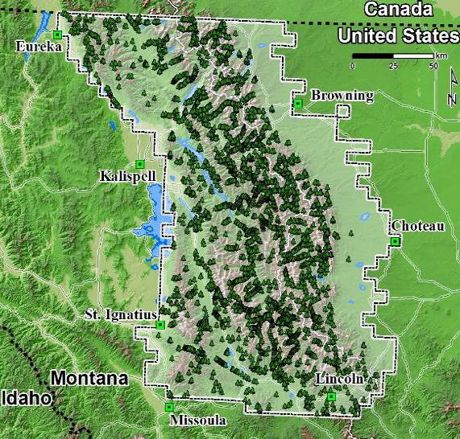
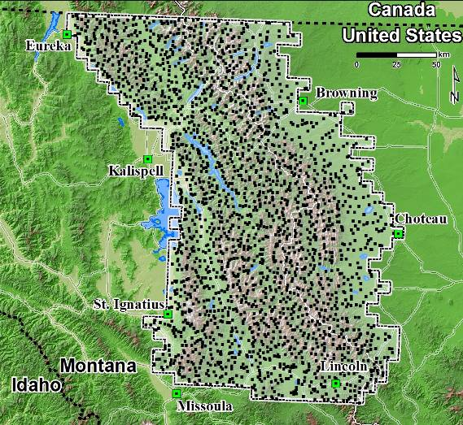
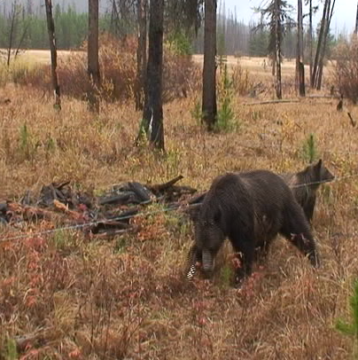
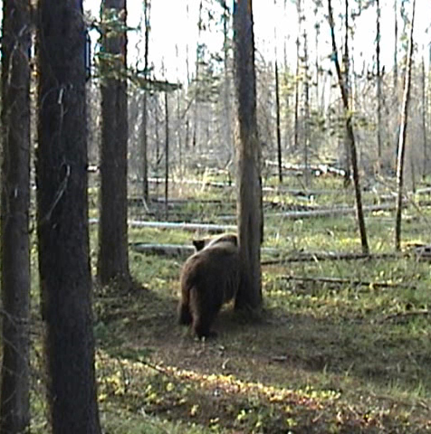
Genetic sample data collection 1998-2000(GNP), 2004,2009-2012
Photo: Kate Kendall
Photo: Amy Macleod
Notes:
Sampled across ecosystem

Slide 7
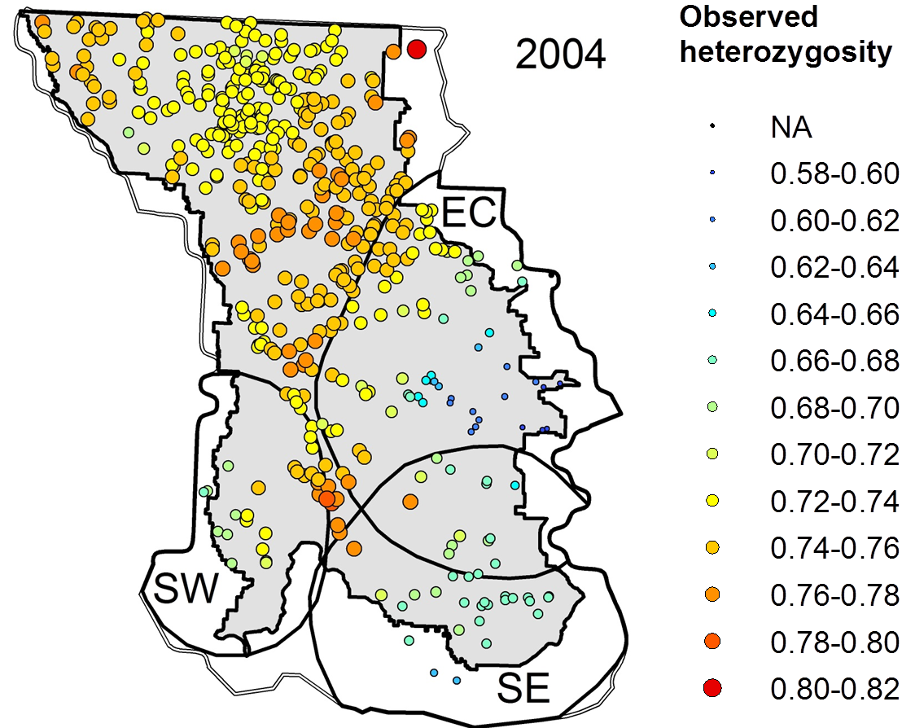
Spatial genetic diversity in 2004
Mikle et al. 2016

Slide 8
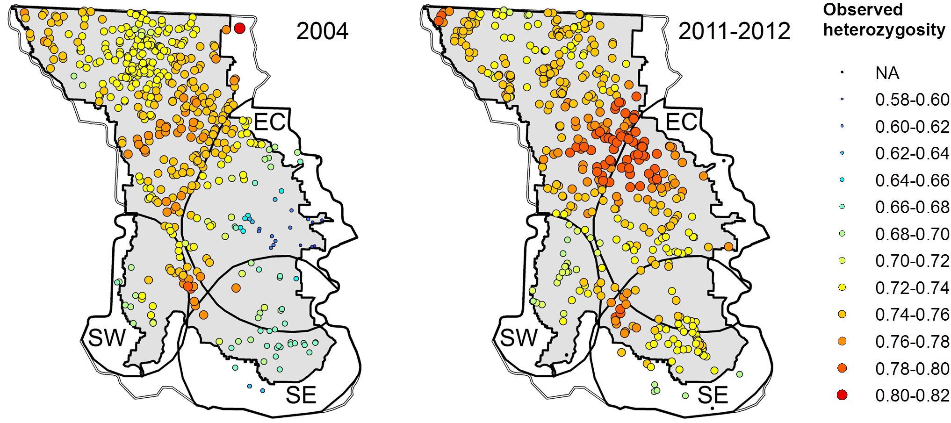
Diversity rapidly increases across time
Ho= 0.69
Ar= 6.75
n= 98
Ho= 0.76*
Ar= 6.84
n= 120
Ho= 0.70
Ar= 5.27
n= 28
Ho= 0.70
Ar= 5.40
n= 32
Ho= 0.67
Ar= 5.83
n= 45
Ho= 0.73*
Ar= 5.90
n= 72
Mikle et al. 2016
Preliminary Data- Do Not Cite
Notes:
Keep in mind, this is less than 1 generation- extremely quick, not genetic drift

Slide 9
Why? Family tree of grizzly bears showed that:
Lower diversity in 2004 resulted from a few highly reproductive individuals (1 male had 101 descendants, another 63 descendants)
Migration into areas (especially from long distances) and subsequent offspring with residents rapidly increased genetic diversity
Mikle et al. 2016

Slide 10
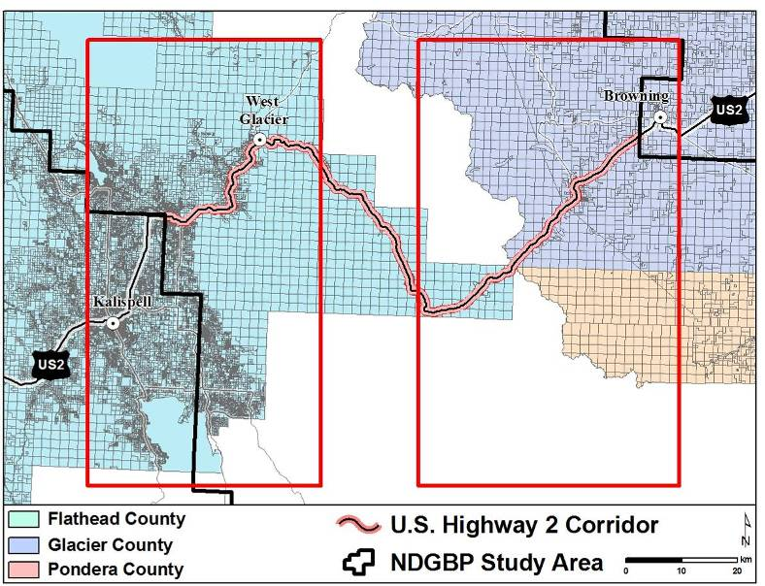
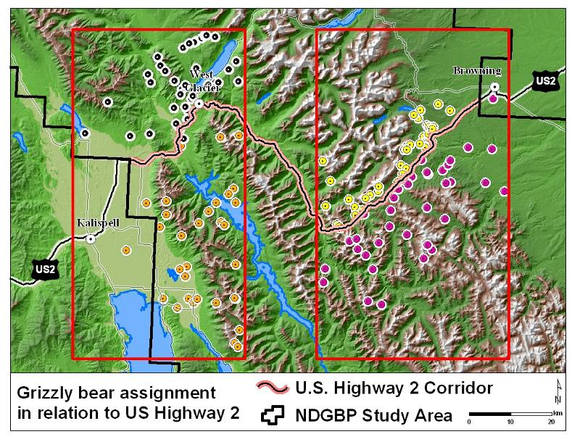
Connectivity
Primary highway and rail line in study area
Kendall et al. 2009
Notes:
Assignment tests to determine gene flow across a potential barrier

Slide 11
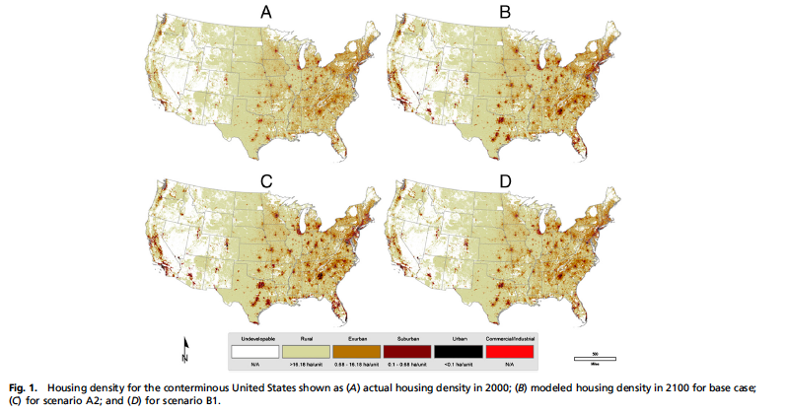
Notes:
Bierwagen et al 2010

Slide 12
ELK/ deer /Pronghorn/ sheep
Collisions very costly
Some mitigations ‘pay ‘ for themselves
Important tradeoffs if migration is impeded (forage, survival, etc.)

Slide 13
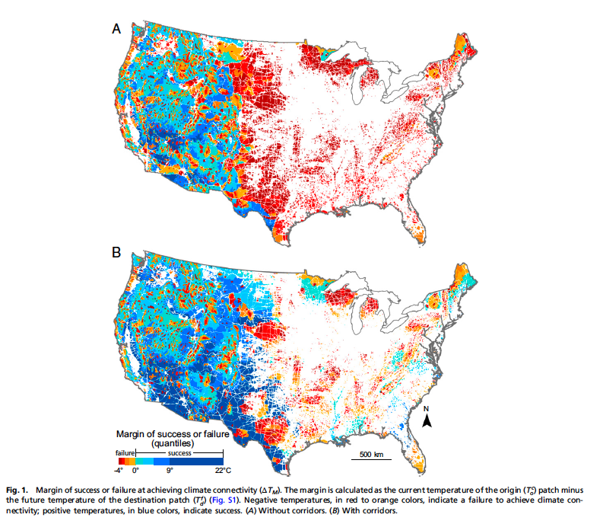
Adding climate projections Highlights Need for action to achieve climate connectivity
McGuire et al. 2016
Only 41% of natural land area retains enough connectivity to allow plants and animals to move with increasing temperatures
Without corridors
Adding corridors increases to 65%, with big impacts in low elevation regions and southeastern US
With corridors

Slide 14
Attaining connectivity
Land conservation/ easements
Removal of barriers
Fences
Highway crossings

Slide 15
Example: Highway
A few years post-construction being used extensively by most animals
Different animals preferred different characteristics (e.g. open view, closed culvert, sizes)
Sometimes can modify existing culverts for small animals (e.g. Foresman et al. - grates allowing animals to stay above water)
DOTs in many states open to this – good examples include AZ, MT
Highway DOT funding
External input

Slide 16
Definitions
Structural connectivity: Mostly continuous vegetation or protected lands (e.g., no roads) that we can see/map
Functional connectivity: An animal, plant, or process (e.g. fire) of interest uses the connection with characteristics that may be defined based on things can see or other characteristics (e.g. low human use). This is specific to a conservation target.
Notes:
Add pictures.

Slide 17

Conservation Target | Advantages | Disadvantages
Individual species or process of high importance | Robust science to support decisions. | Time-consuming/costly.
Functional groups: e.g., aquatic species, meadow specialist, forest specialist, human-tolerant, edge specialist, disturbance-intolerant | Cover more species/processes. If use actual species to represent group, most likely to connect at least those species. | Still somewhat time-consuming/costly.
Structural patterns: e.g., vegetation type; human modification | Relatively fast, cheap. Useful coarse filter. | High uncertainty as to connection of particular species/processes.
Land facets: i.e., connect similar topographic characteristics | Relatively fast, cheap. Topography unlikely to change quickly (potentially buffers corridor from climate effects). | High uncertainty as to connection of particular species/processes.
Notes:
Might do this as several slides so as not to overwhelm…
An individual species of high importance
Functional groups (aquatic, meadow-specialist, forest-specialist), sometimes with a species representing that group (somewhat aligned with structural connectivity approaches)
Broad ecosystem or vegetation types (very aligned with structural connectivity idea)
Land facets (similarity in topography or other characteristics that are unlikely to change in the range of decades even with climate change)

Slide 18
Conservation Target | Advantages | Disadvantages
Individual species or process | Robust science to support decisions. | Time-consuming/costly.
Functional groups: e.g., aquatic species, meadow specialist, forest specialist, human-tolerant, edge specialist, disturbance-intolerant | Cover more species/processes. If use actual species to represent group, most likely to connect at least those species. | Still somewhat time-consuming/costly.
Structural patterns: e.g., vegetation type; human modification | Relatively fast, cheap. Useful coarse filter. | High uncertainty as to connection of particular species/processes.
Land facets: i.e., connect similar topographic characteristics | Relatively fast, cheap. Topography unlikely to change quickly (potentially buffers corridor from climate effects). | High uncertainty as to connection of particular species/processes.
Notes:
Might do this as several slides so as not to overwhelm…
An individual species of high importance
Functional groups (aquatic, meadow-specialist, forest-specialist), sometimes with a species representing that group (somewhat aligned with structural connectivity approaches)
Broad ecosystem or vegetation types (very aligned with structural connectivity idea)
Land facets (similarity in topography or other characteristics that are unlikely to change in the range of decades even with climate change)

Slide 19
Conservation Target | Advantages | Disadvantages
Individual species or process | Robust science to support decisions. | Time-consuming/costly.
Functional groups: e.g., aquatic species, meadow specialist, forest specialist, human-tolerant, edge specialist, disturbance-intolerant | Cover more species/processes. If use actual species to represent group, most likely to connect at least those species. | Still somewhat time-consuming/costly.
Structural patterns: e.g., vegetation type; human modification | Relatively fast, cheap. Useful coarse filter. | High uncertainty as to connection of particular species/processes.
Land facets: i.e., connect similar topographic characteristics | Relatively fast, cheap. Topography unlikely to change quickly (potentially buffers corridor from climate effects). | High uncertainty as to connection of particular species/processes.
Notes:
Might do this as several slides so as not to overwhelm…
An individual species of high importance
Functional groups (aquatic, meadow-specialist, forest-specialist), sometimes with a species representing that group (somewhat aligned with structural connectivity approaches)
Broad ecosystem or vegetation types (very aligned with structural connectivity idea)
Land facets (similarity in topography or other characteristics that are unlikely to change in the range of decades even with climate change)

Slide 20
Conservation Target | Advantages | Disadvantages
Individual species or process | Robust science to support decisions. | Time-consuming/costly.
Functional groups: e.g., aquatic species, meadow specialist, forest specialist, human-tolerant, edge specialist, disturbance-intolerant | Cover more species/processes. If use actual species to represent group, most likely to connect at least those species. | Still somewhat time-consuming/costly.
Structural patterns: e.g., vegetation type; human modification | Relatively fast, cheap. Useful coarse filter. | High uncertainty as to connection of particular species/processes.
Land facets: i.e., connect similar topographic characteristics | Relatively fast, cheap. Topography unlikely to change quickly (potentially buffers corridor from climate effects). | High uncertainty as to connection of particular species/processes.
Notes:
Might do this as several slides so as not to overwhelm…
An individual species of high importance
Functional groups (aquatic, meadow-specialist, forest-specialist), sometimes with a species representing that group (somewhat aligned with structural connectivity approaches)
Broad ecosystem or vegetation types (very aligned with structural connectivity idea)
Land facets (similarity in topography or other characteristics that are unlikely to change in the range of decades even with climate change)

Slide 21
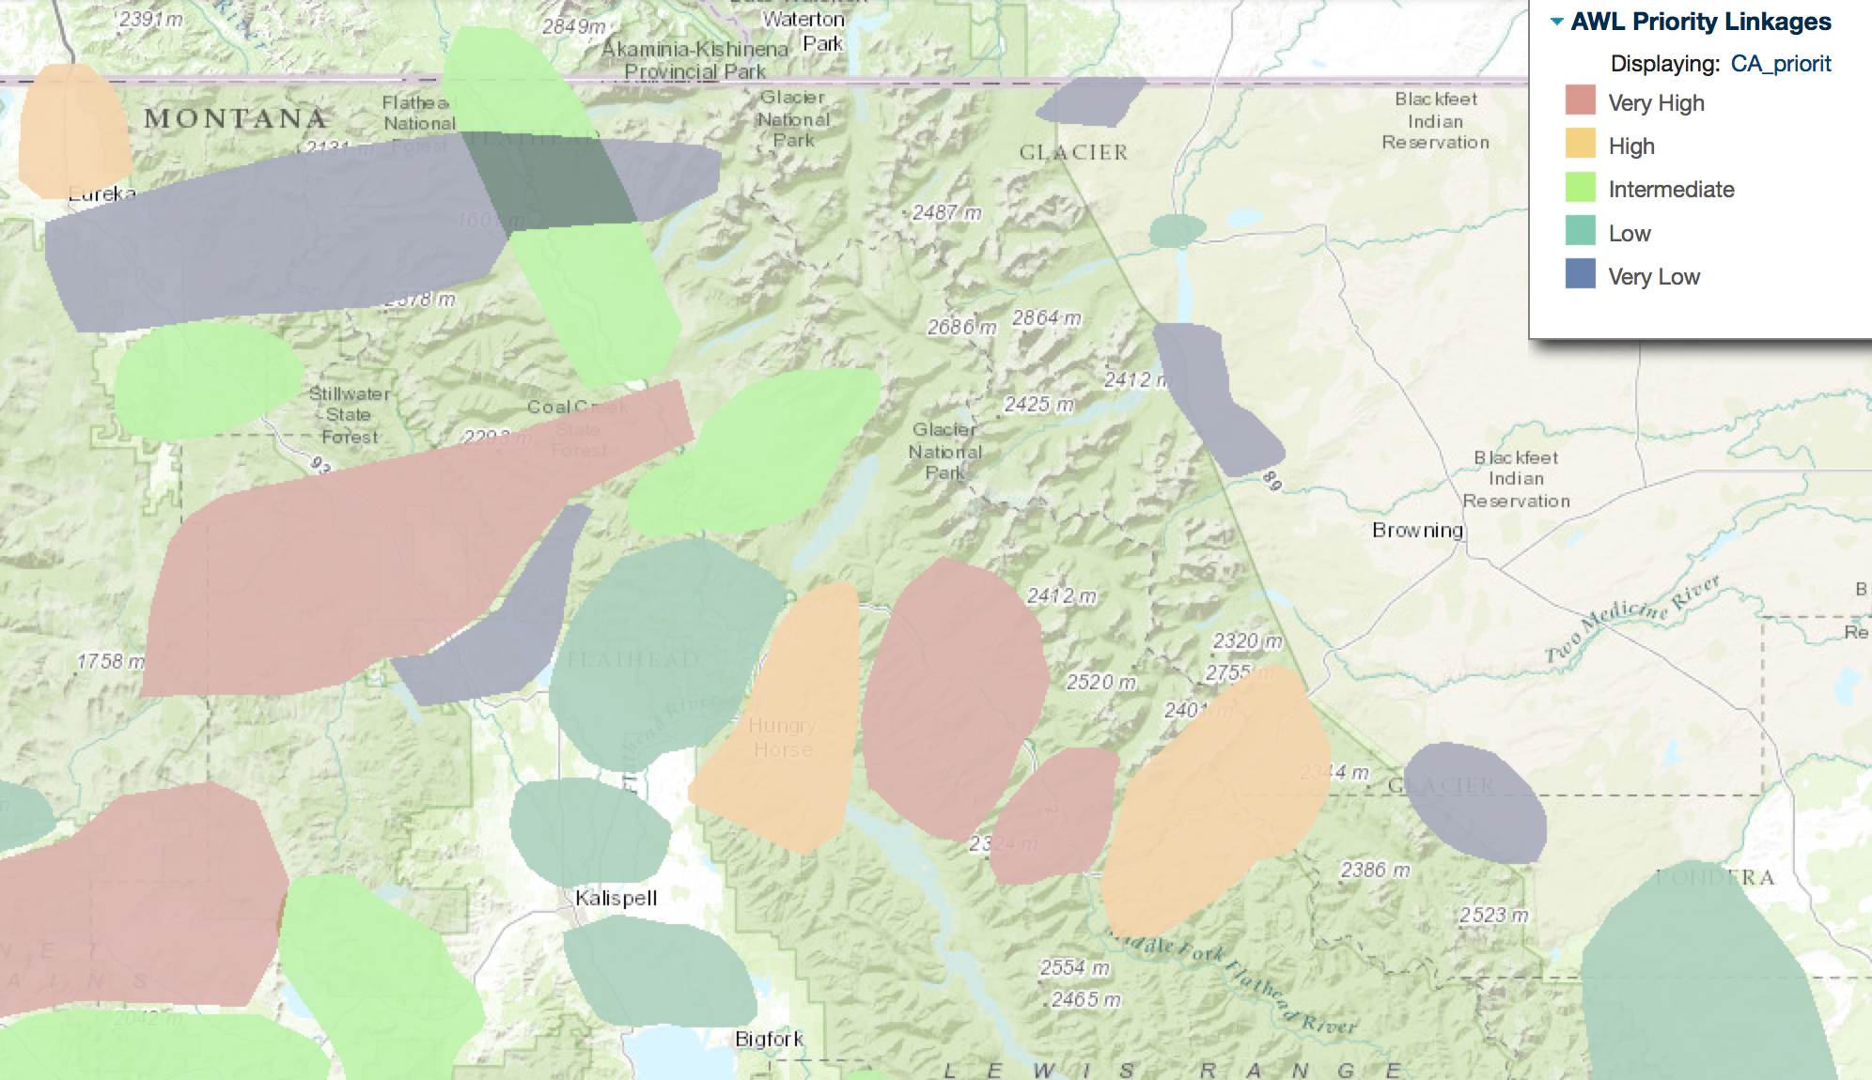
Conserving connectivity
Possible to create corridors that connect populations of animals
Broad-scale/regional level often involves identifying general areas where connectivity is important- big circles, polygons, large arrows
At the finer scale, when want to manage land use, many approaches but all share an underlying cost, or resistance surface.
Notes:
Add example of these from databasin? American Wildlands? Other?

Slide 22
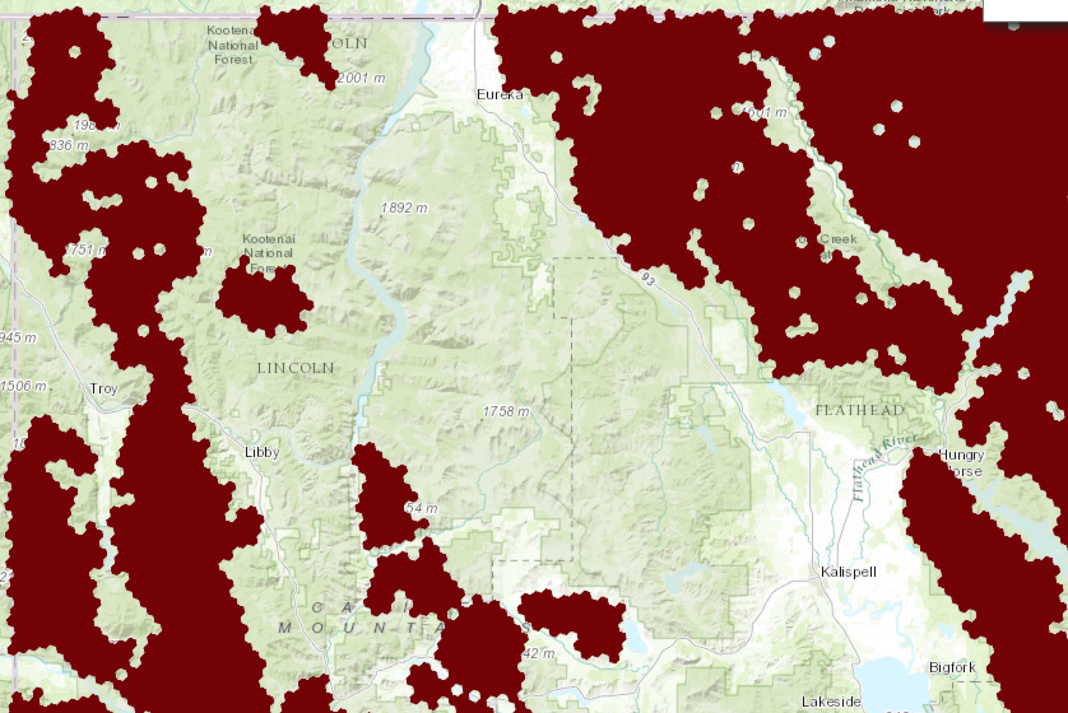
Corridor Plans
Choose places to connect (e.g., wildland blocks)

Slide 23
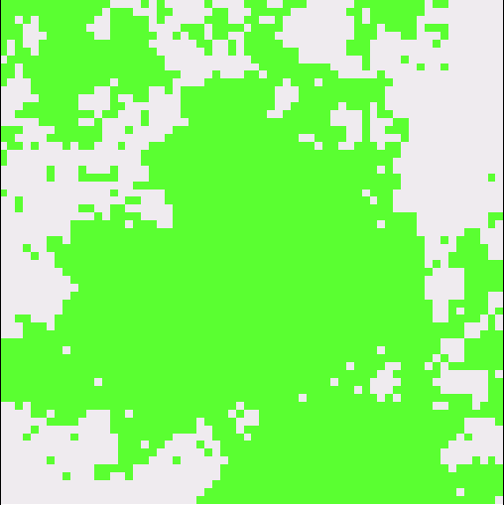

Corridor Plans
Choose places to connect (e.g., wildland blocks)
Identify variables influencing movement and survival (if a species)
Berry presence=0 Meadow=0
Berry absence=1 Forest=1

Slide 24
Corridor Plans
Choose places to connect (e.g., wildland blocks)
Identify variables influencing movement and survival
Guess at or quantify the strength of those influences for each variable to get resistance per pixel
Berry presence=0 Meadow=0
Berry absence=1 Forest=1
Resistance
per pixel:
Berry presence=1 Meadow=1
Berry absence=5 Forest=20

Slide 25
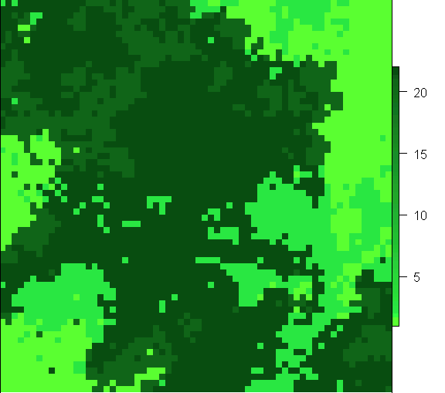
Corridor Plans
Choose places to connect (e.g. wildland blocks)
Identify variables influencing movement and survival
Guess at or quantify the strength of those influences for each variable to get resistance per pixel
Combine costs across variables to get a resistance surface
+ =
Resistance
per pixel:
Berry presence=1 Meadow=1 $2 to $25
Berry absence=5 Forest=20

Slide 26
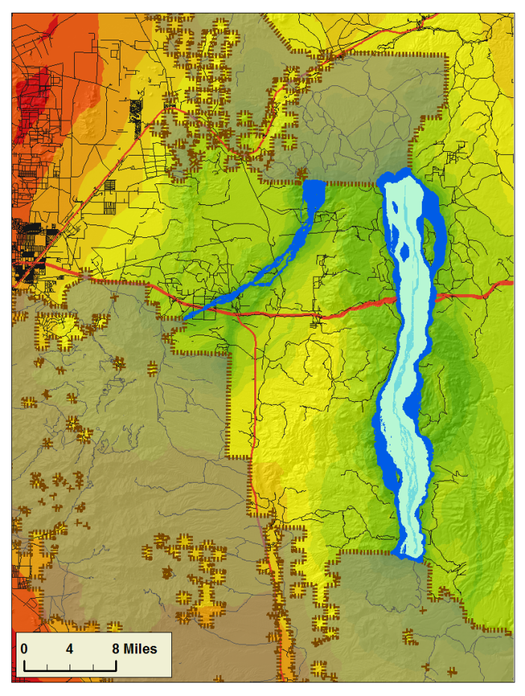
Corridor Plans
Choose places to connect (e.g. wildland blocks)
Identify variables influencing movement and survival
Guess at or quantify the strength of those influences for each variable to get resistance per pixel
Combine costs across variables to get a resistance surface
Find routes that minimize cost distance
Least cost paths or corridors
(based on route with lowest cost to traverse)
Individual based simulations
(retaining simulations that reach the other side)

Slide 27
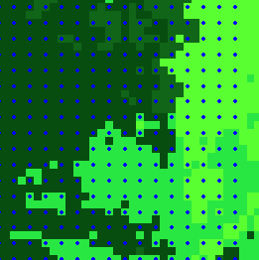
Least Cost Distance
3 distance units * $2/unit = $6
2 distance units*$20 + 1*$2 = $42
6 distance units * $2/unit = $12
Notes:
Put in a different example?

Slide 28
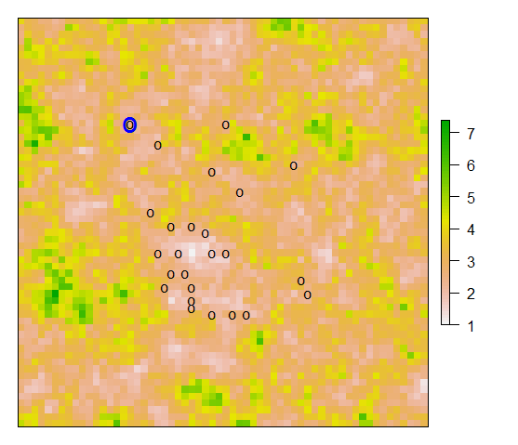
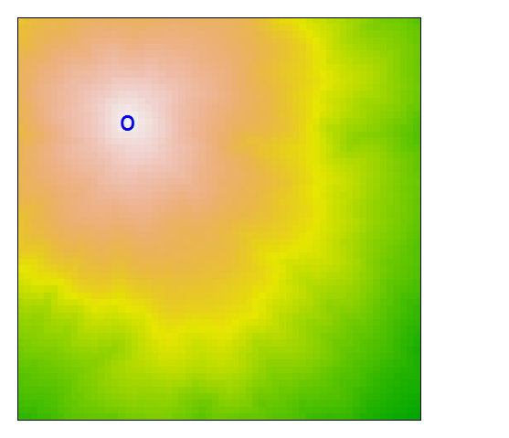
Least Cost Path
Assumes species has ‘knowledge’ of best path
Does not indicate whether the least cost distance along that path is short enough for animals/plants to use it
Notes:
Should I cover this?

Slide 29
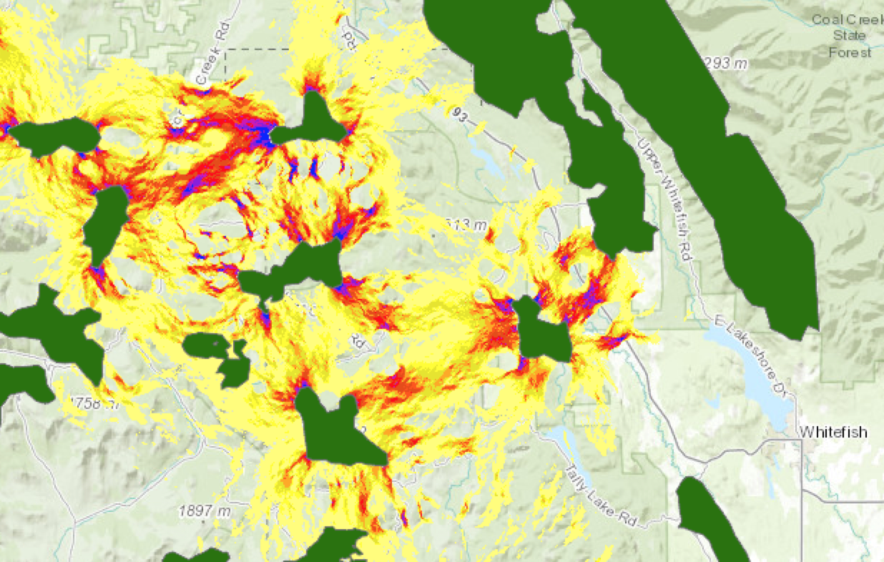
Circuit theory
Treat movement/dispersal like an electrical circuit where
More paths means lower total Resistance Distance between places
Can use for landscape planning (see pinchpoints and alternate paths)
Assumes random movement
Notes:
Should I cover this?

Slide 30
Corridor Plans
Choose places to connect (e.g., wildland blocks)
Identify variables influencing movement and survival
Guess at or quantify the strength of those influences for each variable to get resistance per pixel
Berry presence=0 Meadow=0
Berry absence=1 Forest=1
Resistance
per pixel:
Berry presence=1 Meadow=1
Berry absence=5 Forest=20

Slide 31
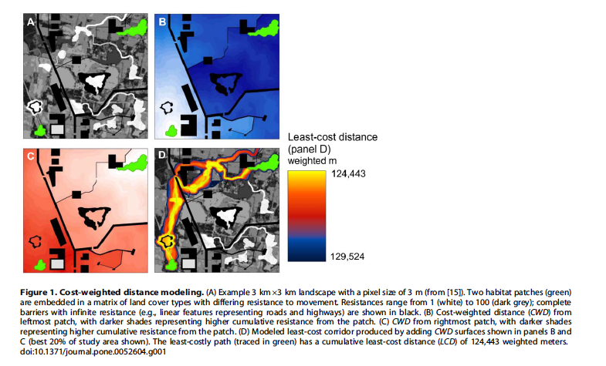
McRae et al. 2012

Slide 32
Data-driven approaches
Focal process | Data | Convert to Resistance | Cost/certainty
Occupancy | Presence/Absence | Assumptions vary | Low/moderate
Habitat | Telemetry/GPS | Typically assume inverse relationship | Moderate/moderate (unless extrapolate)
Individual movement | Telemetry/GPS (more complex analysis than habitat) | Assume dispersal is similar to daily movement | Moderate/moderate
Gene flow | Genetic sampling in different areas want to connect | Estimates likely biased and may not identify subtle factors, but likely identifies major factors | Low-moderate/moderate
Dispersal | Telemetry on dispersing individuals; genetic parentage | Can estimate it or ‘know’ specific paths, assume reproduction happens with enough dispersal | High/high

Slide 33
Data-driven approaches
Focal process | Data | Convert to Resistance | Cost/certainty
Occupancy | Presence/Absence | Assumptions vary | Low/moderate
Habitat | Telemetry/GPS | Typically assume inverse relationship | Moderate/moderate (unless extrapolate)
Individual movement | Telemetry/GPS (more complex analysis than habitat) | Assume dispersal is similar to daily movement | Moderate/moderate
Gene flow | Genetic sampling in different areas want to connect | Estimates likely biased and may not identify subtle factors, but likely identifies major factors | Low-moderate/moderate
Dispersal | Telemetry on dispersing individuals; genetic parentage | Can estimate it or ‘know’ specific paths, assume reproduction happens with enough dispersal | High/high

Slide 34
Data-driven approaches
Focal process | Data | Convert to Resistance | Cost/certainty
Occupancy | Presence/Absence | Assumptions vary | Low/moderate
Habitat | Telemetry/GPS | Typically assume inverse relationship | Moderate/moderate (unless extrapolate)
Individual movement | Telemetry/GPS (more complex analysis than habitat) | Assume dispersal is similar to daily movement | Moderate/moderate
Gene flow | Genetic sampling in different areas want to connect | Estimates likely biased and may not identify subtle factors, but likely identifies major factors | Low-moderate/moderate
Dispersal | Telemetry on dispersing individuals; genetic parentage | Can estimate it or ‘know’ specific paths, assume reproduction happens with enough dispersal | High/high

Slide 35
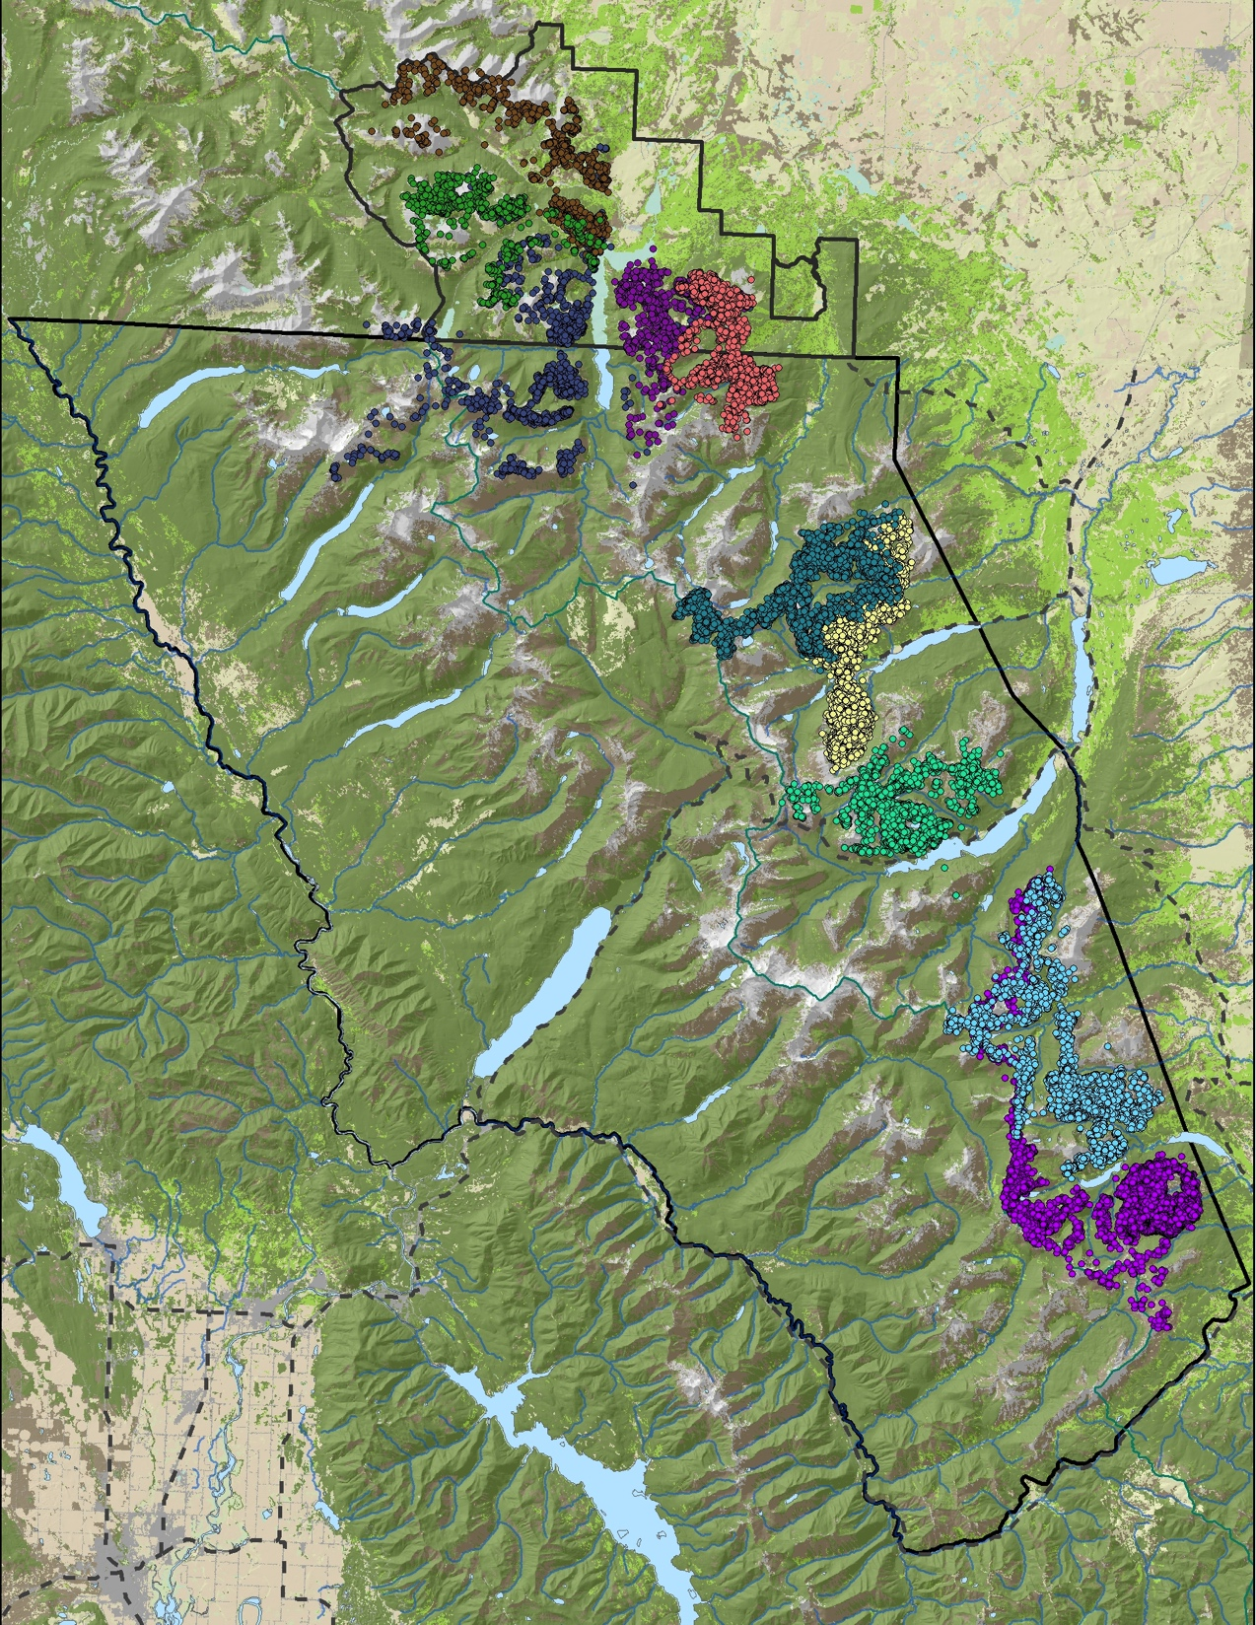
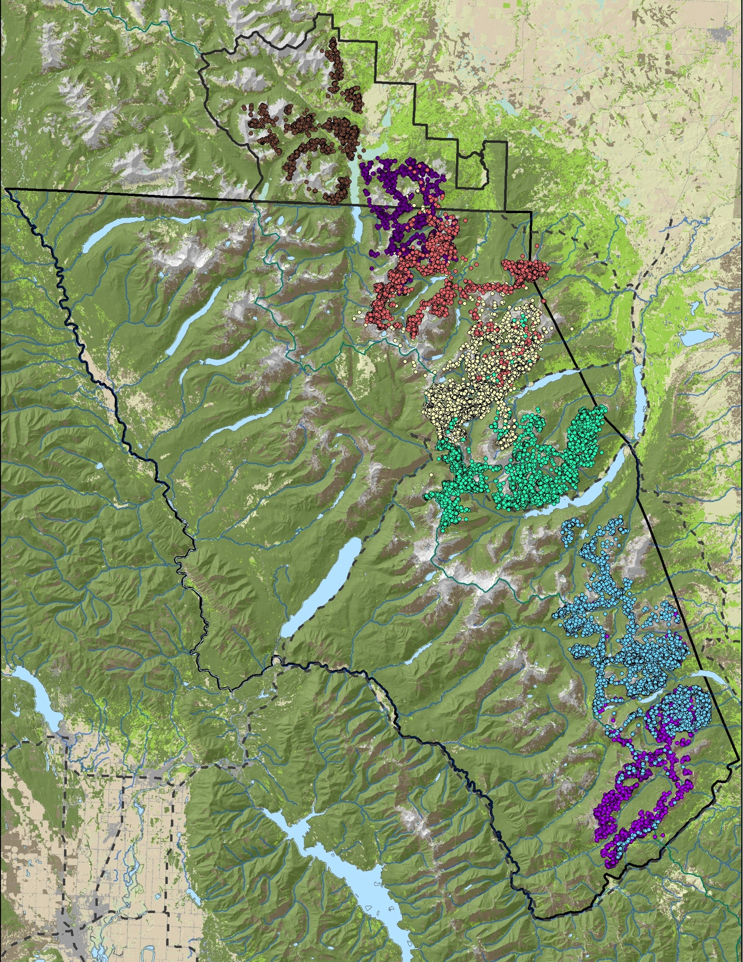
Bighorn sheep project
Focal process | Data | Convert to Resistance | Approach
Individual movement | GPS data (~78 sheep across Glacier NP, Waterton Lakes NP, and Blackfeet Reservation) | Daily movement of interest because interested in disease prevention | Comparing resistance across months and the factors influencing movement
Gene flow | Genetic sampling from captures and fecal pellets | Focused on identifying subpopulation separation | Hierarchical – ancestry values (e.g. Balkenhol et al.)
Notes:
Not going through because that is dealt with later.

Slide 36
Brown Bear Project (Kenai)
Identified behavior switch (cross at night)
Identified specific areas used as ‘habitat’ vs. corridors

Slide 37
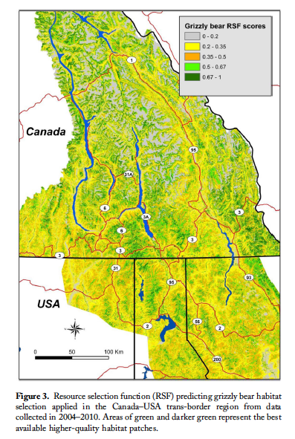
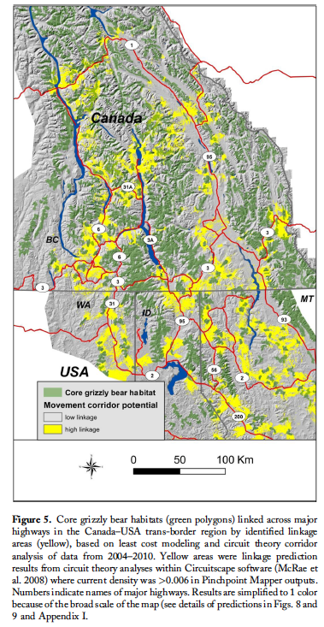

Slide 38
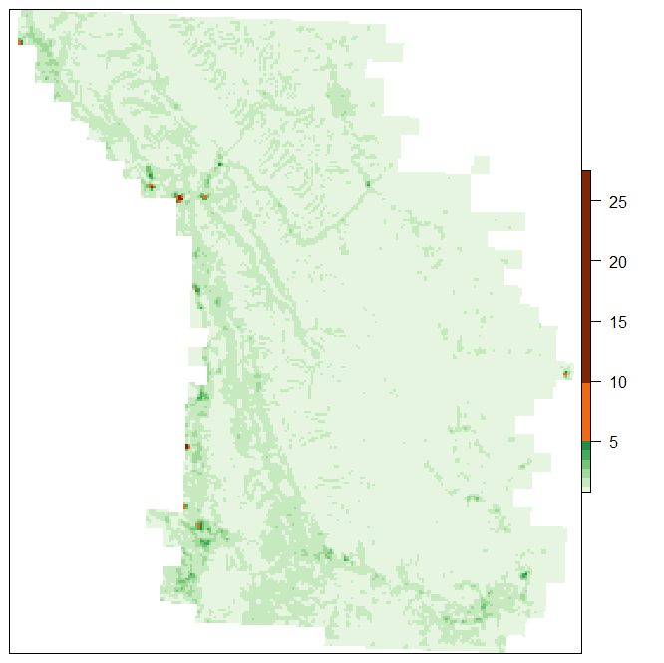
Grizzly Bear projects
Focal process | Data | Convert to Resistance | Approach
Dispersal | Family Tree i- 1165 genotypes ii- ~2000 genotypes (USGS hair projects, state-led trend, BC, AB, GNP, Blackfeet, CSKT) | Estimating directly | Graves et al. 2014
Gene flow | Genetic sampling from bear hair | Did not work well, but used to improve methods | Optimize Mantel correlations (Graves et al. 2014); Optimize conservation (Dilkina et al. 2016)
Notes:
Not going through because that is dealt with later.

Slide 39
Process is important
Beier et al. suggest inclusion of all stakeholders

Slide 40

Seizing the day
Sometimes choices are obvious
Sometimes not enough time for the
most rigorous of studies

Slide 41
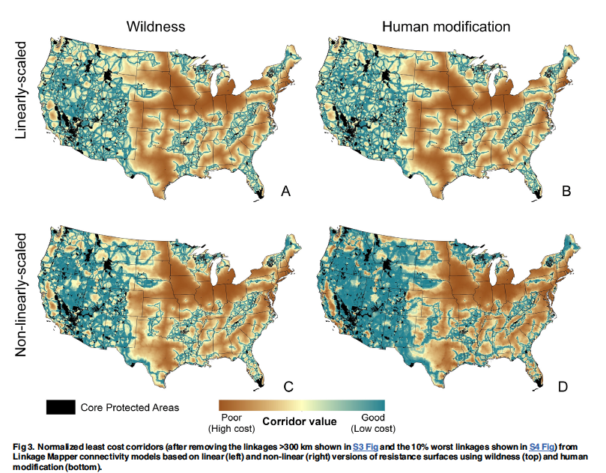
Some locations might be obvious (structural connectivity)
Belote et al. 2016

Slide 42
Expert-driven approaches
Ideal | Approaches
Based on best available research/data | Provide literature to experts prior to asking them to rate the costs
Confront uncertainty | Ask experts to weight strength of knowledge; use species with strong structural association; conduct sensitivity analysis
Transparent | Fully describe process in plain speak and make intermediate and final products available to public
Inclusive | Invite all stakeholders so can incorporate local knowledge and build investment
Described use of math /statistics appropriately | Make assumptions clear, use calculate vs. estimate appropriately
Notes:
Note that

Slide 43
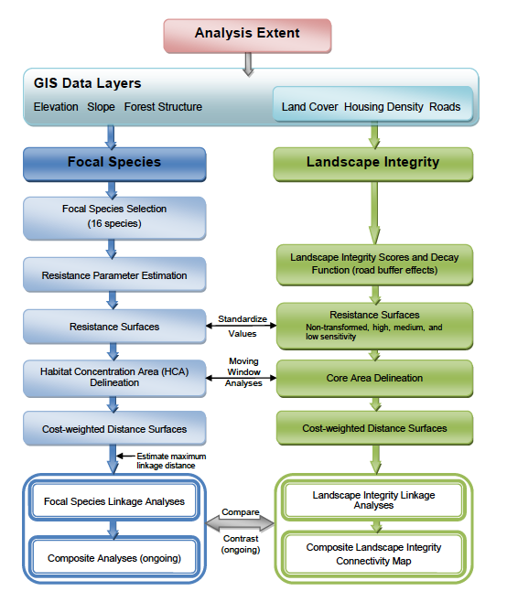
Washington Connected Example
Ideal | Approaches
Confront uncertainty | Used species with strong vegetation association
Transparent | Fully describe process
Notes:
Not going through because that is dealt with later.

Slide 44
Validation- Consistency
Especially important for expert-opinion based approaches, but also important to examine assumptions made in data-based approaches such as extrapolation to areas not sampled and changes in processes over time (e.g., habituation to road-crossing structures, increase in human activities precluding use)
Also important to understanding what works and doesn’t work into the future.
Notes:
(Add something about Paul and Andy’s work evaluating this?)

