Slide 1
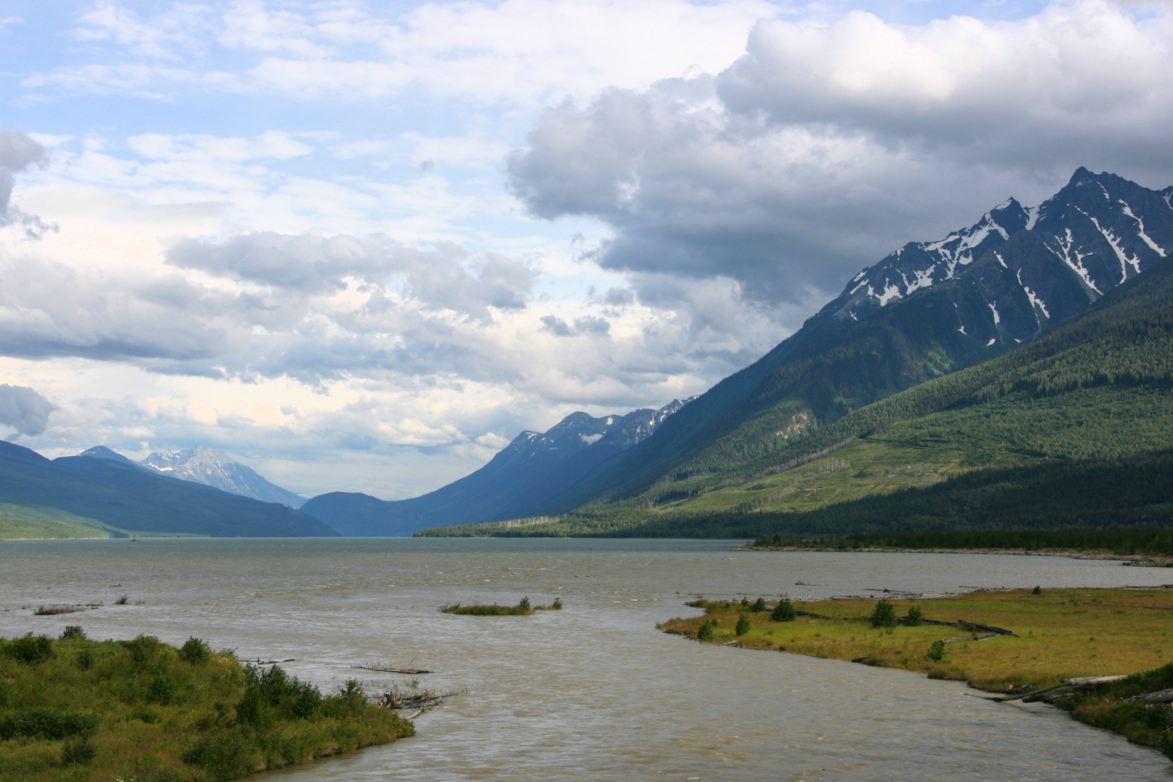


Climate Change Impacts and Implications: An Overview
Lara Whitely Binder
Climate Impacts Group
College of the Environment | University of Washington
Oct 25, 2016
UCUT/ATNI Climate Change Resilience for the Upper Columbia River Workshop
Notes:
https://en.wikipedia.org/wiki/Columbia_River

Slide 2


The UW Climate Impacts Group
Science for climate resilience
Working since 1995 to….
Produce scientific information that is both useful to and used by decision makers
Conduct decision-relevant climate research
Support the interpretation and application of climate science in decision making
Northwest Climate
Science Center
Notes:
The CIG is an interdisciplinary research group based at the University of Washington that studies the impacts of climate variability and change on the built and natural environment.
Since 1995, we have worked to produce scientific information that is both useful to and used by decision makers
We do this by working closely with decision makers to design and conduct decision-relevant research
We also provide technical support on the interpretation and application of climate science in decision making
Finally, we do a lot of presentations and other types of outreach and engagement work…

Slide 3

Tribal culture, health, and identity
Tribal economies
Tribal community investments
Interconnected impacts
Notes:
I want to start by acknowledging that as we talk about climate change impacts today, we are only skimming the surface of a deeply connected sets of issues that shape -- and are shaped by -- tribes.
http://snohomishcountywa.gov/ImageRepository/Document?documentID=25783
http://snohomishcountywa.gov/2991/CWD-Water-Quality

Slide 4
My goal today…
Provide the “big picture” overview to anchor the more detailed presentations that follow.
How is climate changing -- and expected to change further?
How does it affect issues important to tribes?
What can we do about it?
Where can I go for more information?
Notes:
http://snohomishcountywa.gov/ImageRepository/Document?documentID=25783
http://snohomishcountywa.gov/2991/CWD-Water-Quality

Slide 5
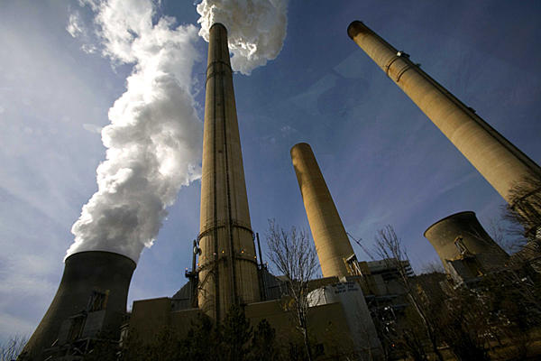
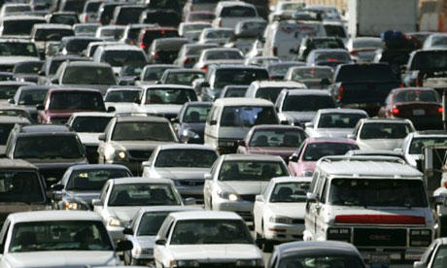
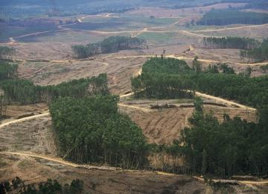

We’re changing the climate...
Notes:
I want to start with a simple statement.
We’re changing the climate, due primarily through our use of fossil fuels and our land-use practices.

Slide 6
Global mean concentration of carbon dioxide in the atmosphere, August 2016 (varies monthly)
402.25 ppm
parts per million
40% increase relative to pre-Industrial Revolution times
(~1750, 280 ppm)
http://www.esrl.noaa.gov/gmd/ccgg/trends/
Notes:
One way we know we are changing the climate is by measuring atmospheric CO2.
The global mean concentration of carbon dioxide in the atmosphere as of April 2016 was 407 ppm. This is 40% higher than the concentration in the atmosphere prior to the start of the Industrial Revolution (about 280 ppm).

Slide 7
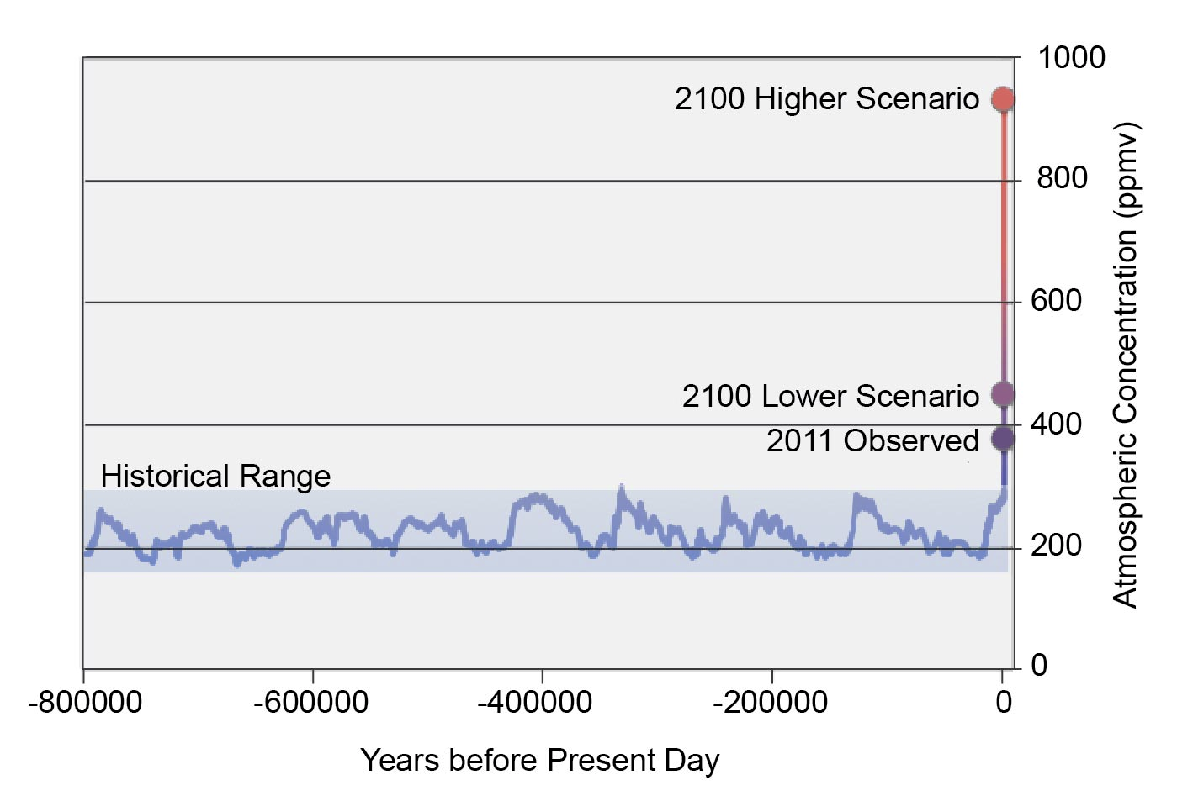
“It is unequivocal that the current concentrations of atmospheric carbon dioxide, methane, and nitrous oxide exceed any level measured for at least the past 800,000 years...
– IPCC 2013, Working Group 1 report, Chapter 6
Atmospheric Carbon Dioxide Levels
Figure 33.5: Atmospheric Carbon Dioxide Levels,
US National Assessment, 2014
Notes:
This increase is also significant geologically. For example, we know (from ice cores) that the current concentrations of greenhouse gases in the atmosphere exceed any level measured for at least the past 800,000 years.
We also know that the observed average rate of increase of these three gases over the past century exceeds any observed rate of change over the previous 20,000 years.
[IPCC 2013, Working Group 1 report, Chapter 6]
Figure caption: Air bubbles trapped in an Antarctic ice core extending back 800,000 years document the atmosphere’s changing carbon dioxide concentration. Over long periods, natural factors have caused atmospheric CO 2 concentrations to vary between about 170 to 300 parts per million (ppm). As a result of human activities since the Industrial Revolution, CO 2 levels have increased to 400 ppm, higher than any time in at least the last one million years. By 2100, additional emissions from human activities are projected to increase CO 2 levels to 420 ppm under a very low scenario, which would require immediate and sharp emissions reductions (RCP 2.6), and 935 ppm under a higher scenario, which assumes continued increases in emissions (RCP 8.5). This figure shows the historical composite CO 2 record based on measurements from the EPICA (European Project for Ice Coring in Antarctica) Dome C and Dronning Maud Land sites and from the Vostok station.
So, these GHG are going up, and they are going up quickly.

Slide 8
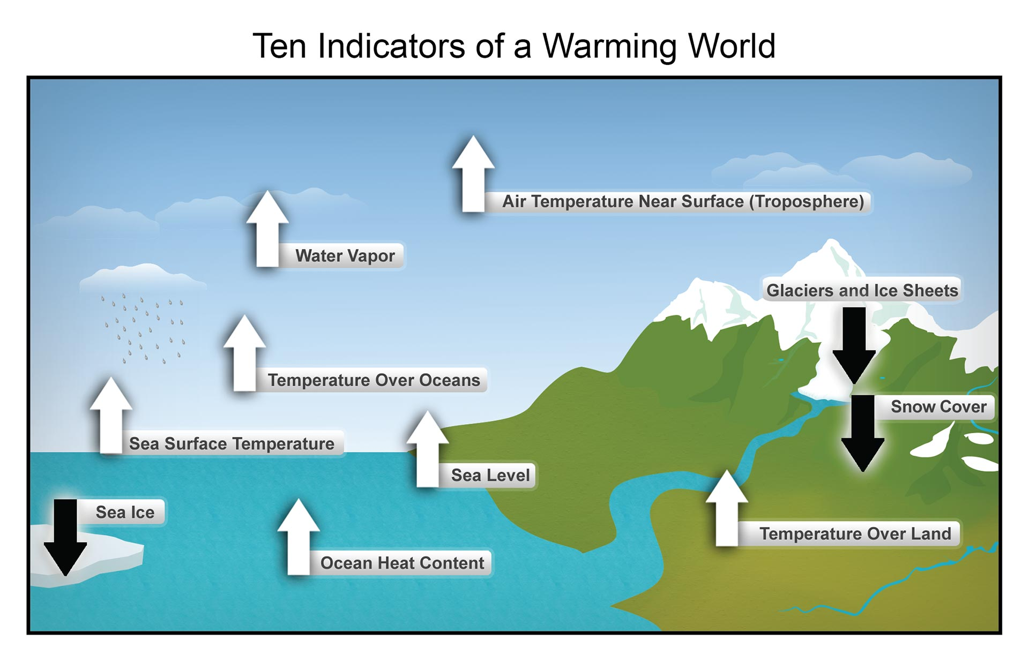
Figure source: NOAA NCDC based on data updated from Kennedy et al. 2010, as used in the US National Assessment 2014
Notes:
But it’s not just the measurements of greenhouse gases that we can take form the atmosphere and ice cores. We also see evidence of a warming climate in instrumental and observational data from around the world.
From these sources, for example, we know that….
Average global temperature increased +1.5°F between 1880 and 2012, and that warming has been stronger over land than water…
That globally, heat waves and heavy rainfall events have become more frequent since 1950 and cold snaps are becoming rarer…
That global sea level has risen about +7 inches since 1901 and that the rate of global mean sea level rise has accelerated during the last two centuries…
That snow and ice cover has been decreasing,
That ocean surface waters (top 250 ft.) warmed by +0.6 to +0.9°F from 1971 to 2009 (global average) and that warming trends are evident at nearly all depths in the ocean… and
That the acidity of the ocean has increased by about +26% since 1750.
There is also lots of evidence of species ranges shifting and the timing of bloom dates and other biological processes changing in response to rising temperatures, but that is a topic for another time.
---------
[Atmospheric water vapor is increasing in the lower atmosphere, because a warmer atmosphere can hold more water.]
Figure 2.1: These are just some of the indicators measured globally over many decades that show that the Earth’s climate is warming. White arrows indicate increasing trends, and black arrows indicate decreasing trends. All the indicators expected to increase in a warming world are, in fact, increasing, and all those expected to decrease in a warming world are decreasing. (Figure source: NOAA NCDC based on data updated from Kennedy et al. 2010¹).

Slide 9

Observed changes in PNW climate
Warming. Washington and the Pacific Northwest have experienced long-term warming (+1.3F, 1885-2011), a lengthening of the frost-free season, and more frequent nighttime heat waves.
Hydrologic change. Long-term reductions in snow and ice, and shifts in streamflows reflect the influence of warming.
Sea level change. Sea level is rising along some parts of the Oregon and Washington coastline and falling in others.
Ocean acidification. The coastal ocean is acidifying and some local inshore coastal waters are warming.
Attribution. PNW climate is changing in ways consistent with climate change projections, however natural variability continues to play a key role in observed trends.
(Kunkel et al. 2013, Mote et al. 2013, Snover et al. 2013, NRC 2012, Feely et al. 2010, and many other sources)
Notes:
Trends related to temperature:
Average annual temperature has increased +1.3°F, 1885-2011 (Kunkel et al. 2013, Mote et al. 2013)
Frost-free season has lengthened 35 days (+6 days), 1885-2011 (Kunkel et al. 2013)
No discernible long-term trend in precipitation (Kunkel et al. 2013)
Annual and seasonal temperatures have generally been above the long-term average for the last 25 years.
Since 1986, all but 2 years have had average annual temperatures above the 1901-1960 average.
Two of the three warmest years on record, 1992 and 2003, have occurred since 1986.
Five of the nine warmest summers have occurred since 1998. (Kunkel et al. 2013)
Trends related to hydrology
Spring snowpack varies year-to-year but declined ~25% from mid-20th century through 2006 (Stoelinga et al. 2009, Mote et al. 2008)
Most glaciers are in decline (Mt. Rainier: -27%, 1913-1994). Spring peak streamflow shifted earlier by up to 20 days, depending on location (1948-2002) (Sisson et al. 2011; Sitts et al. 2010; Granshaw and Fountain, 2006)
Spring peak streamflow shifted earlier by up to 20 days, depending on location (1948-2002) (Stewart 2005)
Trends in sea level:
Sea level is increasing on average (+8 inches in Seattle), although results vary by location (NRC 2012, Mote et al. 2008)
Declining sea level found in the few areas where tectonic uplift currently exceeds the rate of global sea level rise observed to date (NRC 2012, Mote et al. 2008)
Examples of differing relative sea level rise:
Friday Harbor, WA: +0.4 in./decade (1934-2008)
Neah Bay, WA: −0.7 in./decade (1934-2008)
Seattle, WA: +0.8 in./decade (1900-2008)
Astoria, OR: −0.1 in./decade (1925-2008)
Trends related to ocean:
Ocean acidity in Washington’s marine waters has increased +10% to +40% since 1800
Ocean waters on the outer coast of Washington and the Puget Sound have become about +10 to +40% more acidic since 1800 (decline in pH of −0.05 to −0.15). (Source: Feely, R.A. et al., 2010. The combined effects of ocean acidification, mixing, and respiration on pH and carbonate saturation in an urbanized estuary. Estuarine, Coastal and Shelf Science 88: 442–449.)
Significant warming in coastal surface ocean temperatures observed in the Strait of Georgia and west of Vancouver Island (+1.4°F, 1970-2005)
No significant warming of coastal surface ocean temperatures offshore of North America, 1900-2008
Sources:
Kunkel, K.E. et al., 2013. Part 6. Climate of the Northwest U.S., NOAA Technical Report NESDIS 142-6.
Mote, P.W. et al., 2013. Climate: Variability and Change in the Past and the Future. Chapter 2, 25-40, in M.M. Dalton, P.W. Mote, and A.K. Snover (eds.) Climate Change in the Northwest: Implications for Our Landscapes, Waters, and Communities, Washington D.C.: Island Press.

Slide 10

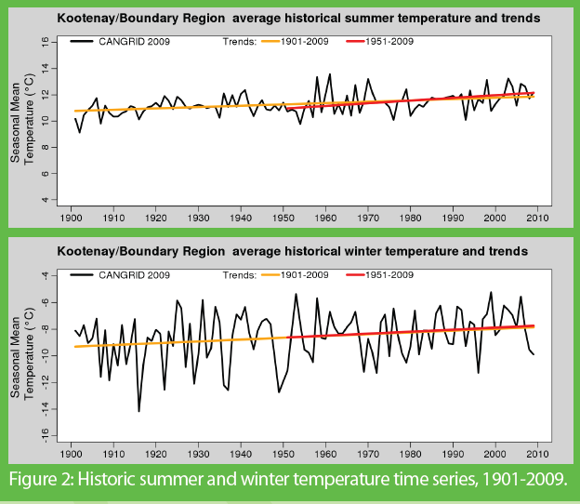
Warming annual, seasonal temperatures in the Kootenay/Boundary region
Average annual temperature has increase just over 1°C (1.8°F) during the 20th century.
Seasonal temperatures are also increasing (varies by season)
Precipitation changes are mixed.
Notes:
https://www.pacificclimate.org/sites/default/files/publications/Summary-Climate_Extremes_in_the_Columbia_Basin.pdf

Slide 11
We’re changing the climate...
…in ways that have committed our climate to change for the next several centuries, if not longer.
Notes:
So let’s take at look at where we are and where could be headed.
We’re changing the climate, due primarily through our use of fossil fuels and our land-use practices.

Slide 12
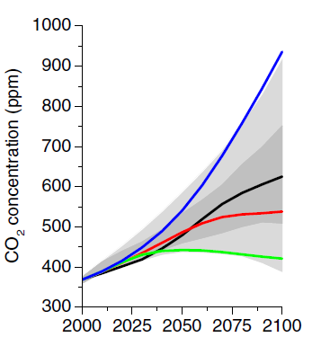
Projecting Future Climate:
Greenhouse Gas Emissions Scenarios
  Different scenarios result in different climate change projections.
(Very low)
(Low)
(Moderate)
(High)
936 ppm
670 ppm
538 ppm
400 ppm
Figure source: van Vuuren 2011
Notes:
Projecting future climate requires estimating future global greenhouse gas emissions. Global greenhouse gas emissions are developed internationally by the research community based on different assumptions about global population growth, intensity of fossil fuel use, integration of economies, and other factors that influence how much carbon dioxide and other greenhouse gases are emitted into the atmosphere (left).
Those emissions will accumulate in the atmosphere over time (right), ultimately leading to changes in global temperature, among other changes.
The CIG takes the global climate model projections and downscales that data to develop more geographically specific climate change scenarios.

Slide 13
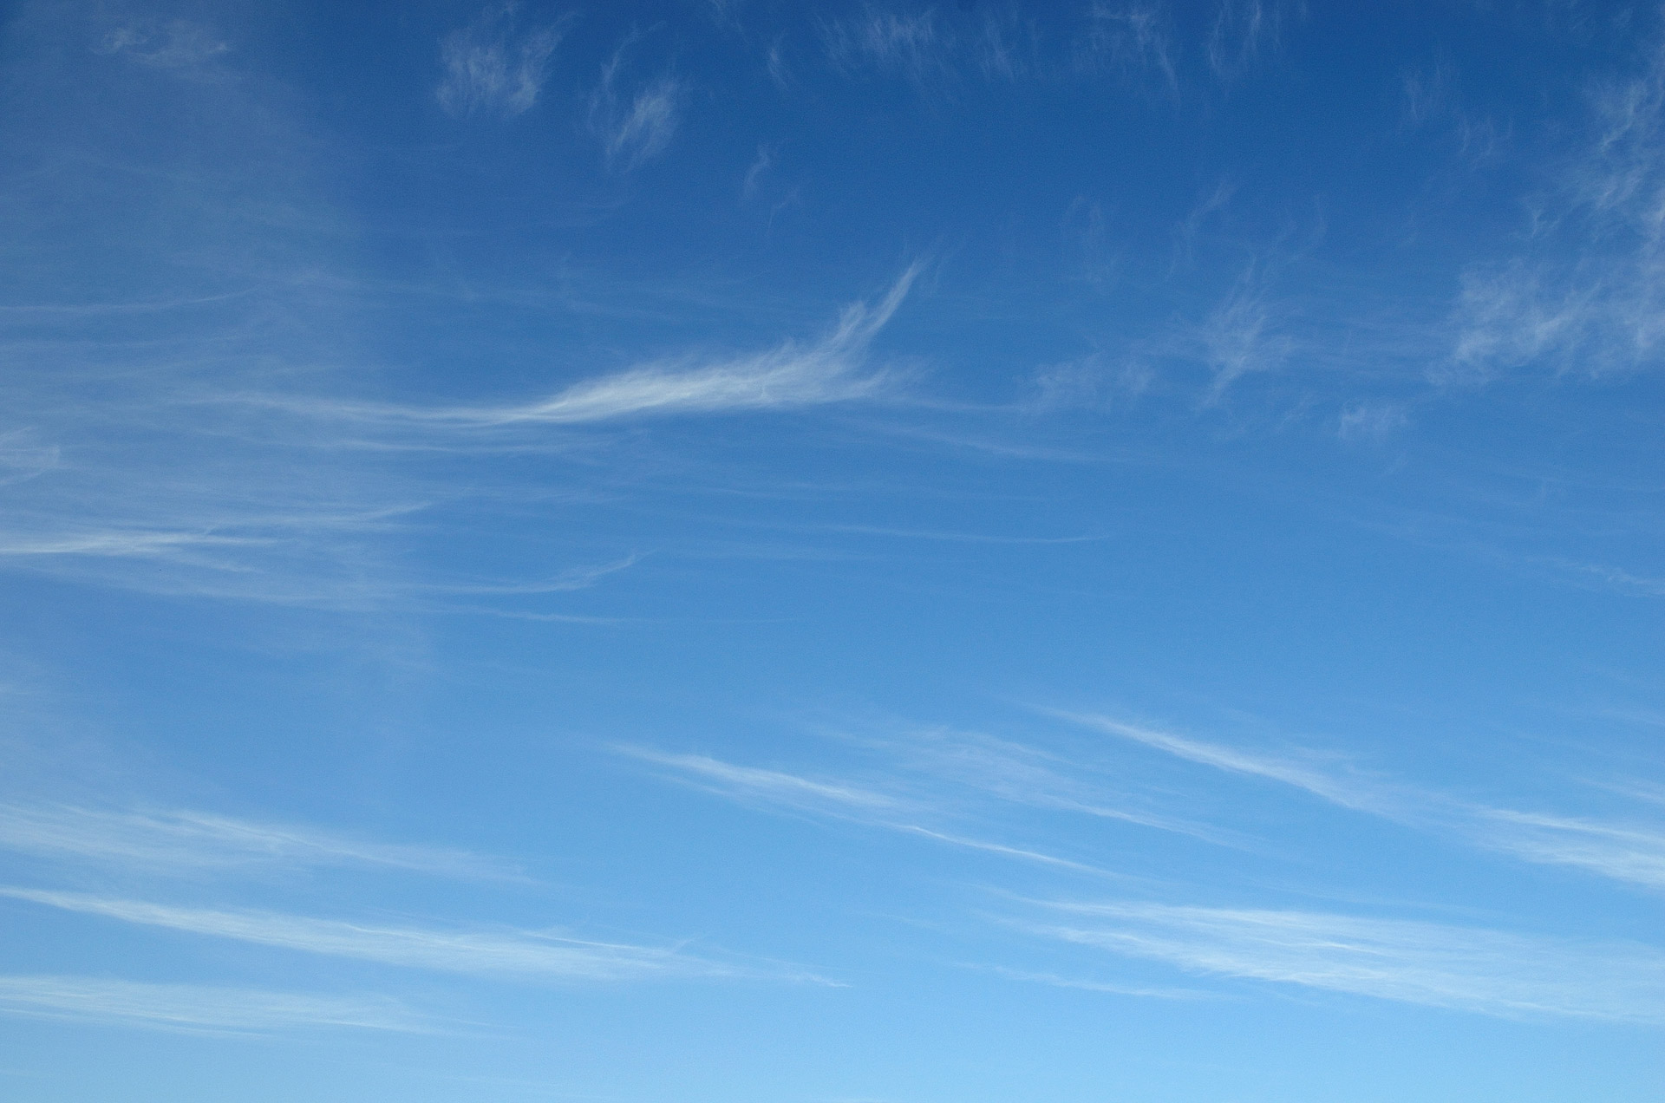
Key changes
Substantial and rapid warming
Increasing heavy rainfall
Changes in hydrology (snow, streamflow)
Changes in species distributions
Sea level rise
Changes in ocean conditions
Additional factors…Natural variability, variations in geography, human responses to climate impacts
Notes:
….that “drive” climate change impacts in the built and natural environment

Slide 14
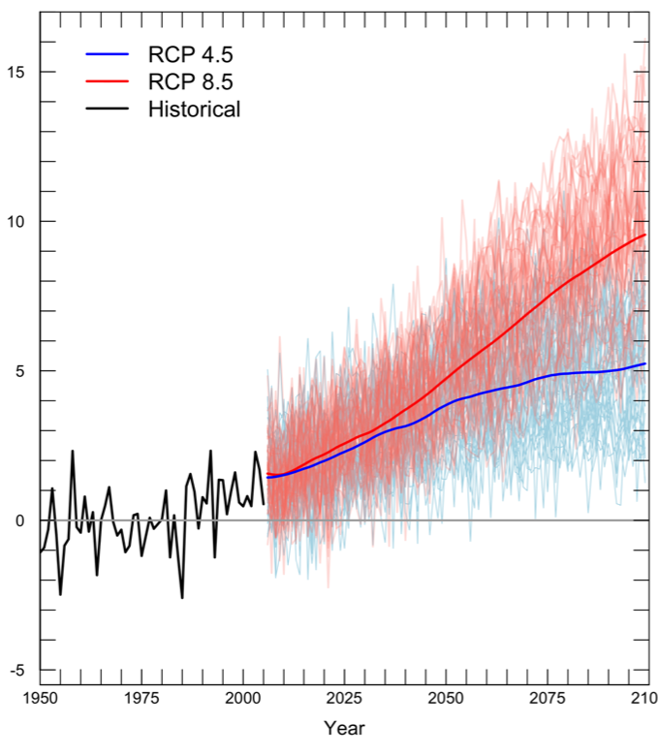
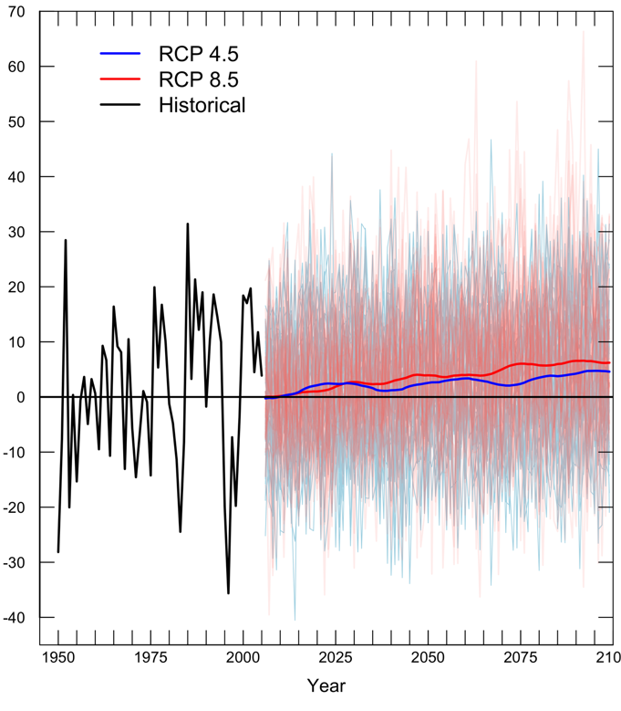
All scenarios show warming but changes in precipitation are mixed
Temperature
Precipitation
Warming: 2050s (relative to 1950-1999)
Low emissions RCP 4.5 | +4.3°F (2.0-6.7°F)
High emissions RCP 8.5 | +5.8°F (3.1-8.5°F)
Precipitation change: 2050s (relative to 1950-1999)
Low emissions RCP 4.5 | -4.3 to +10.1%
High emissions RCP 8.5 | -4.7 to +13.5%

Slide 15
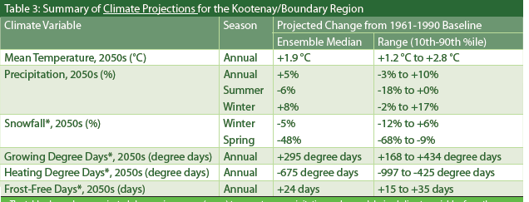
Continued warming expected in the Kootenay/Boundary region
https://www.pacificclimate.org/sites/default/files/publications/Summary-Climate_Extremes_in_the_Columbia_Basin.pdf

Slide 16
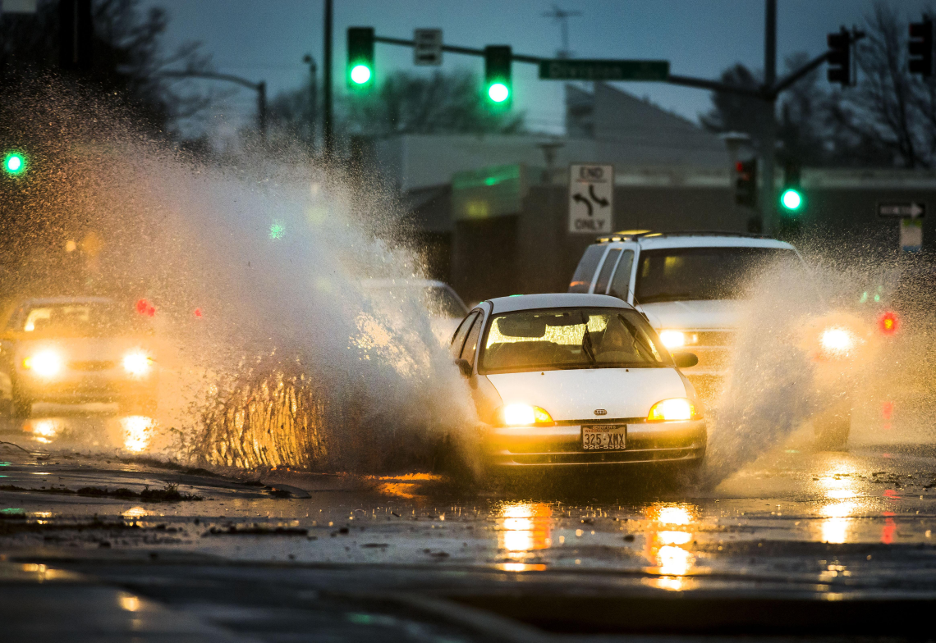
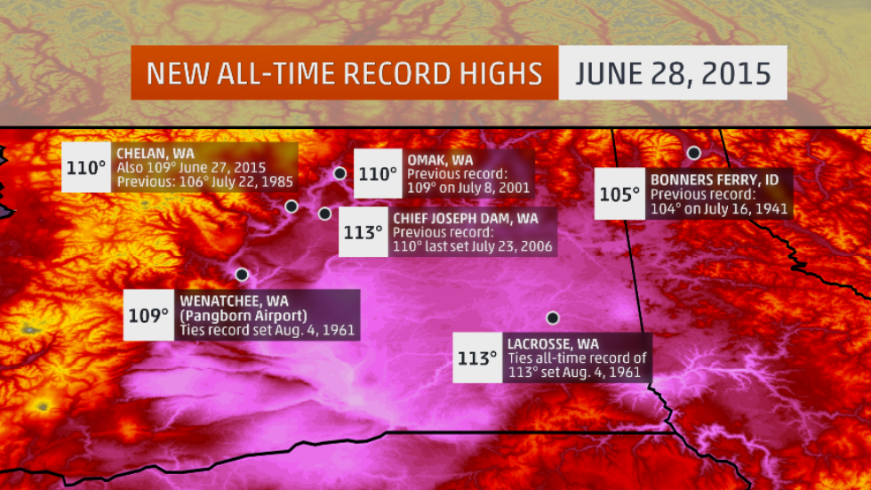
Increased frequency, intensity of extremes
The Spokesman-Review
“Spokane shatters daily rainfall record Monday” (Dec 7, 2015)
The Weather Channel
“Northwest Heat Wave By the Numbers: Dozens of Monthly and All-Time Record Highs” (Sept 22, 2015)
Notes:
Spokane article:
http://www.spokesman.com/stories/2015/dec/07/spokane-shatters-daily-rainfall-record-monday/
Heavy rain in Spokane on Monday broke a 133-year-old daily rainfall record. By 9 p.m., 1.07 inches had been measured at Spokane International Airport. The rainfall breaks the Dec. 7 record of 0.65 inches set in 1882.
The National Weather Service has issued a flood advisory for much of the Inland Northwest that will remain in effect through early Thursday.
Forecasters said that small streams, rural roads, low-lying fields and urban roadways could be affected by high water. In addition, heavier rain in mountain areas may trigger small landslides.
The Kootenai County Sheriff’s Office warned residents not to drive into high water and to watch for falling rocks and slides in mountain areas and along steep slopes.
Another inch or more of rain is expected in lowlands through Wednesday, and up to 3 additional inches of precipitation are possible in mountain areas, the weather service said.
Heat wave image: https://weather.com/news/weather/news/washington-oregon-idaho-all-time-record-highs-june-2015

Slide 17

Are these changes in climate big enough to matter?
Notes:
What does this mean for the western WA?

Slide 18
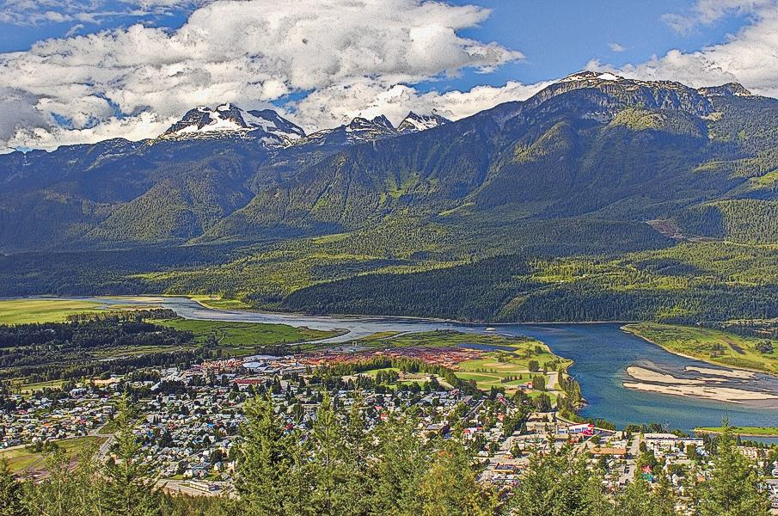

Notes:
http://www.truewestmagazine.com/exploring-the-old-oregon-country/

Slide 19
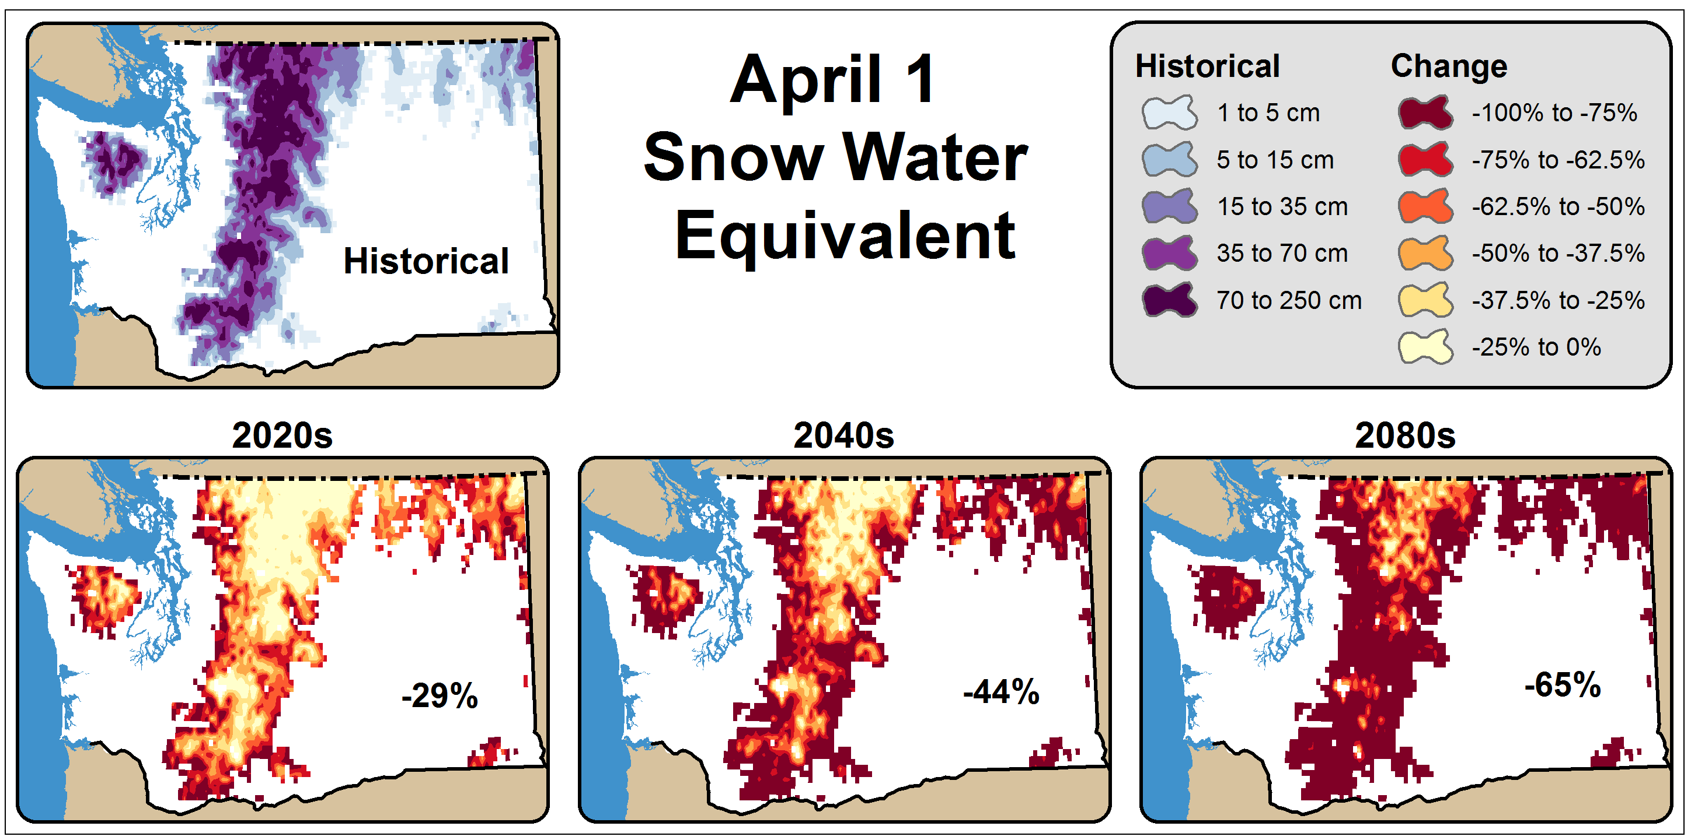
April 1 Snow Water Equivalent

Slide 20
April 1 Snow Water Equivalent
Elsner et al. 2010
Notes:
Elsner, M.M. et al. 2009: Implications of 21st Century climate change for the hydrology of Washington State (and Elsner et al. 2010 Climatic Change paper);
A1B

Slide 21
April 1 Snow Water Equivalent
Elsner et al. 2010
Notes:
Elsner, M.M. et al. 2009: Implications of 21st Century climate change for the hydrology of Washington State (and Elsner et al. 2010 Climatic Change paper);
A1B

Slide 22
April 1 Snow Water Equivalent
Elsner et al. 2010
Notes:
Elsner, M.M. et al. 2009: Implications of 21st Century climate change for the hydrology of Washington State (and Elsner et al. 2010 Climatic Change paper);
A1B

Slide 23
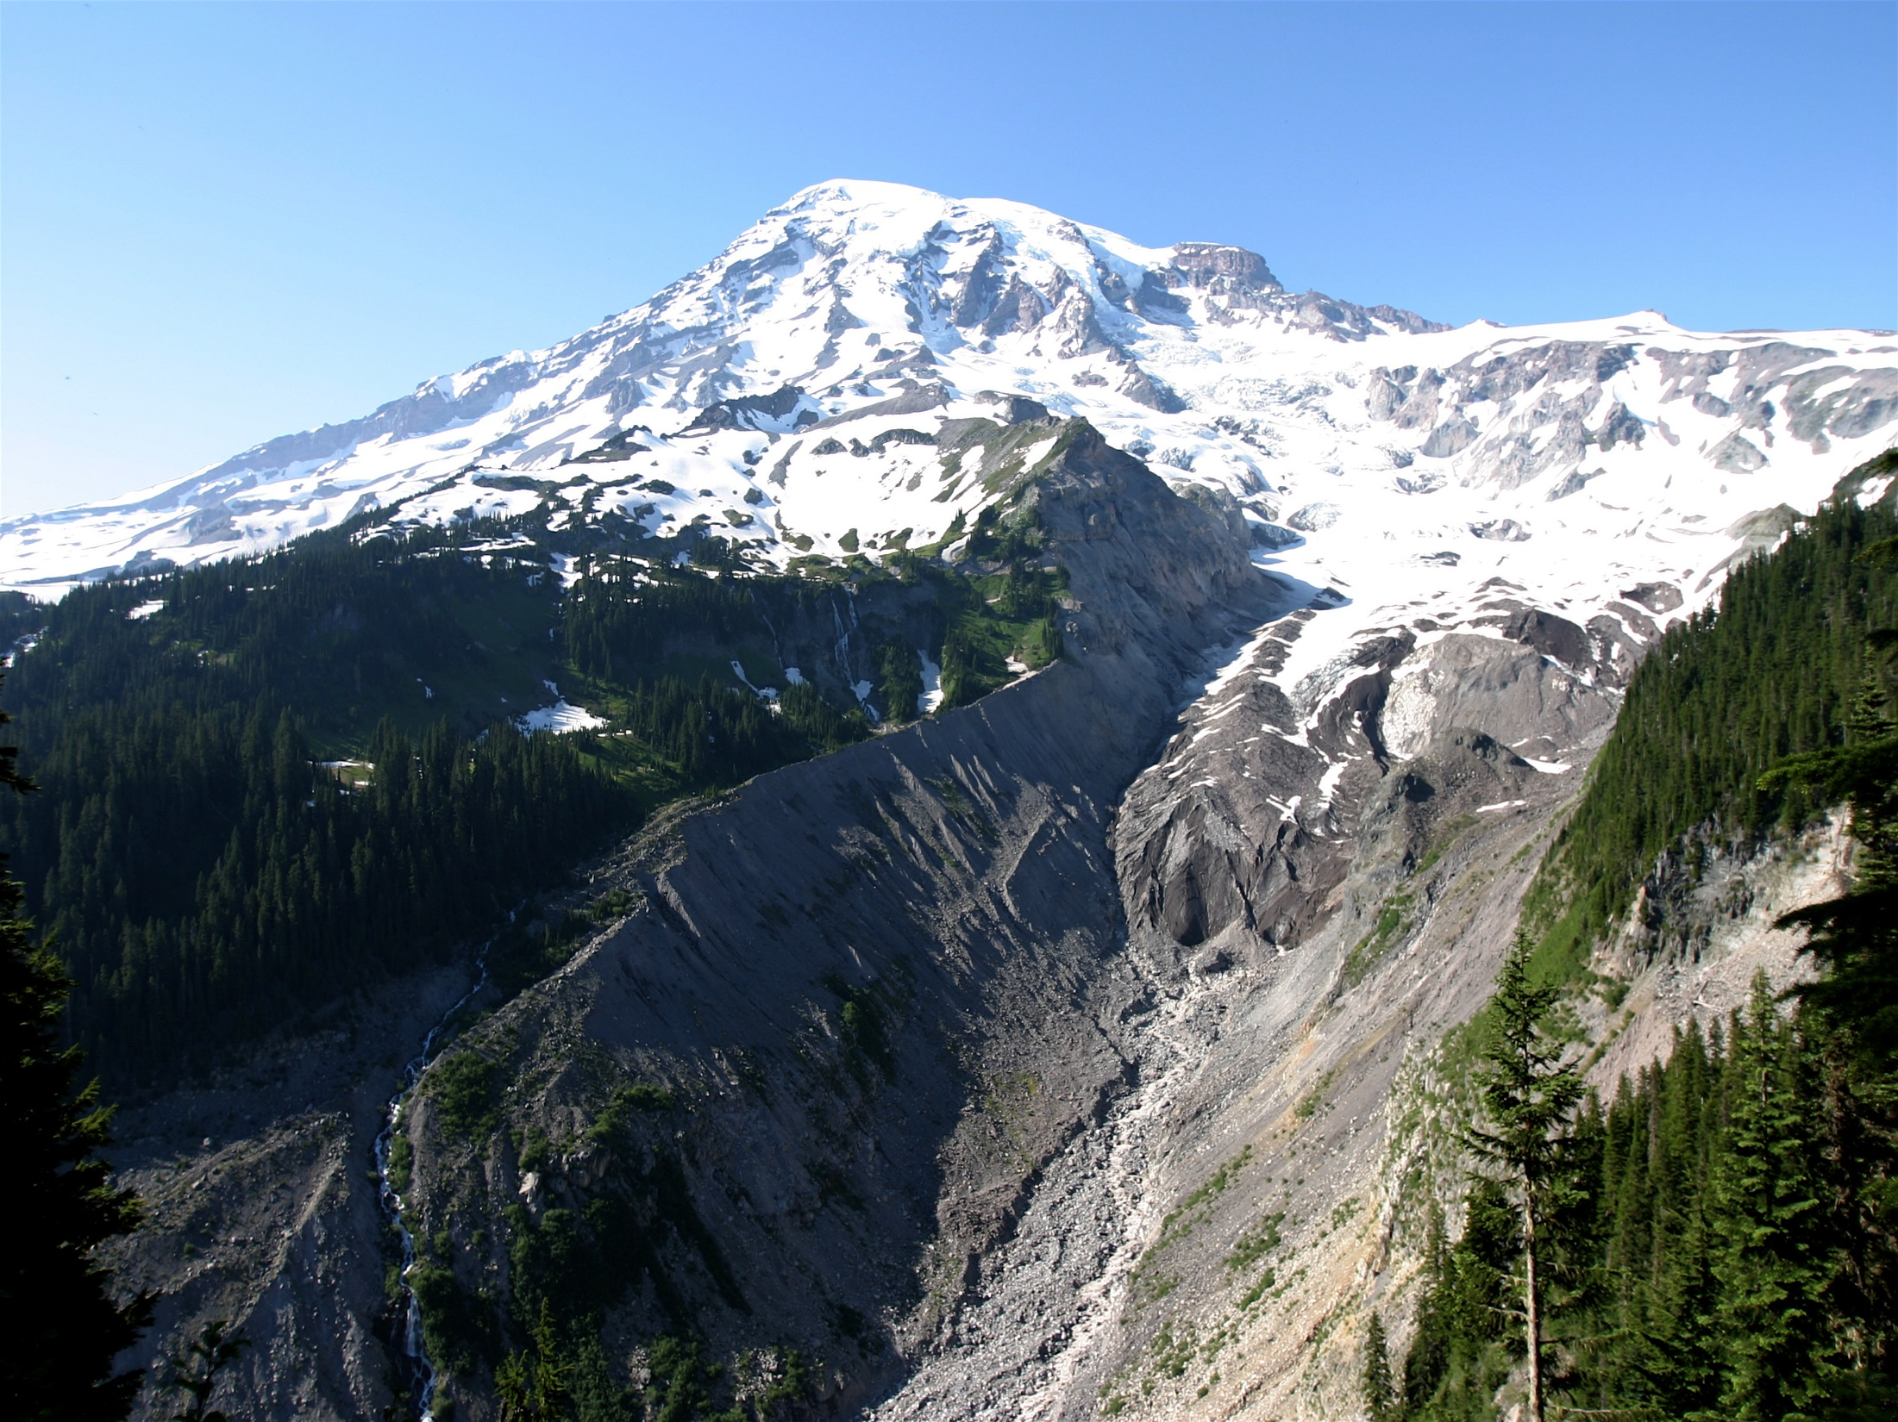
Glaciers will continue to recede, exacerbating hydrologic impacts
Affects:
Summer streamflow volume
Stream temperature
Sediment supply
Notes:
https://commons.wikimedia.org/wiki/File:MtRainierNisquallyGlacier.jpg

Slide 24
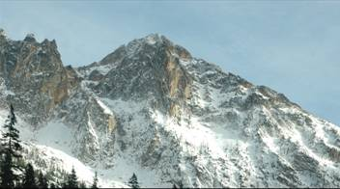
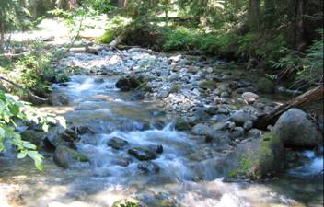
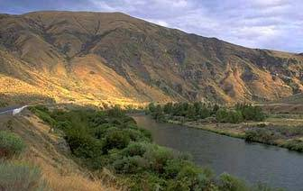
Expected 21st century changes in temperature and precipitation will transform the hydrologic behavior of many mountain watersheds in the West.
Notes:
We know that the water cycle plays a prominent role in transmitting climate impacts into resource impacts here in the PNW: skiing, water supplies, hydropower, aquatic ecosystems, agriculture, forests.

Slide 25
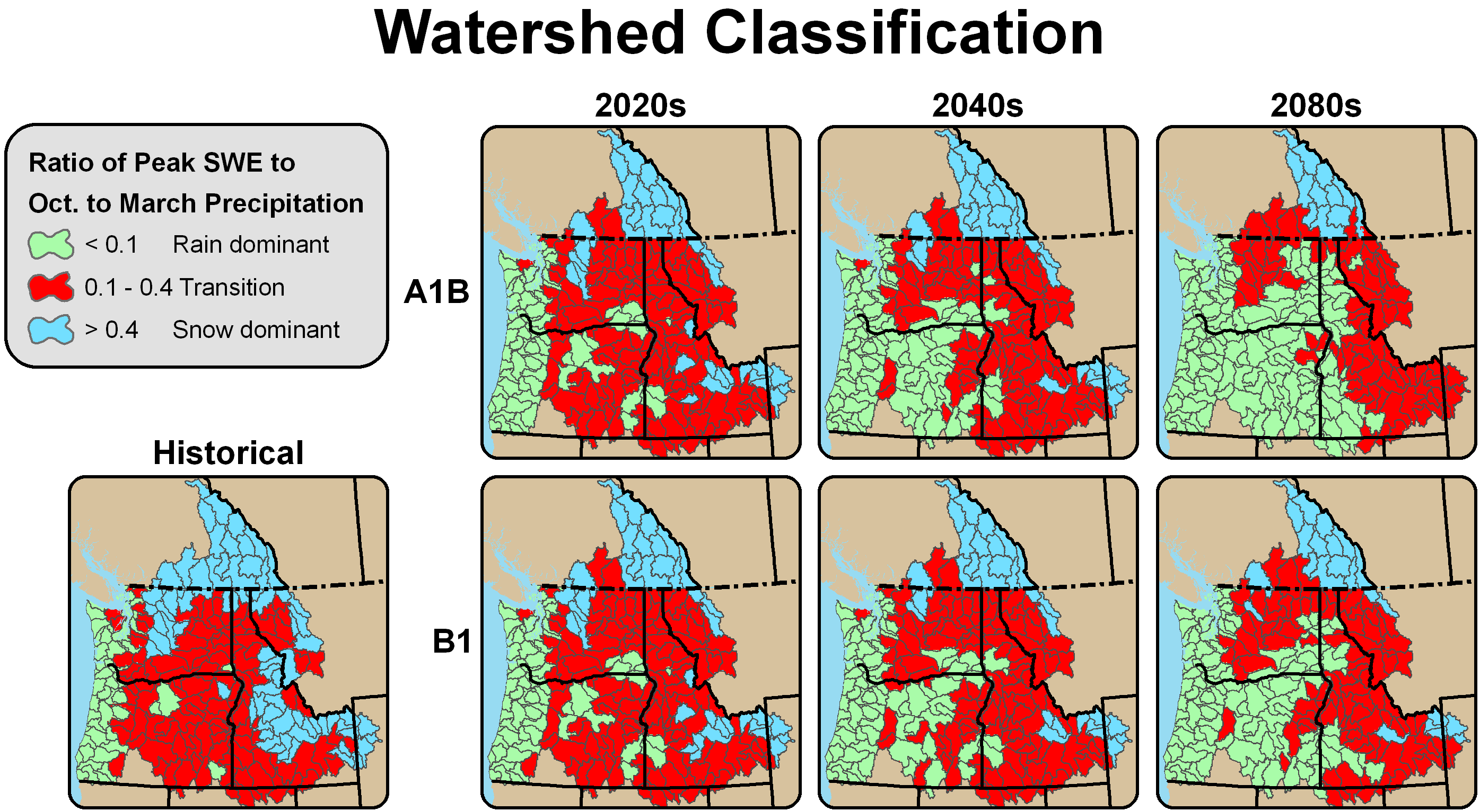
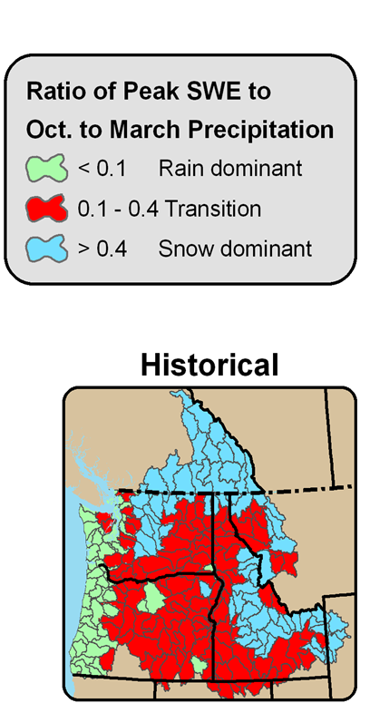

Watershed Classifications: Historical
Figure source: Alan Hamlet (Climate Impacts Group); map by Rob Norheim (CIG)
Notes:
Warmer winter and spring temperatures will affect how much winter (Oct-March) precipitation is stored as snow.
[ADD A DESCRIPTION OF RAIN DOMINANT, TRANSIENT RAIN/SNOW, AND SNOW DOMINANT BASINS]
As we move forward in time, we see
Most snow dominant basins in the U.S. portion of the Columbia basin shifting to transient rain/snow basins (see Snake River Basin in Idaho and north Cascades); and
Many transient basins shifting to rain dominant basins (especially for the A1B scenario; see Oregon, southeast Washington)
rain-dominated
“transient” basins with an early winter peak from rainfall, and a spring peak from snowmelt
snowmelt-dominated basins, where streamflow peaks in late spring and early summer

Slide 26
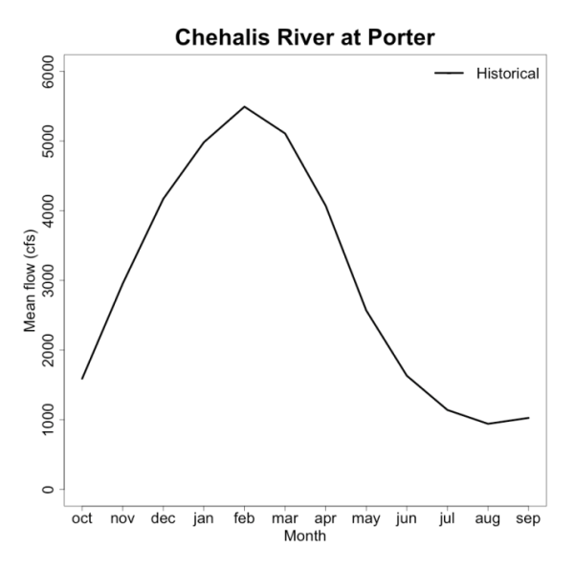
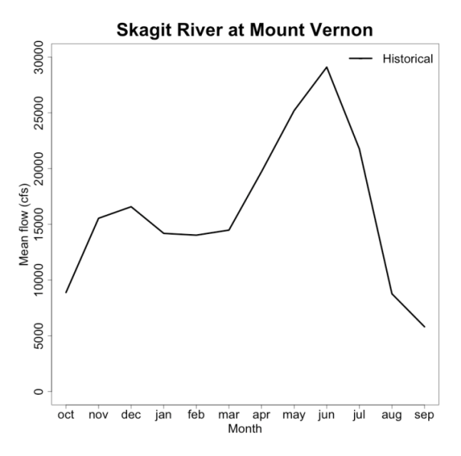
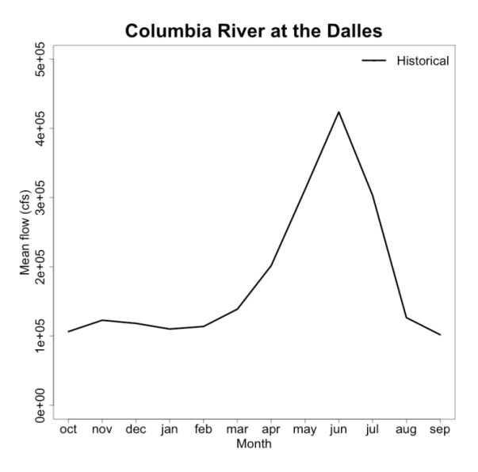
Basin Transformations: Shifting from Snow to Rain
Tohver et al. 2014; map by Rob Norheim (CIG)
Notes:
Warmer winter and spring temperatures will affect how much winter (Oct-March) precipitation is stored as snow.
[ADD A DESCRIPTION OF RAIN DOMINANT, TRANSIENT RAIN/SNOW, AND SNOW DOMINANT BASINS]
As we move forward in time, we see
Most snow dominant basins in the U.S. portion of the Columbia basin shifting to transient rain/snow basins (see Snake River Basin in Idaho and north Cascades); and
Many transient basins shifting to rain dominant basins (especially for the A1B scenario; see Oregon, southeast Washington)
rain-dominated
“transient” basins with an early winter peak from rainfall, and a spring peak from snowmelt
snowmelt-dominated basins, where streamflow peaks in late spring and early summer

Slide 27



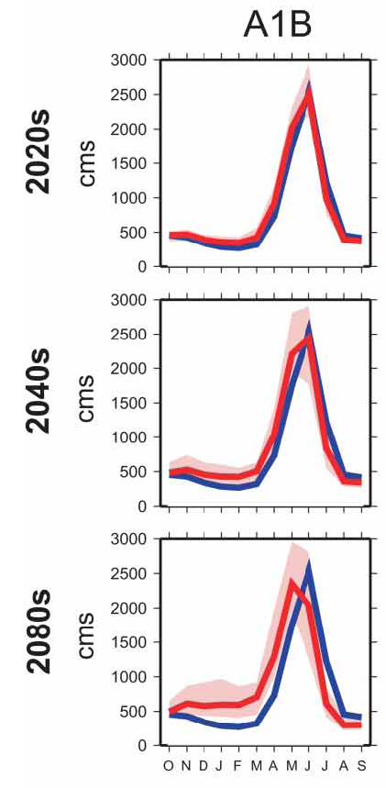
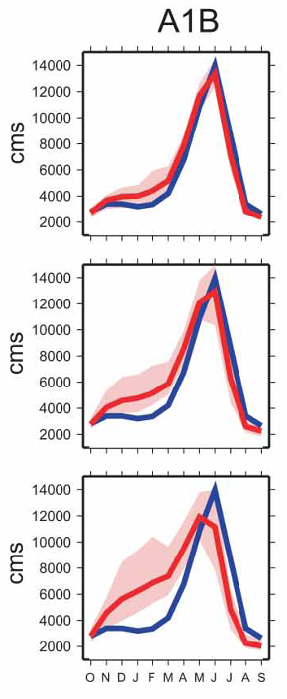

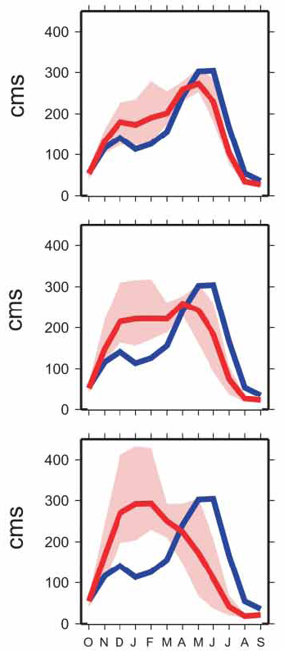
at Corra Linn
at The Dalles
at Parker Dam
Naturalized flows; blue line = historical (1916-2006)
Hamlet et al. 2013

Slide 28
Basin Transformations: Shifting from Snow to Rain
Medium Emissions Scenario
Tohver et al. 2014; map by Rob Norheim (CIG)
Notes:
Warmer winter and spring temperatures will affect how much winter (Oct-March) precipitation is stored as snow.
[ADD A DESCRIPTION OF RAIN DOMINANT, TRANSIENT RAIN/SNOW, AND SNOW DOMINANT BASINS]
As we move forward in time, we see
Most snow dominant basins in the U.S. portion of the Columbia basin shifting to transient rain/snow basins (see Snake River Basin in Idaho and north Cascades); and
Many transient basins shifting to rain dominant basins (especially for the A1B scenario; see Oregon, southeast Washington)
rain-dominated
“transient” basins with an early winter peak from rainfall, and a spring peak from snowmelt
snowmelt-dominated basins, where streamflow peaks in late spring and early summer

Slide 29
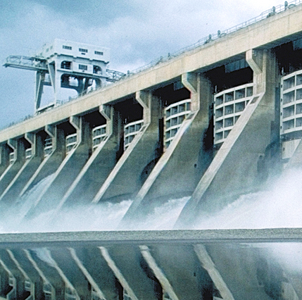
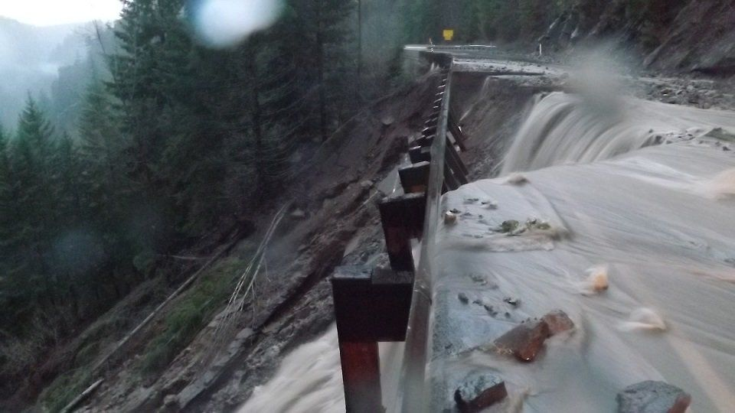
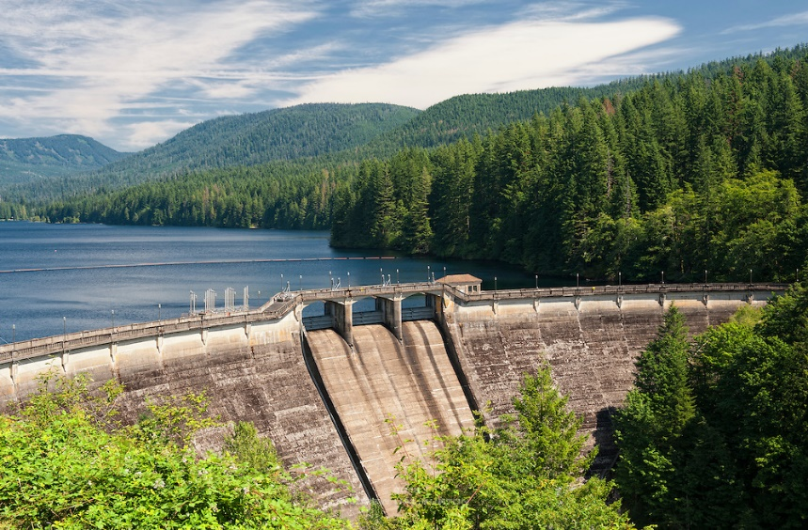
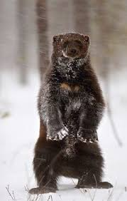
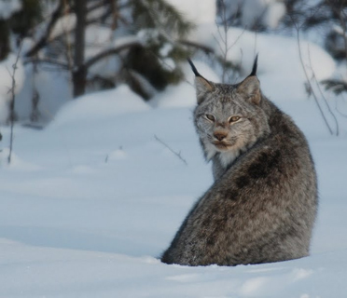
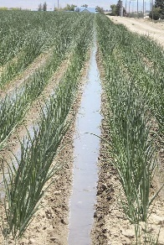
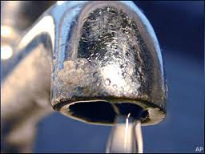
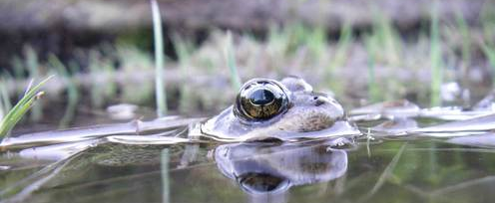
Implications: Upper Watersheds
Impacts on hydropower production
Impacts on mountain infrastructure
Impacts on water supply reservoir management
Impacts on snow-dependent species, alpine wetlands
Notes:
"Morphological adaptations, such as a low foot-loading (ratio of body mass to foot area), enable lynx to outcompete other predators in areas with deep, unconsolidated snow. Declining amount and duration of snowpack could thus result in a contraction of lynx core habitat, and increasing fragmentation and isolation of core areas within the current southern periphery of the lynx range."

Slide 30
Notes:
http://www.truewestmagazine.com/exploring-the-old-oregon-country/

Slide 31
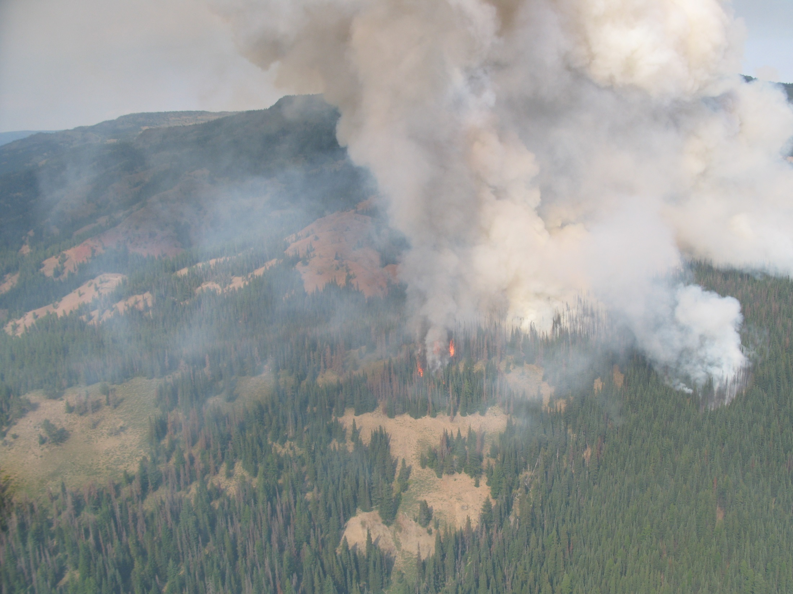

Increased wildfire risk
Area burned by fire in the Columbia River Basin is projected to double by 2020s, triple by 2040s, x5 by 2080s (relative to median for 1916-2006). (Littell et al. 2010, 2012)
Discovery Fire burns near volatile stands of
insect-damaged trees, 2009, DNR
Notes:
Wildfire suppression costs have increased as fire seasons have grown longer and the frequency, size, and severity of wildfires has increased due to changing climatic conditions, drought, hazardous fuel buildups, insect and disease infestations, nonnative invasive species, and other factors. Funding has not kept pace with the cost of fighting fire. Over the last 10 years, adjusting for inflation, the Forest Service has spent an average of almost $1.13 billion on suppression operations annually.
http://content.govdelivery.com/accounts/USDAOC/bulletins/102c14b
2009 Discovery Fire burns near volatile stands of insect-damaged trees, DNR
Https://www.flickr.com/photos/wastatednr/3773164066/in/set-72157621770445607
The area burned by fire regionally (in the U.S. Columbia Basin) is projected to double or triple (medium scenario, (A1B)), from about 425,000 acres annually (1916-2006) to 0.8 million acres in the 2020s, 1.1 million acres in the 2040s, and 2.0 million acres in the 2080s.
Median regional (WA, OR, ID, w. MT) area burned is projected to increase from about 0.2 million ha (0.5 M ac, 1980-2006) to 0.3 million hectares (0.8 M ac) in the 2020s, 0.5 million ha (1.1 M ac) in the 2040s, and 0.8 million ha (2.0 M ac) in the 2080s (average of CGCM3 and ECHAM5 GCM simulations under the SRES-A1B emissions scenario, Littell et al. 2010). The probability of exceeding the 95th percentile area burned for the period 1916–2006 increases from 0.05 to 0.48 by the 2080s (Littell et al. 2010). The probability of exceeding the late 20th century historical (1980-2006) 95th percentile under expected future hydroclimate (Elsner et al. 2010; Mote and Salathé, 2010, for SRES-A1B and SRES-B1 ensemble averages of 20 and 19 GCM realizations for the 2020s, 2040s, and 2080s) is a range of 0 to 30% for non-forested systems, 1 to 19% for the western Cascade Range, and 0 to 76% for the eastern Cascade Range, Blue Mountains, and Okanogan Highlands (after Littell et al. 2010). No statistical relationships could be constructed for the Oregon Coast Range and Olympic Mountains, though climate effects on fire in those ecosystems are evident in the recent paleoecological record (Henderson et al. 1989) and the consequences of rare events are extreme (>0.5 million ha burned in single events).
There is greater uncertainty about impacts to western WA/OR forests than interior PNW forests.
Changes in forest fire risk: Higher fire frequency and higher fire intensity expected, especially in drier interior PNW where fuel hazard is high. Increases in area burned projected. Increased potential for regional/landscape scale fires (regional synchronization of fuel availability)
As temperature increases, the atmosphere evaporates more water from the landscape, plant tissues, and fine fuels
This produces larger than normal, and more connected areas of depleted fuel moisture during the fire season
Regional synchronization of fuel availability occurs
Fire “blowups” are driven by extreme weather, but are contingent on climatically-driven fuel moisture.

Slide 32
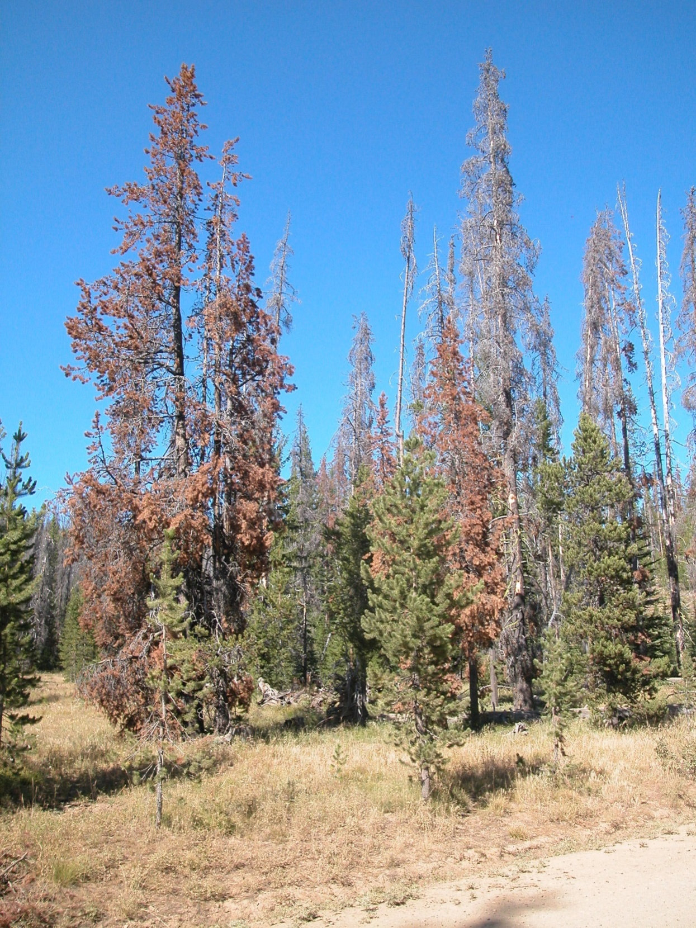
Increased risk of insect outbreaks
Near-term increased risk of mountain pine beetle outbreaks in drier forests will exacerbate fire risk. (Littell et al. 2010, 2012)
Discovery Fire burns near volatile stands of
insect-damaged trees, DNR
Photo: DNR
Notes:
DNR photo: https://washingtondnr.files.wordpress.com/2012/08/rp_fh_mtn_pinebeetle_mortality.jpg
Due to climatic stress on host trees, mountain pine beetle outbreaks are projected to increase in frequency and cause increased tree mortality. Climatically suitable habitat for pine species susceptible to mountain pine beetle is likely to decline dramatically by the 2040s.
Note also another beetle that is making its way north and affecting west side pines
“Newcomer beetle is not welcome in Washington State
November 30, 2012” -- California fivespined Ips (CFI)
“The beetle referenced in our previous blog (California fivespined Ips) is a different bark beetle species that also attacks pines, primarily ponderosa. This beetle has not previously been known to occur in Washington, although it is considered native to California and Oregon. We’ve detected it as far north as Joint Base Lewis-McChord now. It probably is focused on trees that are weakened by something else like drought or snow-breakage wounds and may be moving north due to a favorable climate. It seems to be mostly confined to ponderosa pines that grow west of the Cascades and in relatively weak trees. Landowners in the Washington Gorge area are working to reduce populations by controlling the amount of dead host material created by fires, storms, etc. that the beetles breed in.”

Slide 33
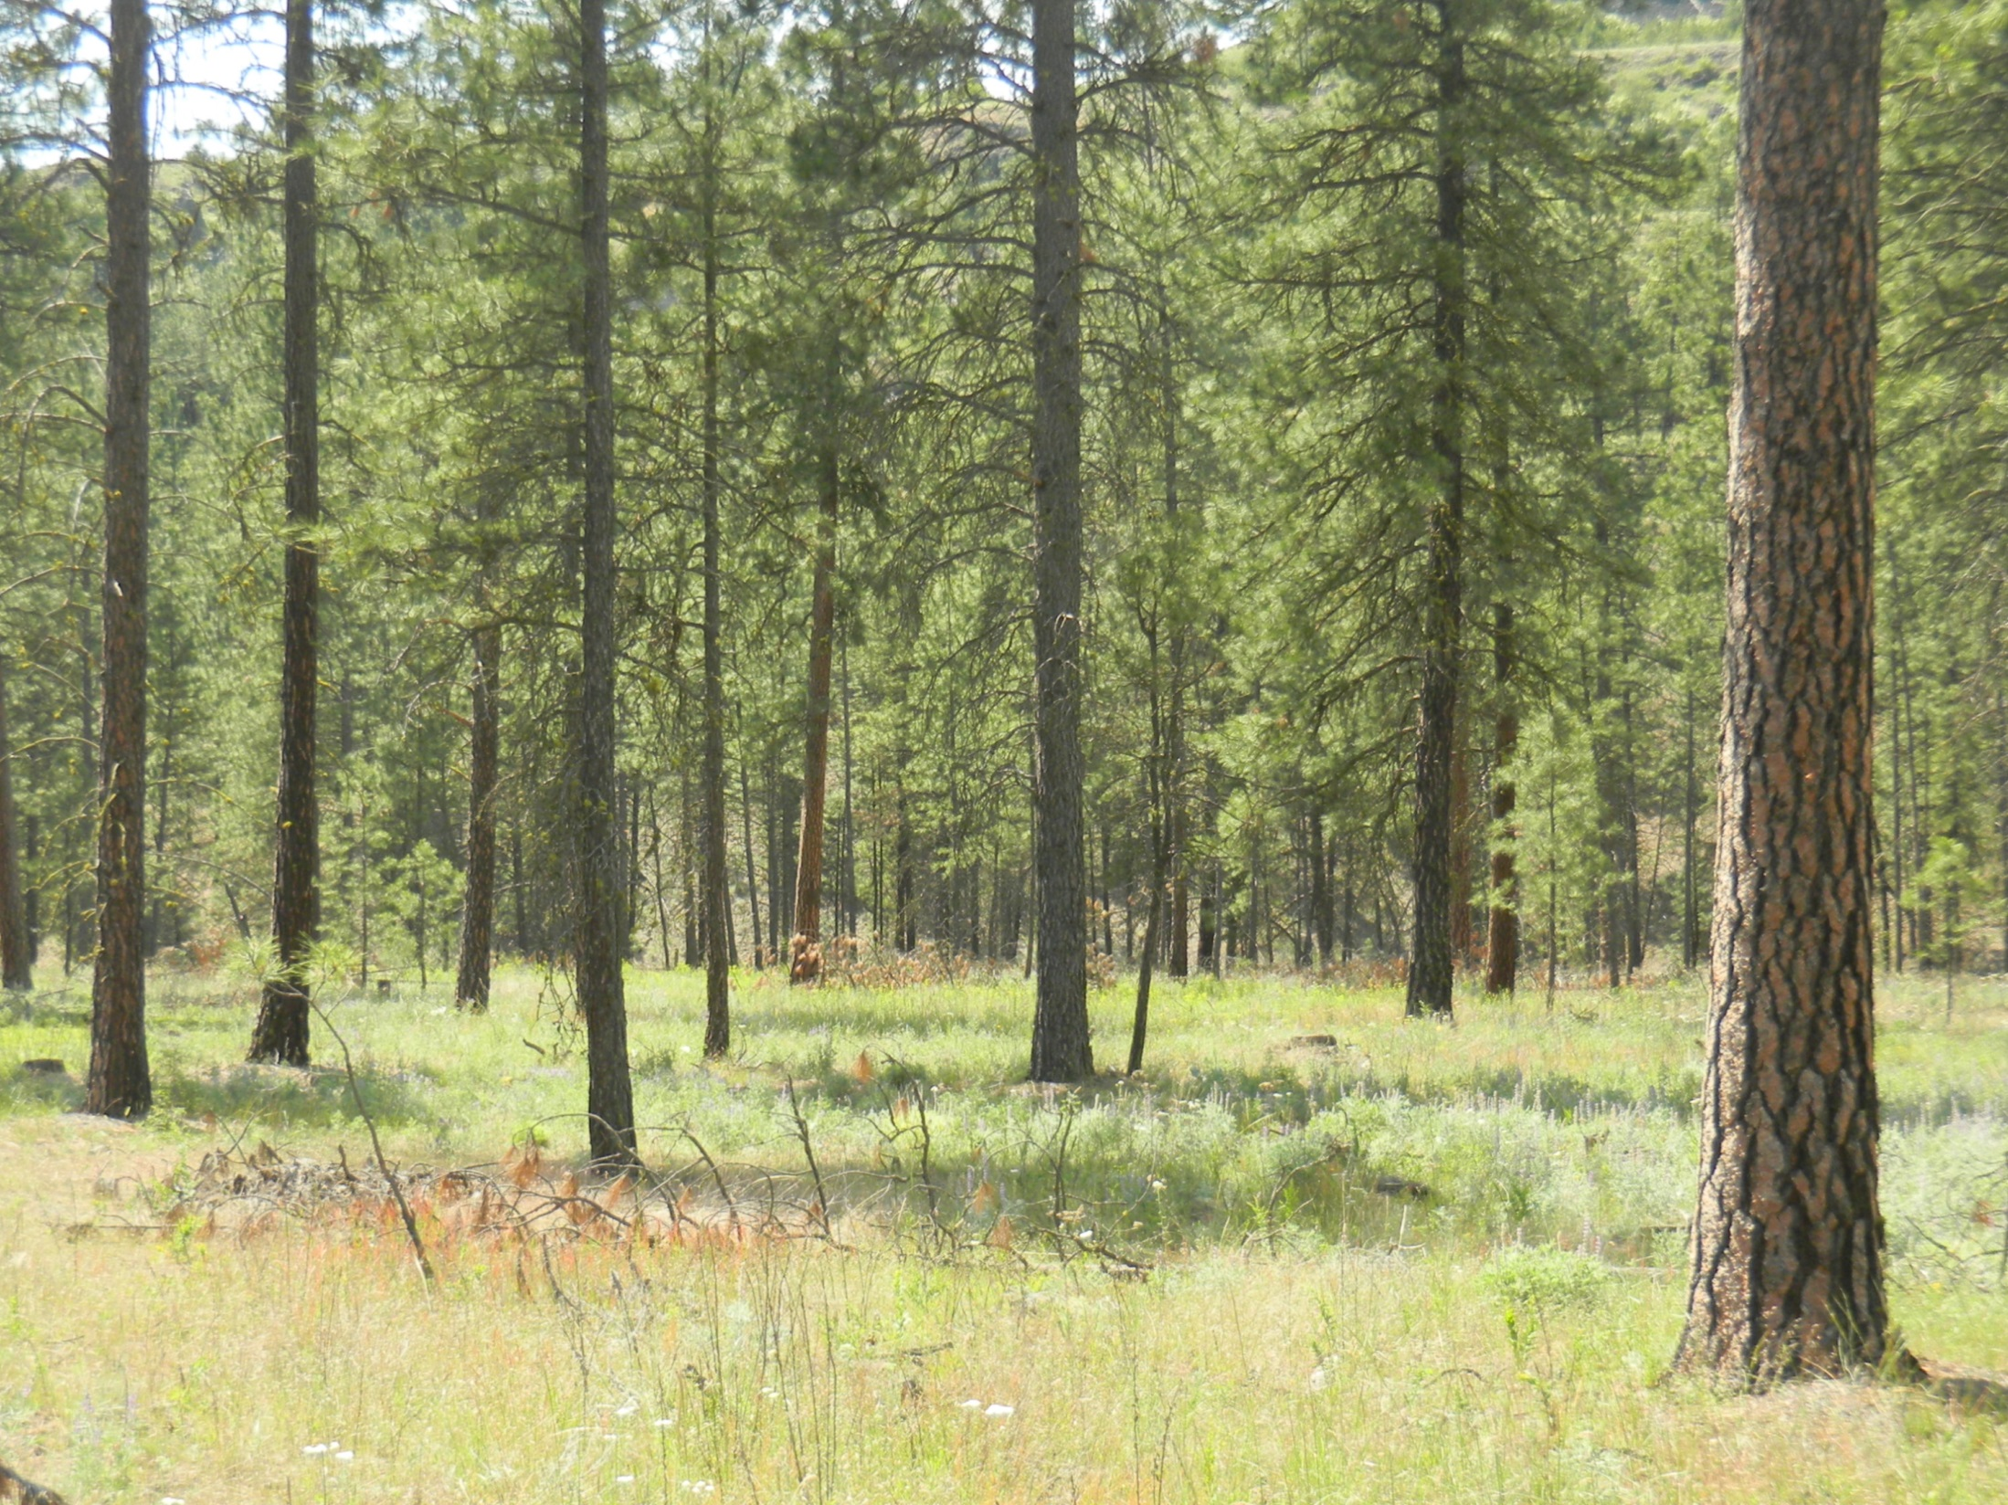
Reduced suitability for key pine species
Only 15% of the area currently suitable for three pine species in Washington – ponderosa pine, lodgepole pine, and whitebark pine - is projected to remain suitable for all three by the 2060s. (Littell et al. 2010, 2012)
Photo: DNR
Notes:
Changes in species distribution: Generally expect to see shifts upwards in elevation. Species will re-distribute according to their genetic tolerances for climate variables. Lodgepole pine is one of the currently wide-spread species with the most dramatic changes in future climatic suitability.
Changes in productivity: Increased productivity likely at high elevation due to lower snowpack; decreased productivity at low elevation due to moisture stress

Slide 34
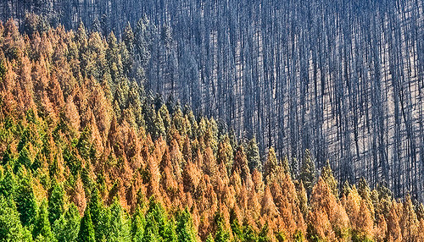
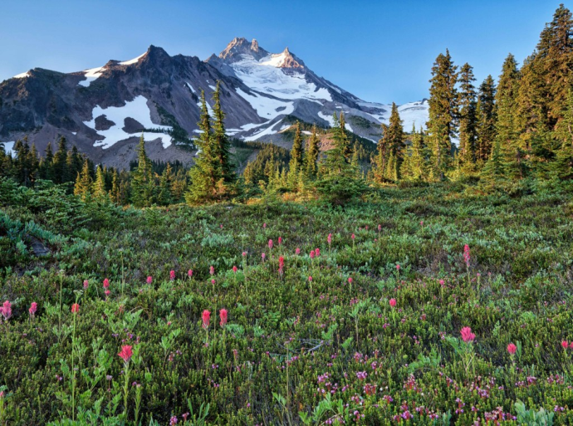
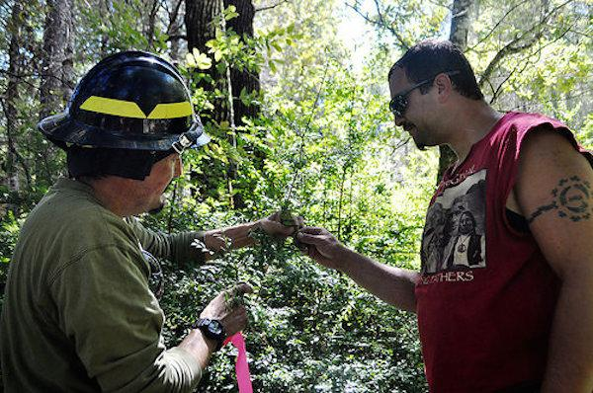
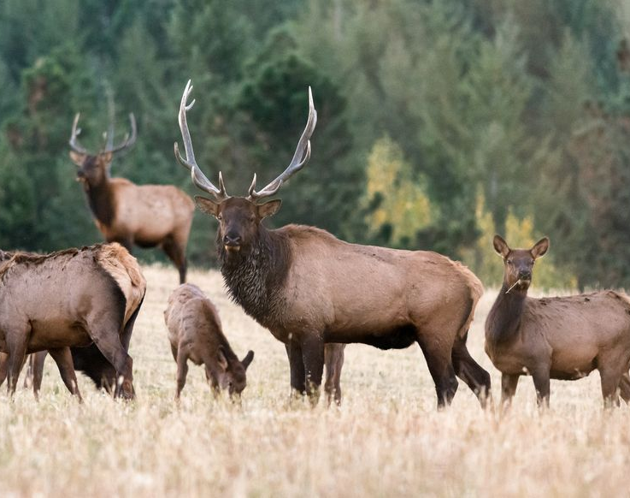
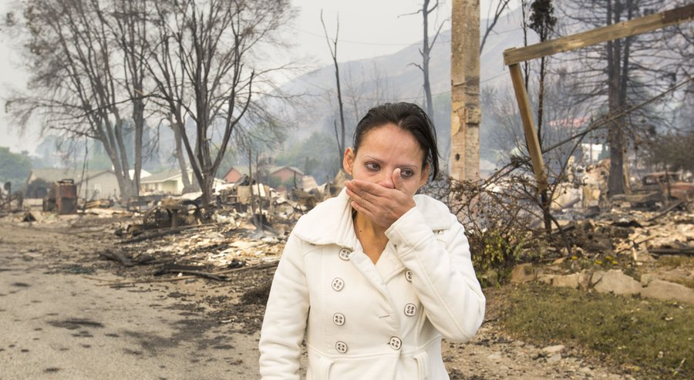
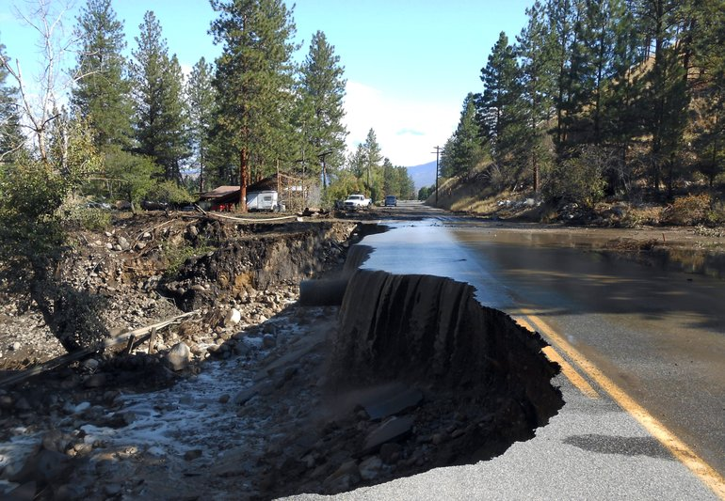
Implications: Forests and the Urban/Wildland Interface
Impacts on timber production, habitat
Tree encroachment on sensitive habitat
Opportunity to restore forest health
Impacts on forage lands, species
Loss of personal property, community infrastructure
Post-fire vulnerability
Notes:
Benefits of fire in restoring ecosystem diversity:
The Karuk and Yurok Tribes traditionally managed entire watersheds and ecosystems on their ancestral lands to meet their dietary, cultural and spiritual needs. The Tribes are now working to reestablish the once rich and bio-diverse ecology of their ancestral homeland forests and waterways using traditional agroforestry management systems.
“By putting fire back on the landscape, we intend to restore the currently wildfire-prone food desert into a healthy, bio-diverse, fruit, nut and wildlife-rich forest,” said Karuk Department of Natural Resources Director Leaf Hillman in a statement.
Read more at http://indiancountrytodaymedianetwork.com/2014/12/02/traditional-knowledge-fuels-yurok-and-karuk-habitat-restoration-project-usda-158099

Slide 35
Notes:
http://www.truewestmagazine.com/exploring-the-old-oregon-country/

Slide 36
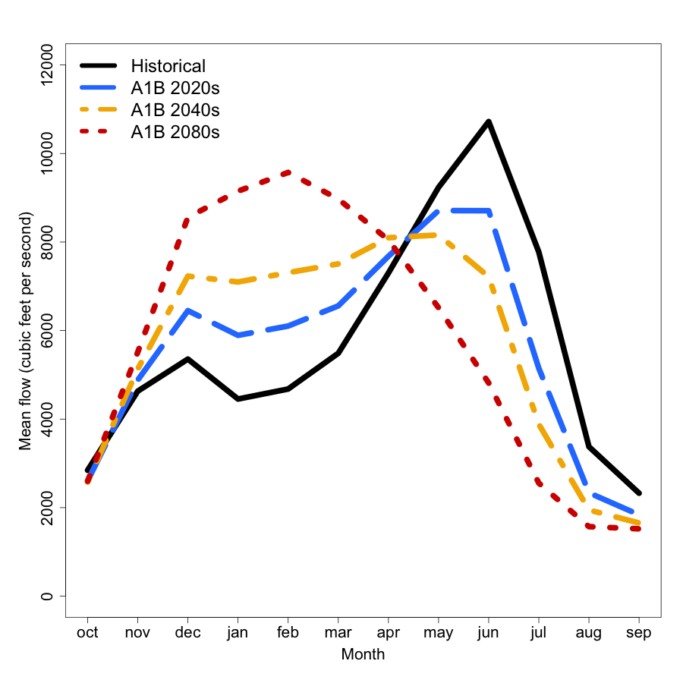
Changes in Streamflow
Increasing winter streamflows
Earlier peak runoff
Lower, warmer summer streamflows
Longer low-flow period
Mauger et al. 2015

Slide 37
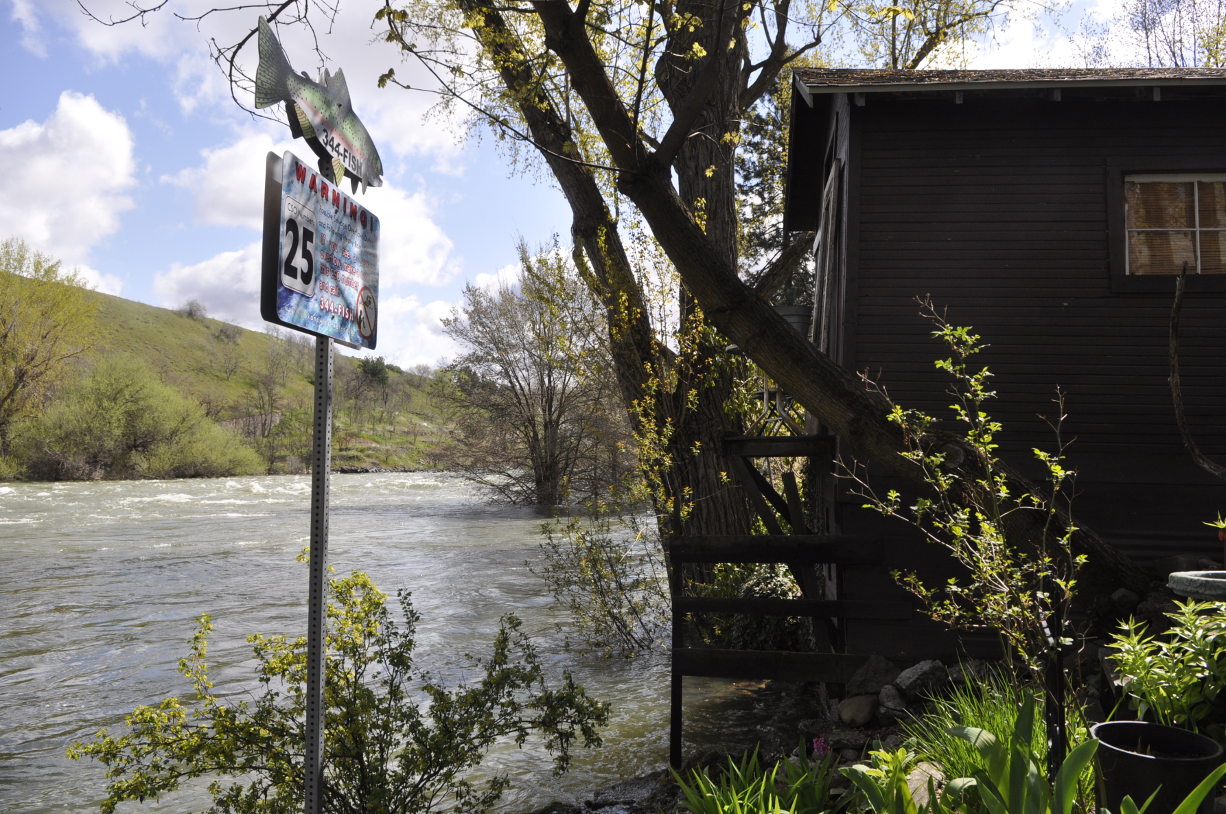
Flood Risk Increases
FRIDAY, APRIL 27, 2012, 8:41 A.M. Spokane River reaches flood stage in Spokane
http://media.spokesman.com/photos/2012/04/27/floodwater.jpg

Slide 38
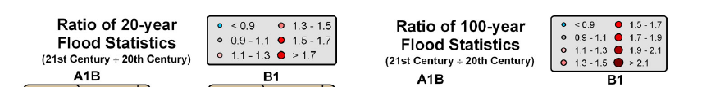
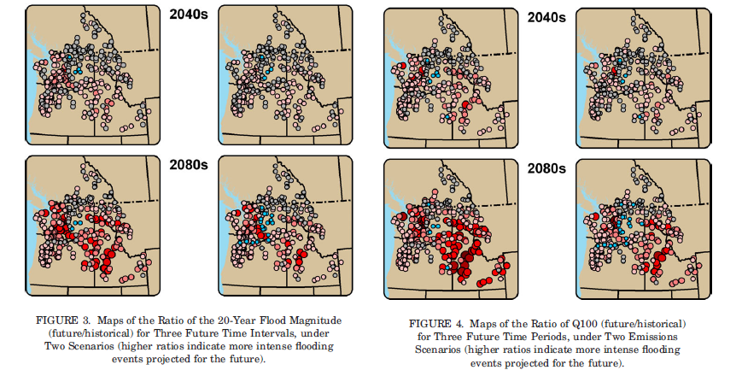
B1 = Low emissions/warming; A1B = Moderate emissions/warming

Slide 39

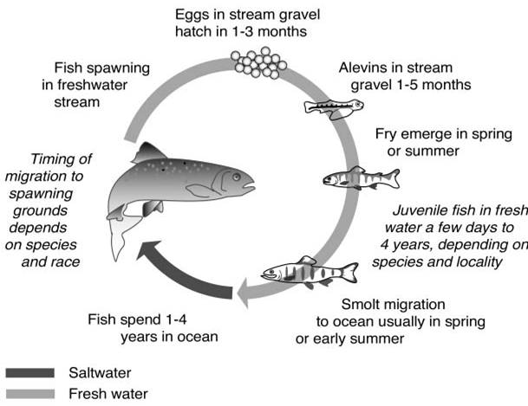
Salmon Impacted Across Full Life-Cycle
Floods
Early peak flows
Warm, low
streamflow
Ocean Acidification?
Warmer sea surface temps?
Notes:
Thermal barriers to migration for salmon: 70-72°F (21-22°C)
The key for understanding climate change impacts on salmon comes with understanding the cumulative impacts of all the factors that influence salmon during their life cycle. Climate change (global warming) can be considered as being a part of habitat change and habitat degradation, but the ultimate impacts of climate change on NW salmon cannot be assessed in isolation from the impacts of other factors influencing habitat, or harvest and hatchery practices. This framework also suggests that at least some of the negative impacts of climate change on salmon can be mitigated by alleviating existing negative impacts on salmon that come with other aspects of habitat, hatchery and harvest practices.
Floods: higher winter streamflow can lead to more streambed scouring events
Early peak spring floods: could lead to a disconnect between when estuary-bound migrating juveniles need the increased streamflow and when the water is there to carry the juveniles out (the water may come too early)
Warm, low summer streamflows: Warm, summer streamflows can cause stress or create thermal barriers to salmon living in summer streams or migrating in summer back to their spawning grounds. Thermal stress typically begins when average air temperature exceeds 68F; thermal barriers exist when average air temperature exceeds the 70-72F range.
Questions about the ocean: We do not know how climate change will alter coastal ocean conditions and, in turn, affect salmon.

Slide 40

Aug mean air temp – moderate (A1B) warming scenario
Data source: Norwest; figure source: Climate Impacts Group (Rob Norheim)

Slide 41

Source: Mantua et al. 2009
Notes:
An example of the change in duration
Spatial distribution of the number of weeks projected to present thermal barriers for migrating salmon
Bubble size is proportional the the number of weeks exceeding 21C
By the 2080s much of the Columbia Basin and some sites in western Washington as well (like Lake Union and the Stillaguamish at Arlington) will have longer periods
Presenting thermal barriers for salmon.

Slide 42





Implications:
Rivers, Floodplains, and Communities
Increased summer demand – public water supplies
Decreased reliability of irrigation supply
Increased demand for irrigation
Implications for infrastructure design
Increased sediment loading
Implications for restoration activites
Notes:
Flood photo: Naches River flooding near US 12, Dec 9, 2015 (http://www.nbcrightnow.com/story/30708278/severe-weather-causes-mudslides-and-flooding-in-central-Washington)
Drought photo: irrigation ditch in eastern WA, summer 2015

Slide 43

(Some of the)
Implications for Ecosystems
Shifts in ranges, changes in species assemblages
Habitat loss/gain
Changes in ecological stressors (drought, flooding, fires, pollutant loading + the human response)
Implications for phenology (i.e., timing of biological events)
Potential decoupling of interspecies interactions (e.g., predator/prey relationships, pollinators)
Changes in pressures from invasive species
Notes:
https://www.flickr.com/photos/19387539@N00/6414762563

Slide 44







Implications: Physical, Spiritual, Economic and Cultural Security
Notes:
Gathering bitterroot: http://nativeyouthleadership.org/johnny-buck/
Lummi crab fishermen: http://www.columbian.com/news/2015/nov/23/lummi-tribe-members-say-fishing-is-in-their-dna/

Slide 45


How Will We Experience Climate Change?
Primarily through changes in the frequency, intensity, and duration of many existing stressors….
“This never used to happen,” Mr. Toussaint said. “I’ve owned this place eight years, and now it’s all the time.”
Notes:
Scenes of street flooding, like this one on Alton Road in Miami Beach in November, are becoming increasingly common. Angel Valentin for The New York Times

Slide 46

How Will We Experience Climate Change?
Primarily through changes in the frequency, intensity, and duration of many existing stressors….
…but also through the emergence of new issues.
Notes:
Scenes of street flooding, like this one on Alton Road in Miami Beach in November, are becoming increasingly common. Angel Valentin for The New York Times

Slide 47

What are our options for dealing with this reality?
Notes:
“Not so new” refers tot h fact that we’ve known about climate impacts for 20+ years (and climate change since the 1860s).

Slide 48

Option 1: Assume climate change is not a problem
(or deny it altogether)

Slide 49








Mitigation and adaptation are required
&
Mitigation
Reducing emissions of greenhouse gases
Adaptation
Identifying, preparing for, and managing the change that occurs as mitigation strategies are implemented.
Notes:
Historically, dealing with the climate change problem meant focusing on reducing greenhouse gas emissions, or mitigation. However, as it has become clear that we are not going to avoid climate change impacts, the conversation has broadened to include strategies for managing the impacts of climate change (adaptation).
For many reasons these two strategies were initially presented (and often debated) as either/or activities. These two strategies must happen simultaneously given the need to:
avoid the most serious projected impacts (by reducing greenhouse gas emissions), and
prepare for the impacts that are difficult to avoid at this point.
The focus of today’s conference is on the need for adaptation.

Slide 50

Building Climate Resilience Through Adaptation: Ask the Climate Questions
Can we achieve our goals in a changing climate?
How do we sustain our resources and investments as the climate changes?
What is necessary to reduce risks associated with a changing climate?
How do we avoid creating new risks?
What opportunities should we prepare for?
What is necessary for success in a world of ongoing change and certain uncertainty?

Slide 51

Main Messages about Climate Change
Climate matters
Significant changes in climate are expected as a result of rising greenhouse gas emissions
Climate change affects tribal cultures, economies, investments, and health
The knowledge and tools to reduce climate risks exists, but mitigation is also required
Coast Salish Canoe Journey 2009 landing in Pillar Point; photo by Carol Reiss, USGS
Notes:
Coast Salish Canoe Journey 2009 landing in Pillar Point; photo by Carol Reiss, USGS
Image source: http://www.eopugetsound.org/sites/default/files/topical_article/images/canoe_landing--Carol_Reiss_0.jpg

Slide 52





Regional Expertise (Examples)
University of Washington Climate Impacts Group
cig@uw.edu
Northwest Climate Hub

Slide 53




For more information…
The Climate Impacts Group
cig.uw.edu
cig@uw.edu
Lara Whitely Binder
lwb123@uw.edu
Northwest Climate Science Center
Available for download at cig.uw.edu

