Slide 1

Confederated Tribes of the Colville Reservation
Climate Change Adaptation Project
Mike Sanders, F&W, Manager, Strategic Initiatives

Slide 2

Agenda / Overview
Project Launch and First Steps
Project Scope
First Tasks and Early Challenges
Getting Organized
Early Lessons Learned
Project Partners
Current Status and More Lessons Learned

Slide 3
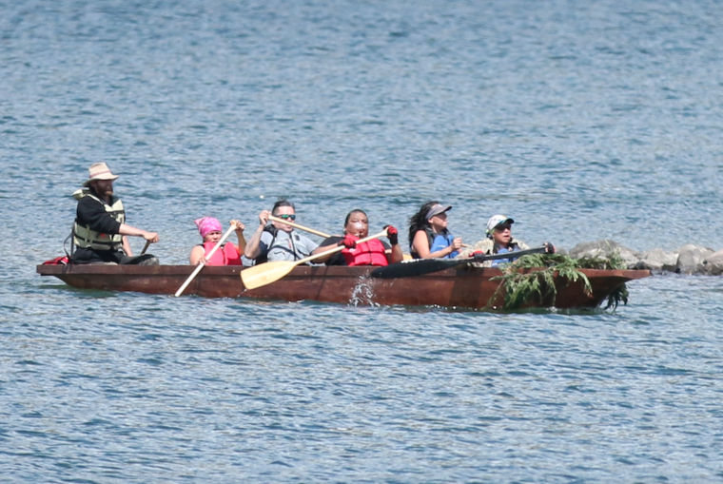
Project Launch
Project originally conceived and launched in 2014 by Rhonda Dasher in F&W
Successful grant applications though BIA and GNLCC

Slide 4


Project Scope
Develop a comprehensive strategy to predict, prepare and respond to climate change on and around reservation lands
Formation of an advisory group
Develop Tribal Capacity in Climate Change Adaptation

Slide 5
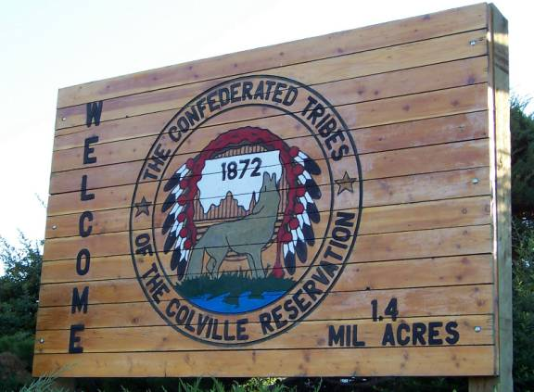
Project Scope
Complete a comprehensive inventory of environmental data collected by the Tribe’s various Departments

Slide 6


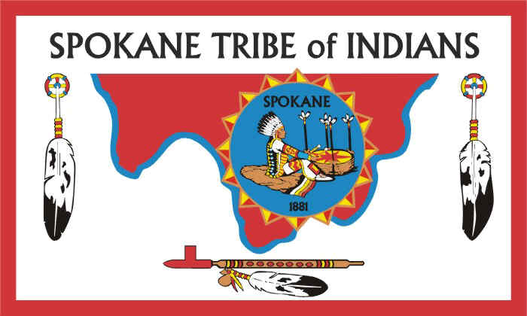

Project Scope
Work cooperatively with partners in the Upper Columbia United Tribes to combine forces and share learning

Slide 7
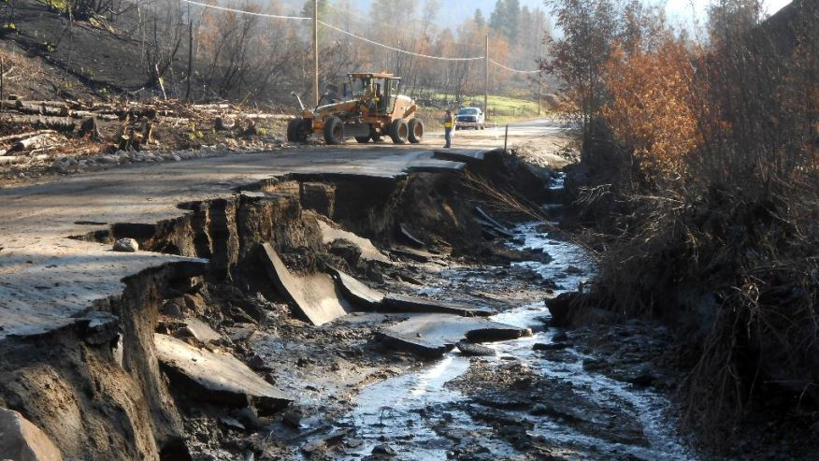
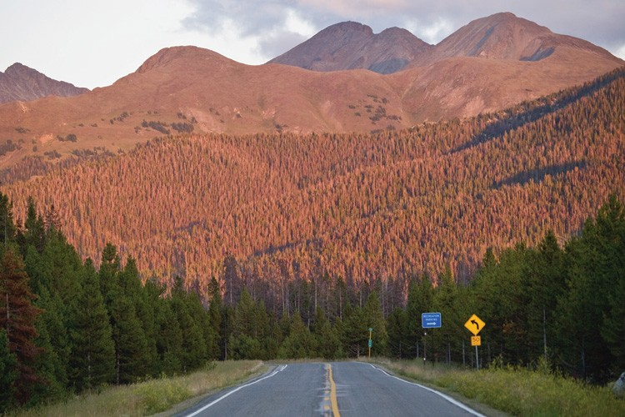
Project Scope
Complete a vulnerability assessment with respect to climate change
Incorporate TEK (Traditional Ecological Knowledge) into our study and plans

Slide 8





Project Scope
Benchmark best practices in climate change adaptation from Tribes and agencies that have gone before us

Slide 9







Project Scope
Partner with leading climate change scientists and thought leaders

Slide 10
First Tasks and Early Challenges
Developing initial scope of project
Securing funding
Building a climate change project team
  Small Planning group
  Larger Steering Committee
Initial planning exercises
Re-scoping (expanding) project

Slide 11
First Tasks and Early Challenges
Building capacity within our project team
  Workshops, webinars, conferences, individual research and learning
  ITEP Climate Change Adaptation Workshop
Benchmarking the work of other Tribes and agencies
  Reviewing sample reports

Slide 12
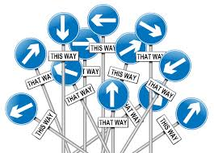
Getting Organized
Development of initial Climate Change planning team
Development of CCT Climate Change Steering Committee

Slide 13
Functions of “Planning Group”
Coordinate grant/project activities with outside agencies (BIA, UCUT, UW, etc.)
Provide climate change consulting services to Tribal Departments
Assist Departments with tools, grant resources and development opportunities
Provide overall climate change project leadership

Slide 14
Functions of the “Steering Committee”
Participate in bi-weekly to monthly Steering Committee meetings
Participate in climate change development activities to help build Tribal capacity
Provide data and expertise for Vulnerability Assessment and Climate Change Adaptation Plan

Slide 15
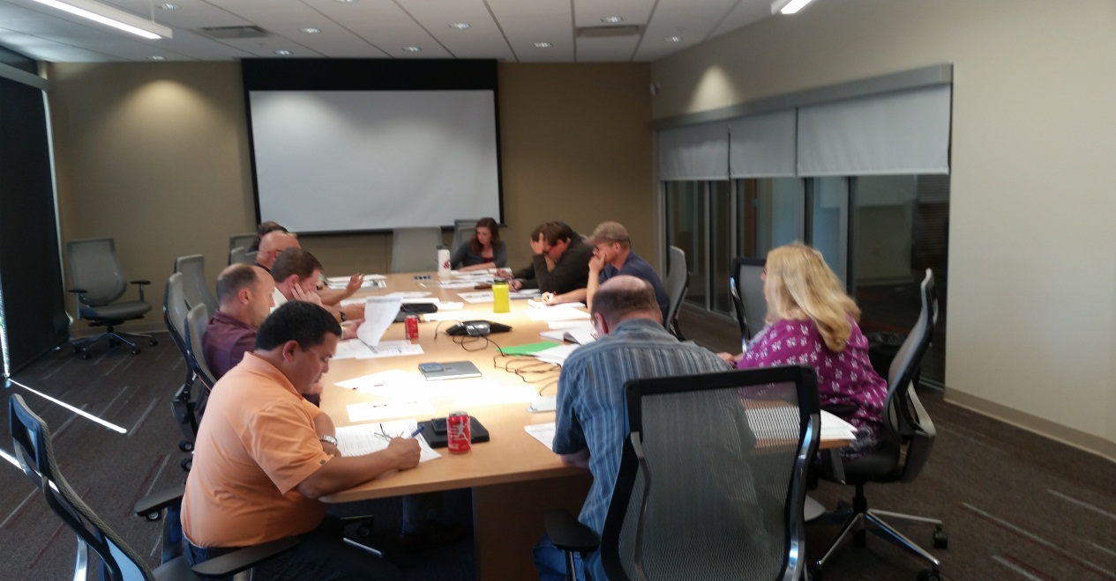
Steering Committee
Communicate back to departments on Climate change programs and initiatives
Research and apply for additional climate change grants to support specific projects

Slide 16
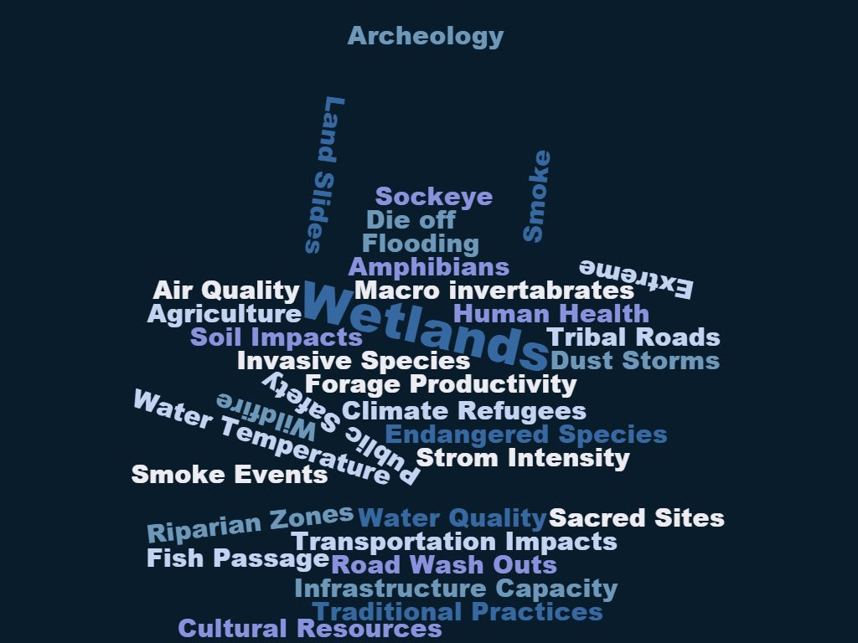
Steering Committee Issues

Slide 17
Early Lessons Learned
The learning curve is steep at the beginning of the project
Climate change affects everything!
Project scope can be difficult to define
It takes a multi-disciplinary team to manage a project of this nature

Slide 18
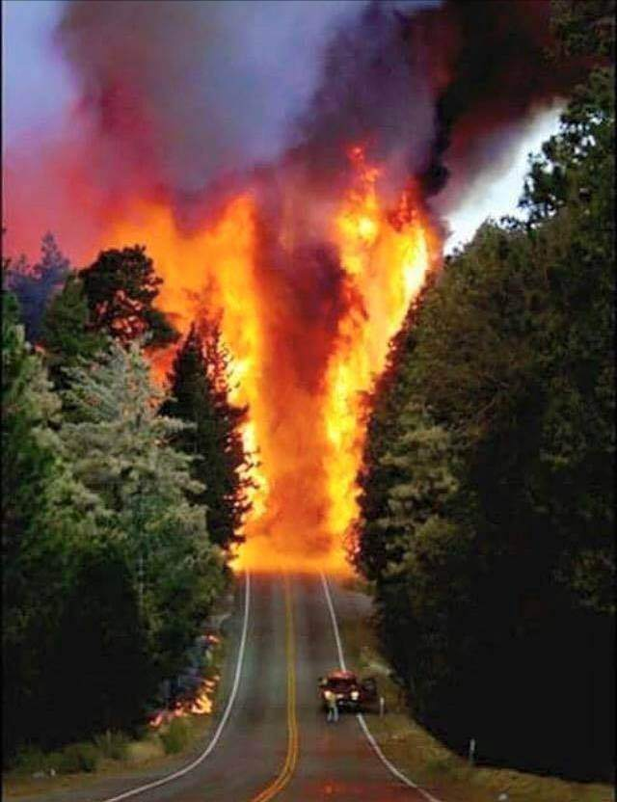
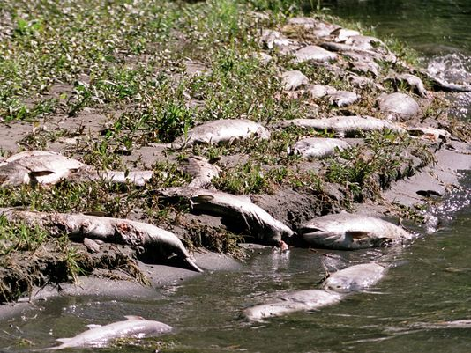
Early Lessons Learned
Climate change is not waiting for us to get ready!

Slide 19
Early Lessons Learned
There are a bewildering number of agencies and resources available to help
It takes time and research to choose partner agencies and a methodology for your project
It’s important to create a “sustainable” funding source for your project

Slide 20
Current Project Tasks
Completion of Rapid Vulnerability Assessment Table
Finalize sub-contract with University of Washington Climate Impacts Group for:
  Physical Drivers Report
  Data Vulnerability Analysis

Slide 21
Rapid Vulnerability Assessment Table
F&W prepared a first draft of a Rapid Vulnerability Assessment Table to get the project started
An initial draft was provided to the Steering Committee for feedback
This is a “qualitative” analysis used to assess potential impacts associated with climate change
We started with five key assessment areas which over time have been expanded to 20 areas

Slide 22
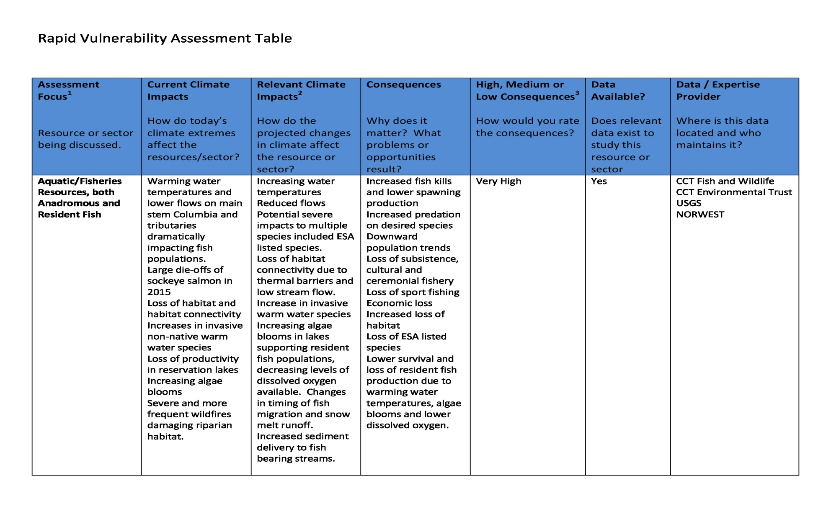
Rapid Vulnerability Assessment Table

Slide 23
Climate Change Reports
Three reports we’re working on
  Physical Drivers Report
    Customized climate forecast for our region
  Data Vulnerability Analysis
    Where we’re vulnerable based on climate forecast
  Climate Change Adaptation Report
    Planning document to build climate resilience
    Specific strategies to minimize negative impacts and take advantage of opportunities associated with climate change

Slide 24
Traditional Ecological Knowledge
    Rhonda Dasher is TEK Project Manager
    Forming a TEK Committee to manage project
    Basic process:
      Determine what information we’re seeking
      Identify costs and funding sources
      Select participant group (Elders)
      Develop & test questionnaire
      Hire and train interviewers
      Set up schedule and interview sites
      Conduct interviews and capture information
      Record for inclusion in reports

Slide 25
Communication Strategy
    Communication Coordinator – Mary Davisson
    Climate Change website with news and updates
    Facebook page on climate change
    Working with youth through youth center activities
    Steering Committee participation
    Participation by elders in TEK project
    Project presentations
    Tribal Tribune

Slide 26
Additional Tasks
Work closely with UW Climate Impacts Center to complete first two foundational reports
Secure additional funding to support development of Climate Change Adaptation Report
Complete and publish first draft of CCT Climate Change Adaptation Reports
Begin working on implementation plans

Slide 27
Summary
Project Launch and First Steps
Project Scope
First Tasks and Early Challenges
Getting Organized
Early Lessons Learned
Project Partners
Current Status and more lessons learned

Slide 28
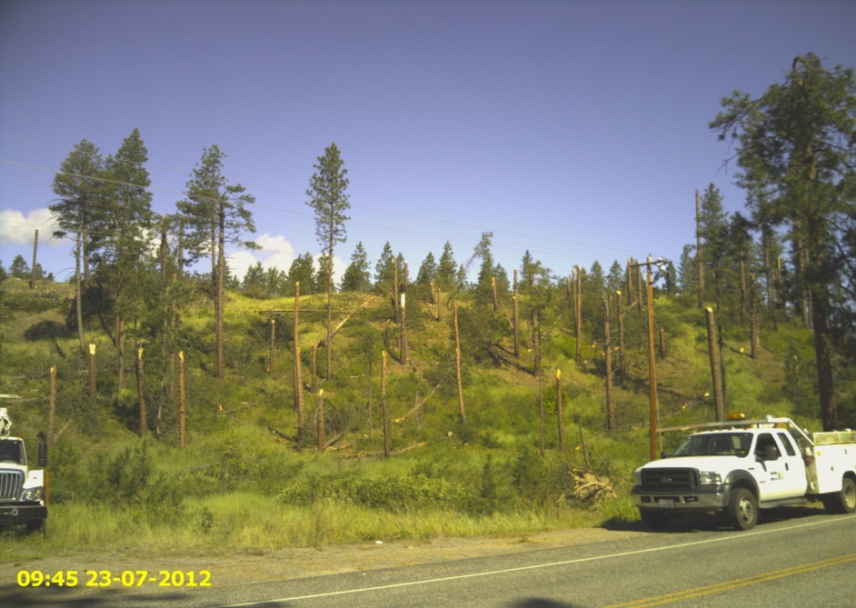
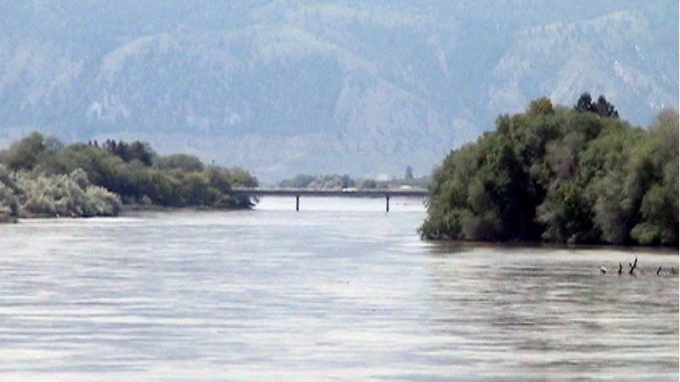
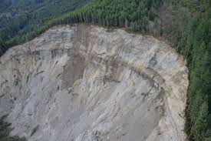
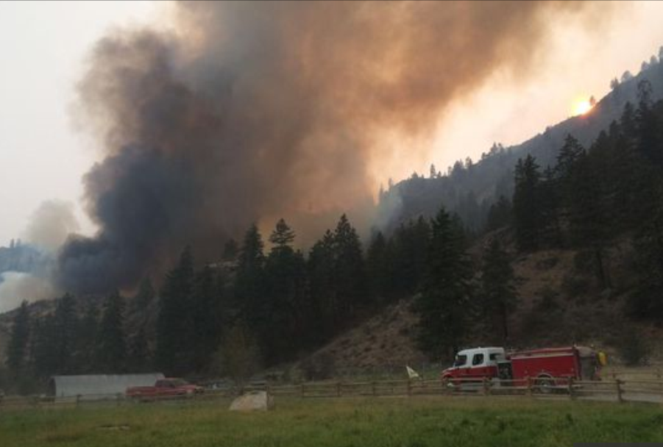
Climate Change is not Waiting for us to be Ready

