Slide 1

Climate Resilience for the Upper Columbia River Workshop Climate Change Group Activity
Mike Sanders, F&W, Manager, Strategic Initiatives

Slide 2
Rapid Vulnerability Assessment Group Exercise
Break Up Into Four Groups
Go to a Flip Chart in Corner of the Room
Each Group Works on “One” Assessment Focus Area
As a group:
Review Sample Handouts for Questions & Format
Decide which Focus Area You Want to Work On
Write it down on Your Flip Chart
Brainstorm and capture inputs on the 6 Questions

Slide 3
Rapid Vulnerability Assessment Group Exercise
Don’t Worry About Getting it Perfect – This is a Brainstorming Session
Select a Spokesperson to Present Your Results
Prepare for a Debrief at the End

Slide 4
Group One Focus Areas Choose One
Tribal Health
Flooding Risk
Resident Fisheries Management
Power Grid / Energy Program
Public Safety (police, EMS)

Slide 5
Group Two Focus Areas Choose One
Tribal Infrastructure (buildings, wells, public works, IT)
Invasive Species (plants, animals, fish)
Wildlife Management – Ungulates & Predators
Wetlands Management – Riparian Zones
Agricultural Production

Slide 6
Group Three Focus Areas Choose One
Forest Management Practices
Air Quality
Soils Preservation & Productivity
Transportation Infrastructure / Roads, Bridges, Ferries
Anadromous Fisheries

Slide 7
Group Four Focus Areas Choose One
Wild-land Fire Management
Rangelands Management / Grazing
Land Slides
Water Quality (temperature, flows, aquatic habitat)
Tribal History and Archeology

Slide 8
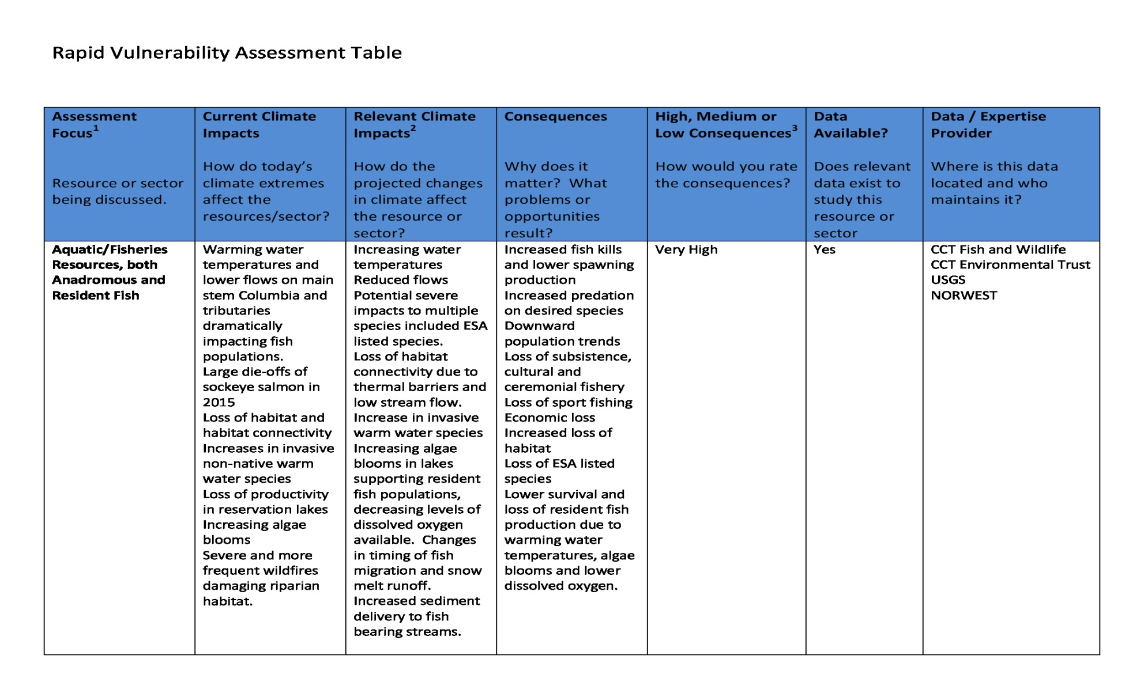
Rapid Vulnerability Assessment Table

