Slide 1
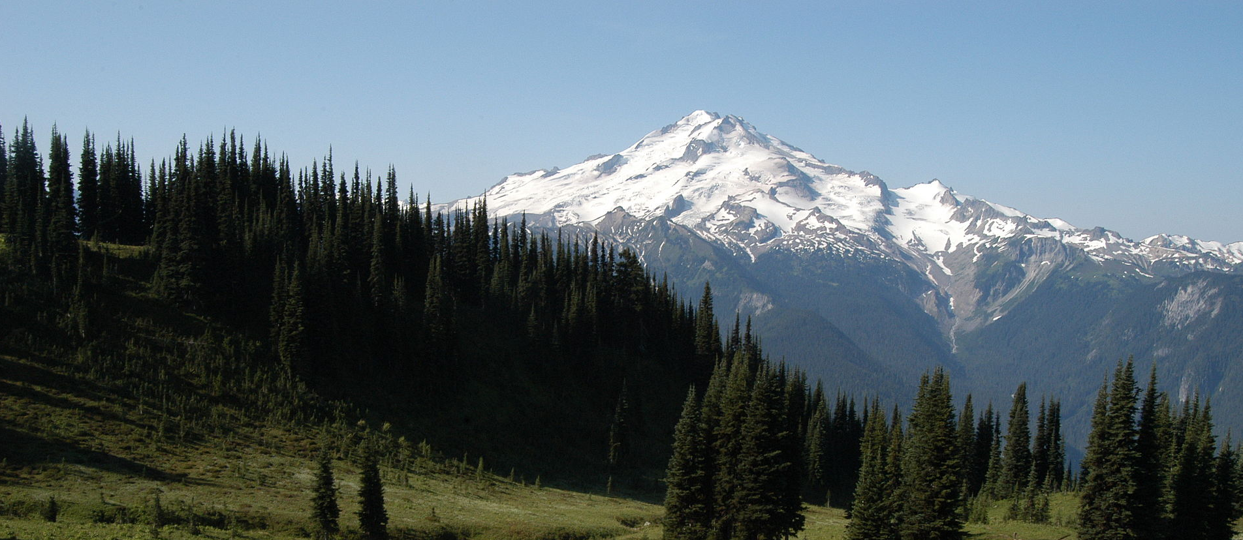


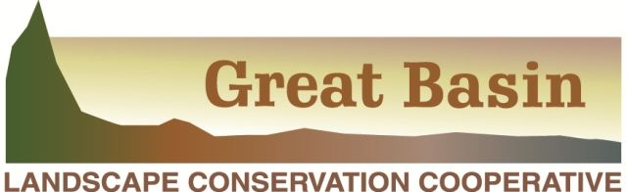

Building Tribal Capacity for Climate Change Vulnerability Assessment
Lara Whitely Binder Climate Impacts Group
University of Washington
Notes:
Hi and thank you for having me here today – it’s a pleasure to be here to hear and learn from the speakers and participants, and tell you about and invite your participation in a new project intended to increase tribal capacity for vulnerability assessment. We’re all here today because of the recognition that preparing for and responding to the impacts of climate change will be critical to the future well-being of tribal communities, yet we also know that there are significant gaps and disparities in tribal capacities for climate change planning and implementation. This process of preparing for and responding to climate change often looks something like this:

Slide 2
Preparing for Climate Change
Define Problem
Identify & Assess Options
Implement
Monitor
Evaluate & Adjust
Vulnerability Assessment
*often done together
Adaptation
Plan
Notes:
We begin by identifying climate risks (“defining the problem”) – how climate will change and how it will affect the things we care about - and then move through identification of actions for addressing climate risks, implementation, monitoring, and evaluation and adjustment.

Slide 3
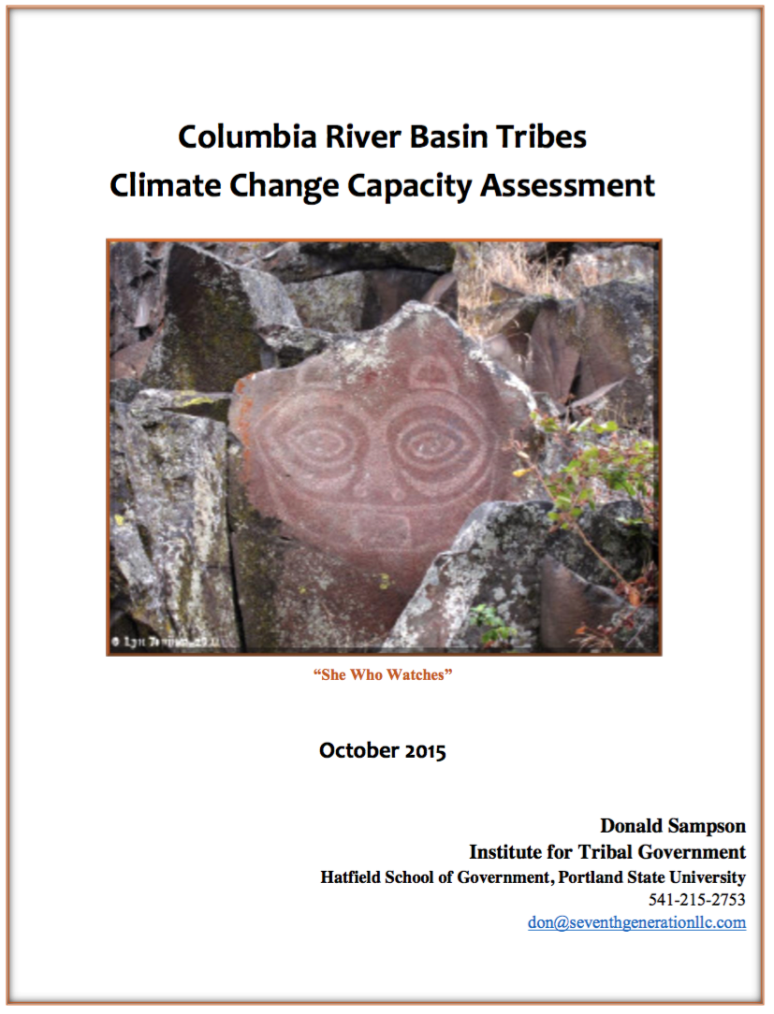
Notes:
The NW CSC recently funded a survey, led by Don Sampson, of 15 Columbia River Basin Tribes and three Inter-Tribal organizations to assess their technical, scientific, and policy capacity for climate change preparedness and adaptation.
This assessment confirmed the presence of significant gaps and disparities in tribal capacities for climate change planning and implementation. Among these, it found that many tribes face barriers to initiating and completing the critical first step of the adaptation planning process: a vulnerability assessment.
The vulnerability assessment process requires significant technical resources and expertise, particularly because you need downscaled climate data to know how the climate will change where you live, and how those changes are likely to affect the plants, animals, and other resources that you care about. Before you can think about how to respond.
The NW CSC wanted to address these needs for additional tribal capacity for vulnerability assessment, and because capacity building is a large part of what we do and because of our experience partnering with Northwest tribes, they contacted us at the Climate Impacts Group at the University of Washington.
It is our recommendation that NW CSC (and North Central CSC) provide more specialized expertise, analysis, and support to the Columbia River Basin Tribes or Intertribal organizations who have completed or are now developing vulnerability assessment or adaptation plans. In order to support Tribes or Intertribal organizations that have not developed vulnerability assessments, the respective LCCs, ITEP, NW Tribal Climate Project, and ATNI should provide webinars, workshops, and outreach strategies as a first step to help prepare them for conducting vulnerability assessments, and other support including:
• Providing training on climate vulnerability and risk assessments and adaptation planning, including innovative strategies to fund implementation of those plans;
• Tribal models for documenting, preserve, protecting, and incorporating TEK;
• How to effectively conduct outreach and engagement of tribal communities;
• Downscaling of climate models to analyze their local resource impacts;
• Provide access to data, analytic tools, and develop or disseminate guidance to support Tribal decision-making; and
• Basic climate change impacts and planning education for Tribal leaders, community members, and non-natural resource department managers including workshops, community conferences, informational videos and brochures.

Slide 4


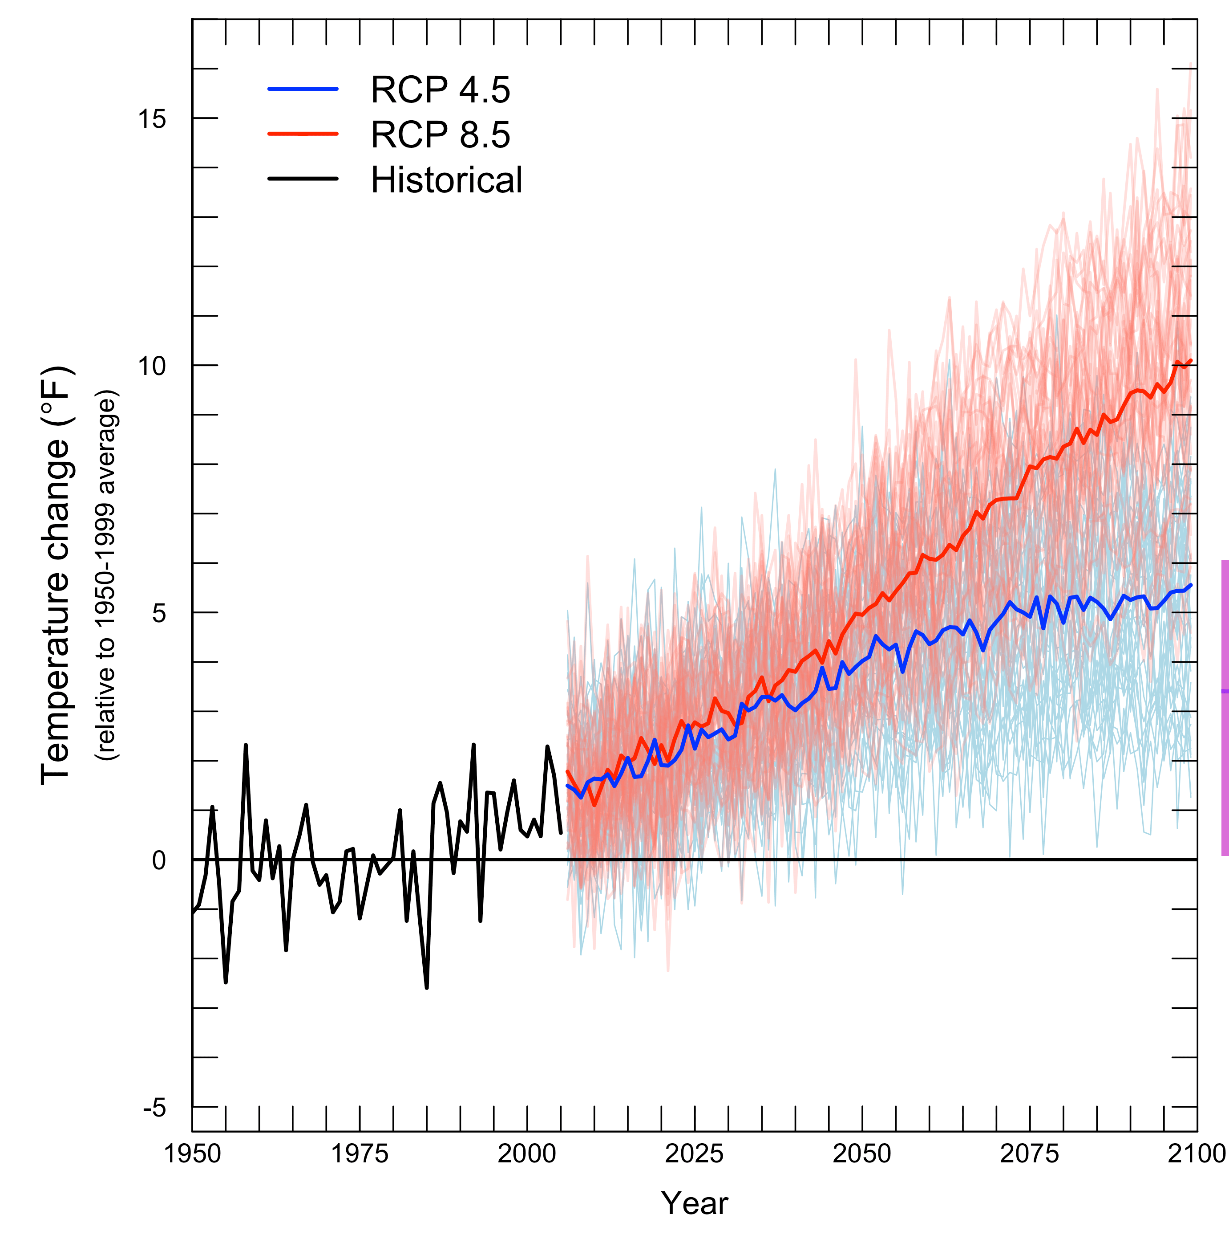
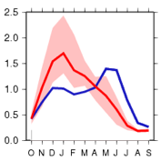
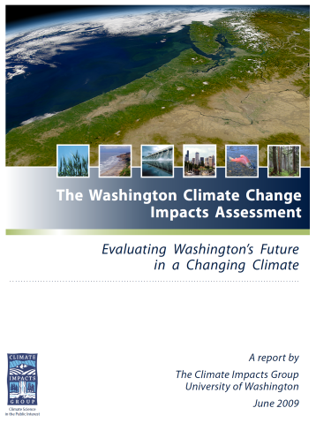
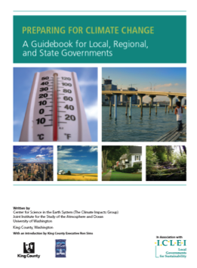
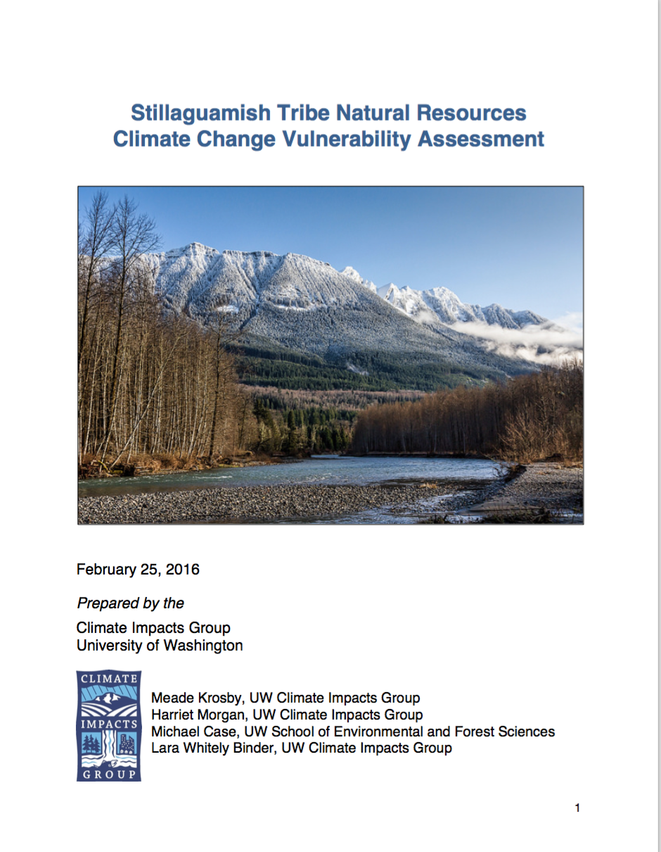
The Climate Impacts Group
Building climate resilience for people and nature for 20 years
Identifying climate risks and response options
Partnering with decision makers: fish and wildlife, forests, agriculture, energy, water, and coasts
Go-to source for climate information: state and federal agencies, tribes, NGOs, media, and public
Notes:
NW CSC reached out to myself and my colleagues at the Climate Impacts Group to collaboratively develop a project that could help address this need for enhanced capacity.
Since its founding in 1995, the Climate Impacts Group, housed at the University of Washington, has provided the fundamental scientific understanding, projections, models, and technical expertise needed to help decision makers assess and manage the impacts of climate variability and change. ** CLIMATE VARIABILITY AND CHANGE **
We have members and collaborators with diverse scientific expertise from across the University of Washington and Washington State University, and from federal agencies and research labs, including NOAA, USFS, and PNNL. We are part of the Dept of Interior’s NW Climate Science Center, a joint effort of USGS, UW, OSU and UI.
Areas of Impact:
-Assessment of impacts for the state – directed by the legislature to both assess impacts and make future projections available to be used in a wide array of planning
-Bringing to the forefront the importance of water, and working with those in Seattle (esp. SPU and City Light) to use information about year-to-year and future change
-Implementation, esp. with ecosystems and infrastructure

Slide 5
Building Tribal Capacity for Climate Change Vulnerability Assessment
Project goal:
Help address limited tribal capacity for climate change vulnerability assessment by providing guidance and data tailored to the needs and capacities of Northwest and Great Basin tribes.
Notes:
And so, we worked with the NW CSC and eventually the Great Basin LCC as well, to develop a project that would address the capacity needs identified in Don’s report. The goal of the project we developed, which is launching later this fall, is to…
All of the work of this project, including its development, has been and will be done in partnership with the NW CSC ESAC (Executive stakeholder advisory committee), a project tribal advisory committee that includes tribal members of the NW CSC’s advisory committee and will also bring in representatives from the Great Basin, and ultimately any tribes in the Northwest and Great Basin that would like to participate.

Slide 6
1. Make the vulnerability assessment process more accessible to tribal staff
Develop online resources related to the vulnerability assessment process that are designed, organized, and presented in ways that make the process more accessible to tribal staff
Collaborate and build synergies with other regional efforts to inform and support tribal climate response
Notes:
These online materials will include protocols, worksheets, and other guidance documents designed to help tribal staff initiate and complete vulnerability assessments. The materials will draw on existing literature as well as the UW Climate Impacts Group’s (CIG) extensive experience with vulnerability assessment efforts in the Northwest. All materials will be added to a project web page hosted on the CIG website.
Curated, online collection of available tools, guides, datasets, and approaches

Slide 7
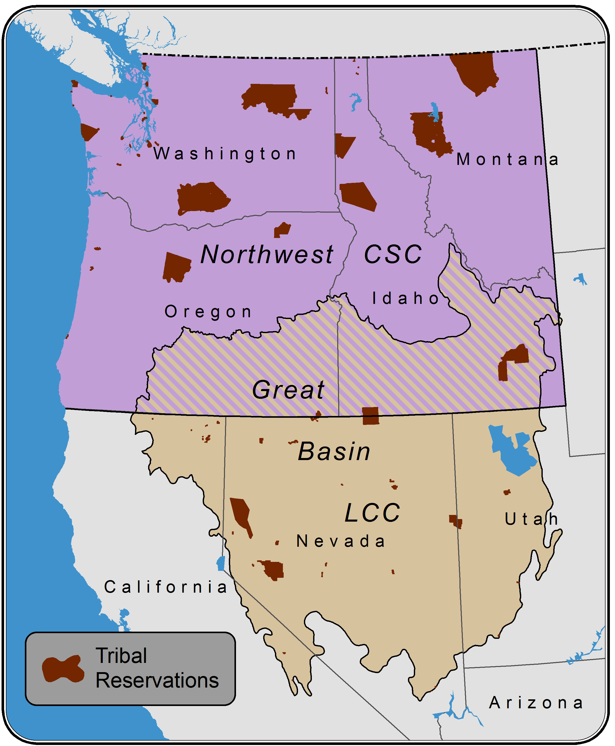
2. Provide climate data at the scale of tribal decision-making
Consult with tribal partners to determine the appropriate scale and variables for analysis
Prepare a suite of downscaled climate datasets specific to tribal needs
Create technical summaries of projected changes in climate

Slide 8
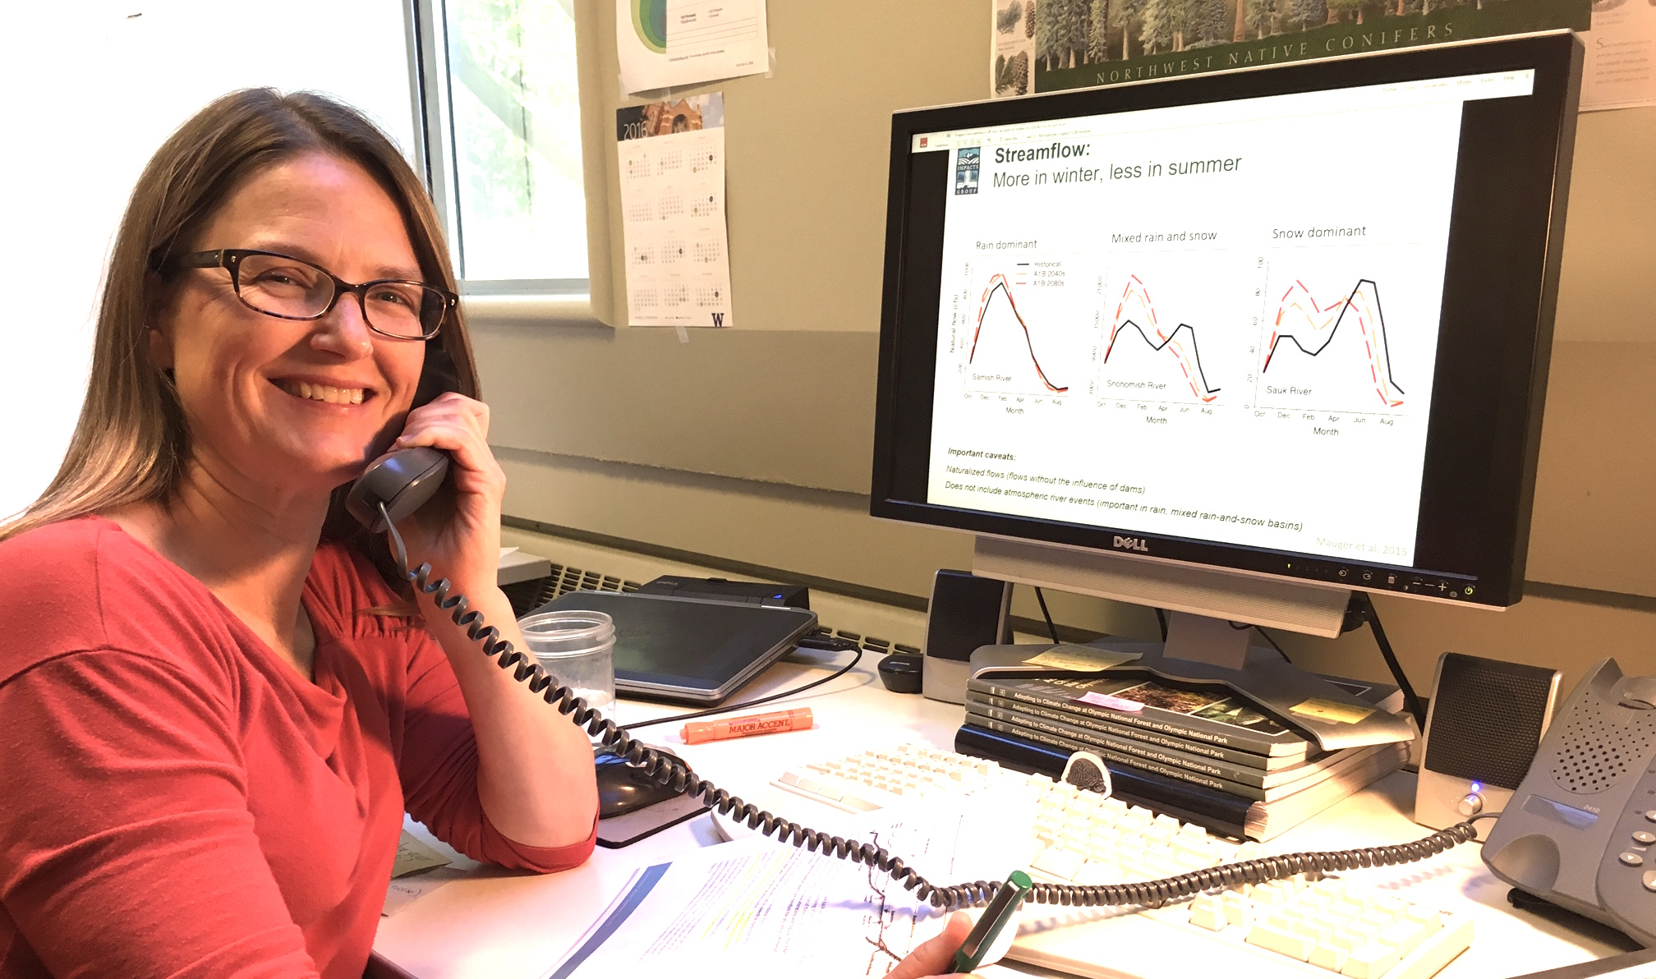
3. Support tribal staff through the vulnerability assessment process
Staff a Tribal Climate Technical Support Desk
Notes:
Tribal Climate Technical Support Desk to provide rapid responses to questions regarding project products and the vulnerability assessment process more generally;
A report summarizing the issues, questions, and other needs addressed by the support desk, and evaluating “lessons learned” and other insights relevant to supporting tribal adaptation needs.

Slide 9
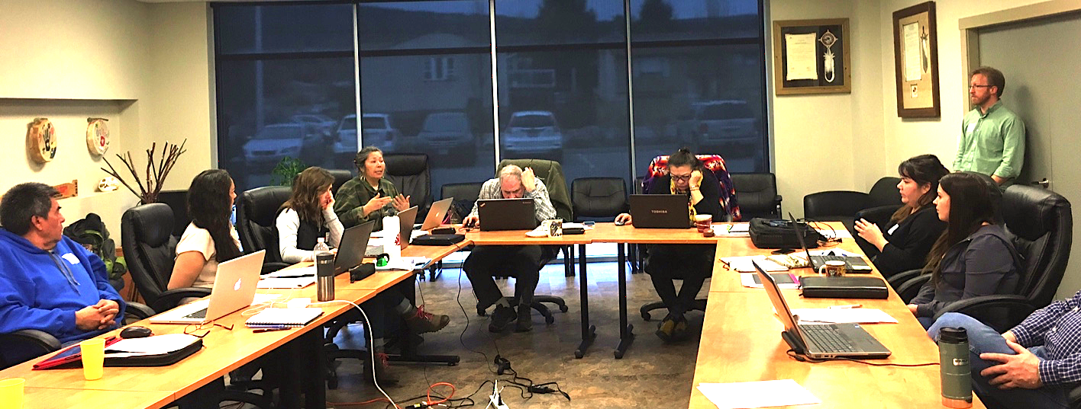
3. Support tribal staff through the vulnerability assessment process
Hold workshops to introduce tribal staff to project resources and datasets, train staff on their use, and provide hands-on guidance around vulnerability assessment.

Slide 10
Project Timeline
Year 1 (Fall ’16- Fall ‘17)
Engage with tribes to determine geographies and variables for climate analysis
Launch the Tribal Climate Technical Support Desk
Work to build synergies among existing and upcoming efforts to support tribal climate preparedness
Year 2 (Fall ’17-Fall ‘18)
Continue staffing the Tribal Climate Technical Support Desk
Release online resources (climate datasets and guidance materials)
Conduct workshops and webinars
Notes:
Surveys, cold-calling, workshops at NW Climate Conference and National Adaptation Forum

Slide 11
We welcome your guidance and participation!
Keep an eye out for project launch information through tribal knowledge-sharing networks
Provide feedback, e.g., tribal geographies for climate data, development of online resources
Call us at the Tribal Climate Technical Support Desk(!!) – 206-616-5349 (Lara; lwb123@uw.edu)
Attend workshops and webinars
Notes:
Project info: The Pacific NW Tribal Climate Project, Institute for Tribal Environmental Professionals (ITEP), Affiliated Tribes of Northwest Indians (ATNI), Northwest Climate Science Center, NW CSC, and the North Pacific, Great Northern, and Great Basin LCCs

Slide 12
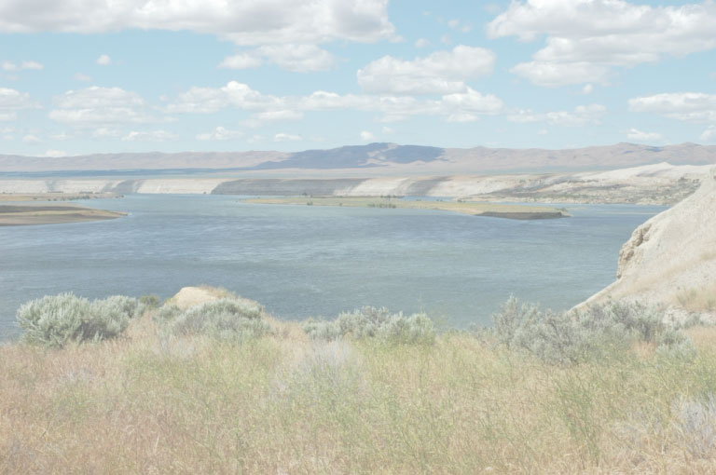
Thank you!
Questions?
Meade: mkrosby@uw.edu
Lara: lwb123@uw.edu

