Slide 1
Climate change and wildfire
Dr. Crystal A. Kolden
Assistant Professor
Forest, Rangeland, and Fire Sciences
October 25, 2016

Slide 2
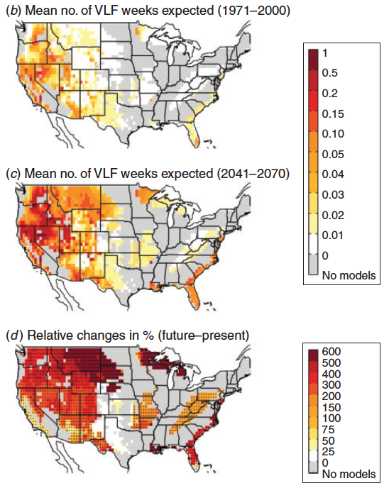
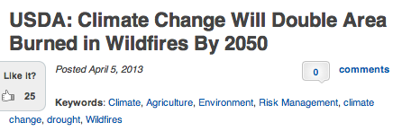
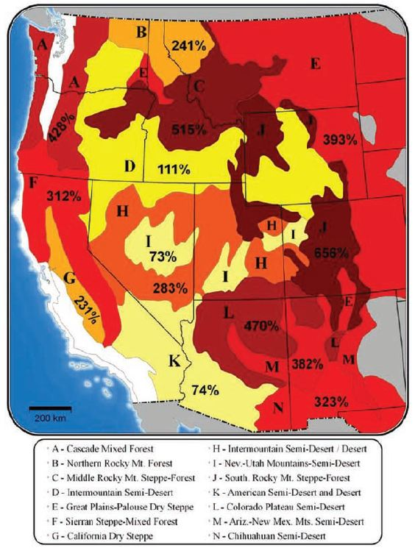
What is the fire forecast?
More fire, more severe fire, bigger fires

Slide 3
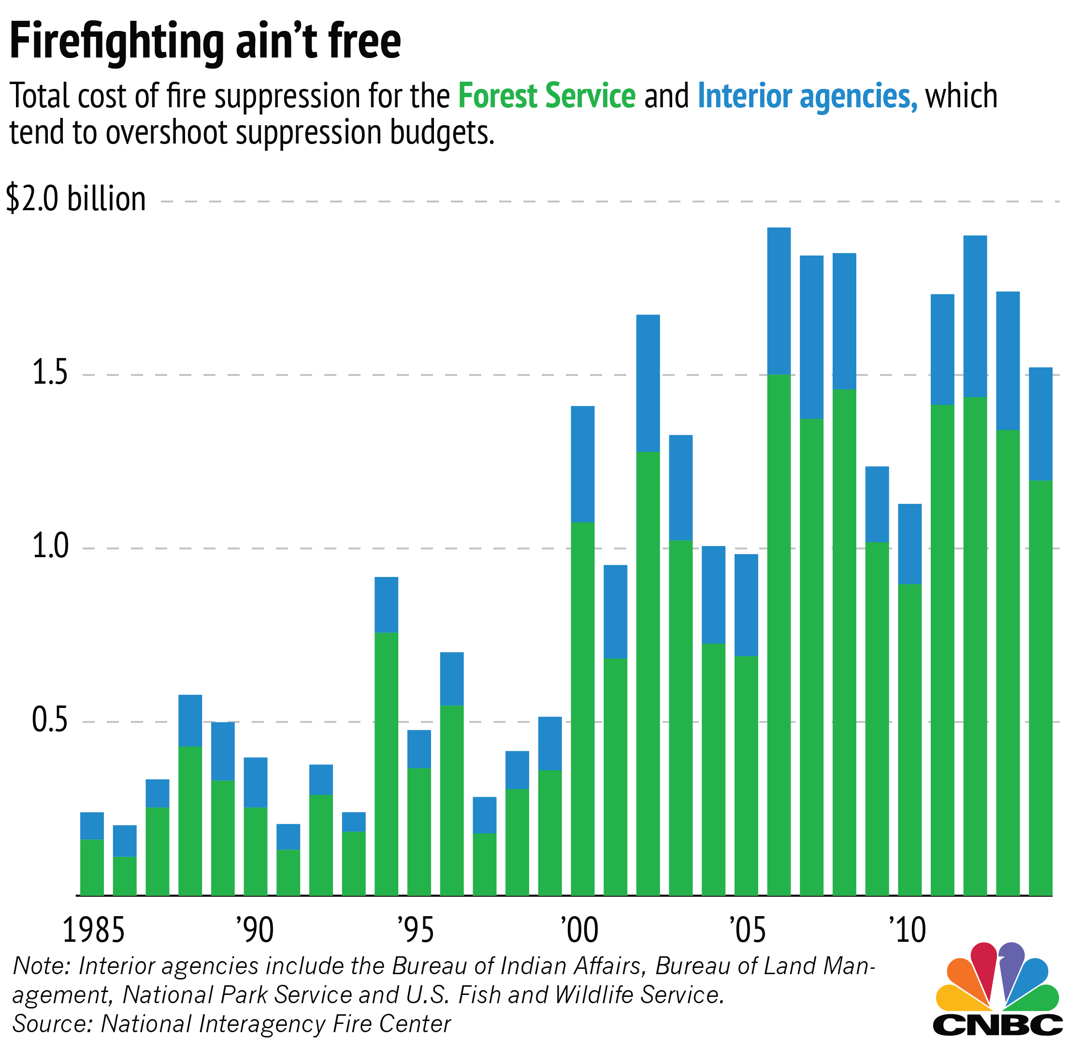
What does that mean?
There is no simple, all-in-one solution
History says we can’t suppress that much fire
Trying to suppress all fire will likely be a very expensive failure
But there will be many negative impacts of more fire: What do we do?

Slide 4
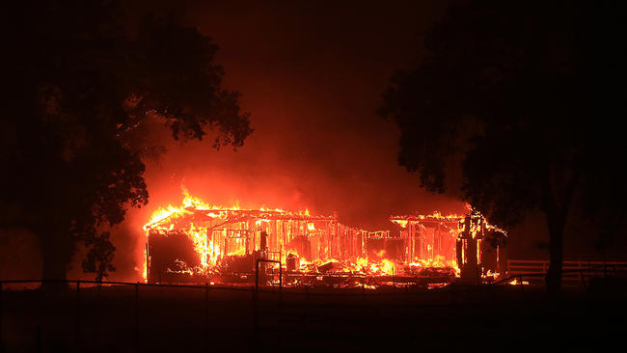
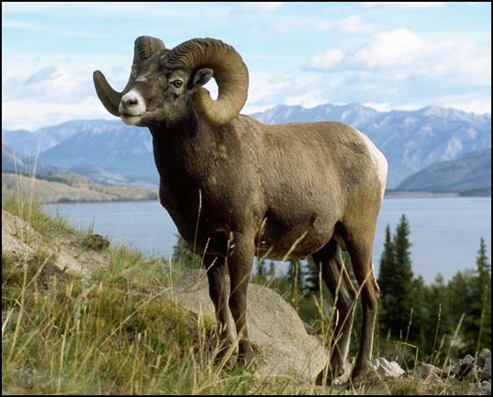
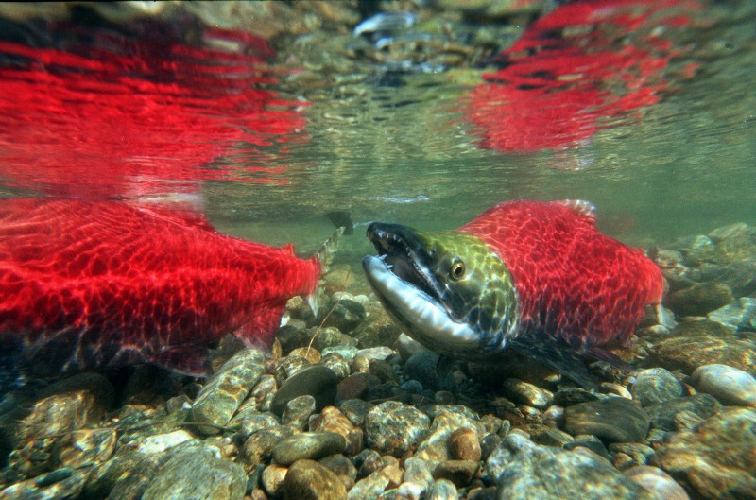
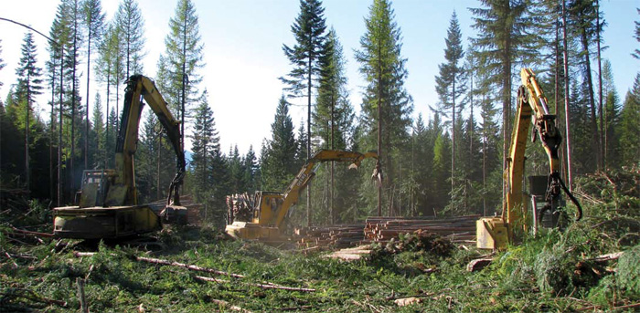
What questions should we ask?
What do we need to know to identify solutions for our lands and people?
What are the most important resources to protect?

Slide 5
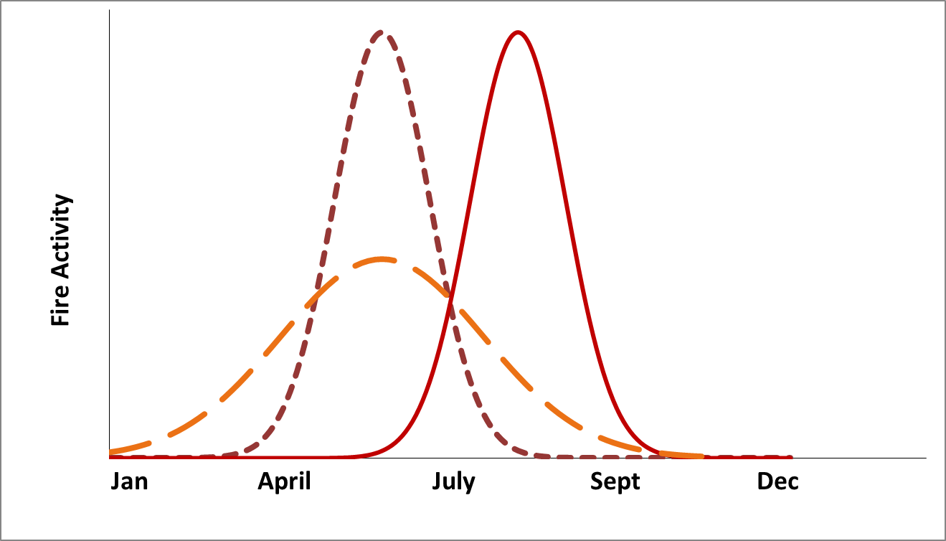
What questions should we ask?
What do we need to know to identify solutions for our lands and people?
What are the most important resources to protect?
When will the “more fire” occur? What time of year?
Historic
Potential Future #1
Potential Future #2

Slide 6
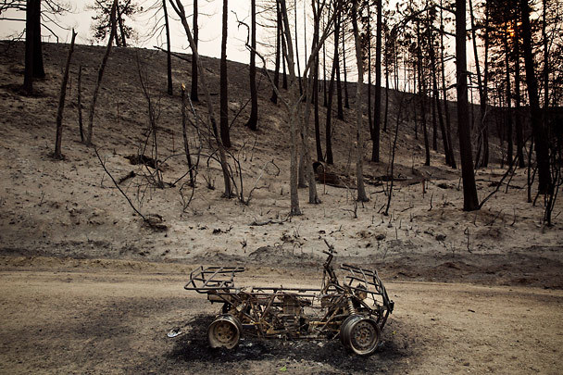
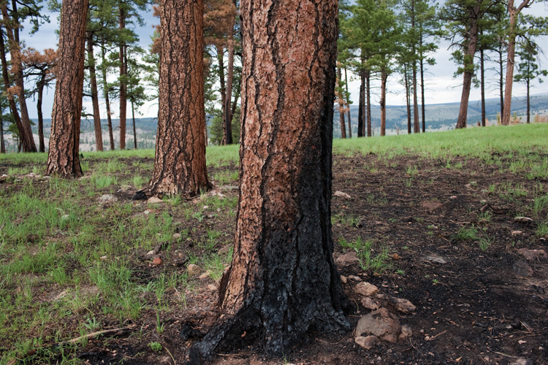
What questions should we ask?
What do we need to know to identify solutions for our lands and people?
What are the most important resources to protect?
When will the “more fire” occur? What time of year?
How severe will that fire be?

Slide 7
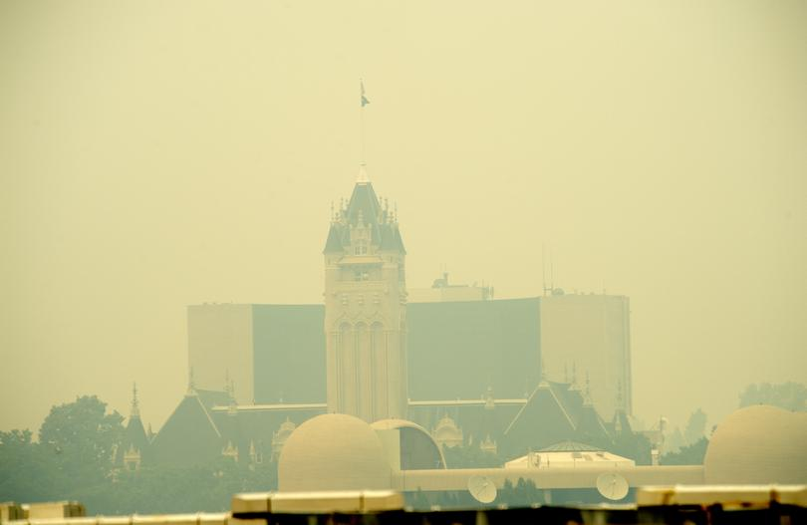
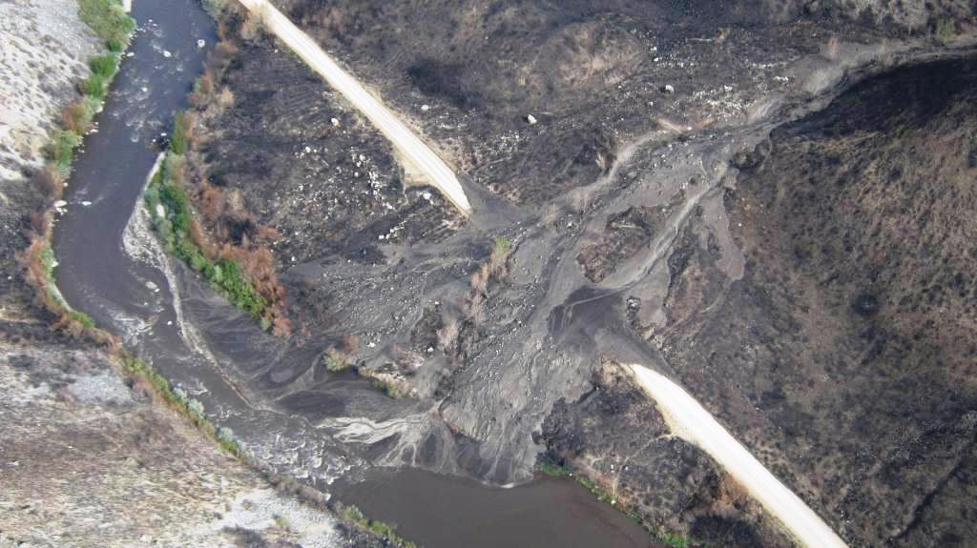
What questions should we ask?
What do we need to know to identify solutions for our lands and people?
What are the most important resources to protect?
When will the “more fire” occur? What time of year?
How severe will that fire be?
What are the highest likelihood negative impacts?

Slide 8
What questions should we ask?
What do we need to know to identify solutions for our lands and people?
What are the most important resources to protect?
When will the “more fire” occur? What time of year?
How severe will that fire be?
What are the highest likelihood negative impacts?
What actions can we take to reduce those impacts?

Slide 9
When you can’t save everything (YET)
Specific actions tied to specific prioritized resources
Potential loss
Timber
Spawning habitat
Clean water
Air quality/health
Homes
Infrastructure
Potential to rebuild
Homes
Infrastructure
Health
Clean water
Spawning habitat
Timber
Potential to mitigate?
Where is potential loss high and rebuilding potential low?
What actions help save multiple resources?
High
Low

Slide 10
Prioritizing activities
What actions mitigate fire effects?
Fuel treatments/forest thinning: not just around homes
Homes: defensible space and fire-resistant materials
Prescribed fire: when do you want your smoke?
Wildfire: controlled management during favorable conditions
Suppression actions: reduce burnout, leave unburned islands

Slide 11
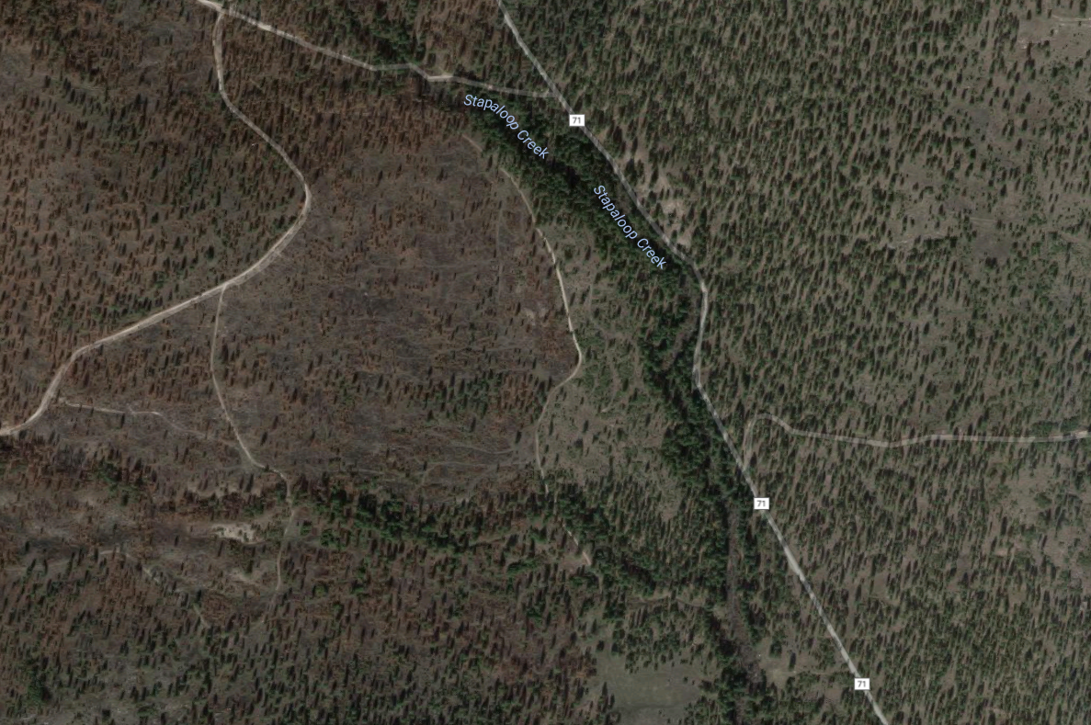
What is an unburned island?
Unburned islands

Slide 12
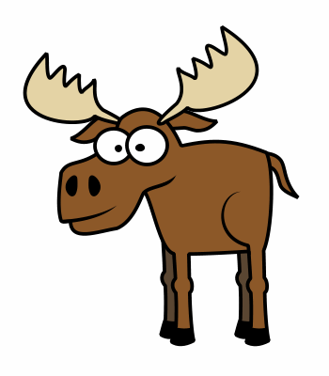
Why are unburned islands important?

Slide 13
Why are unburned islands important?

Slide 14
Why are unburned islands important?

Slide 15
summary
Wildfire activity is projected to increase under climate change due to hotter, drier conditions for longer periods of time
Trying to stop all fire isn’t feasible in this landscape (and very expensive)
Mitigation activities: what resources are most important? Which ones can’t be easily recovered or rebuilt?
Prioritize actions that protect the greatest resources at risk (not necessarily always houses)

Slide 16
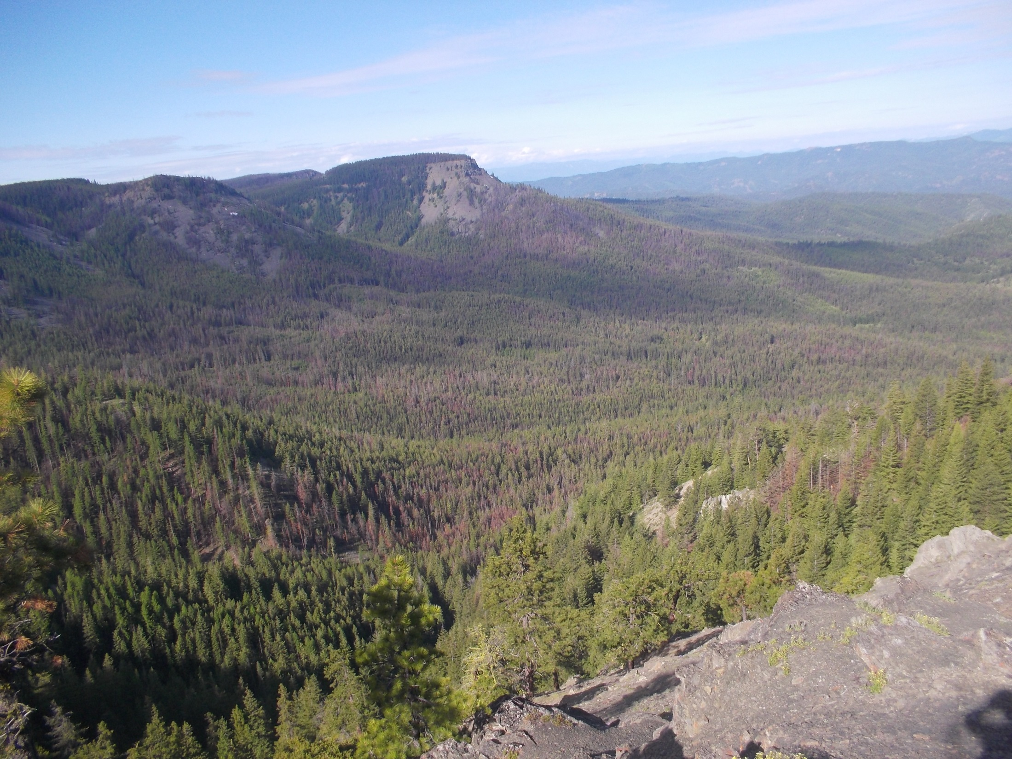
Many thanks for your time
Questions?
ckolden@uidaho.edu

